Slide 1

Finding Mastery
29 Avril 2024
Notes:
That’s so me.

Slide 2

What does mastery look like in our lives?

Slide 3
Share a story of mastery

Slide 4
mastery lessons

Slide 5



Collective teacher efficacy

Slide 6


Slide 7

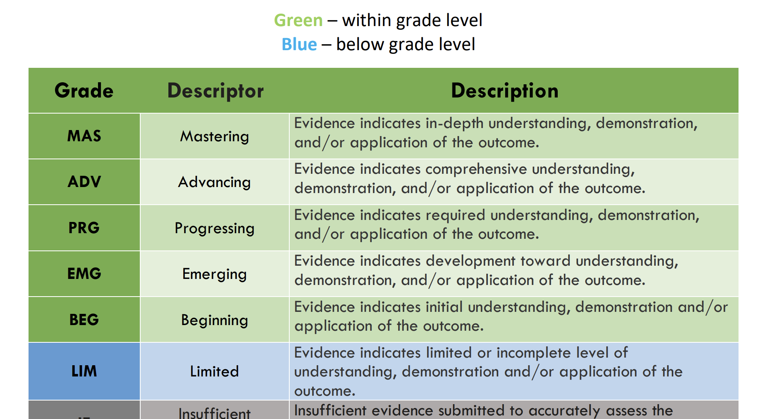

Slide 8
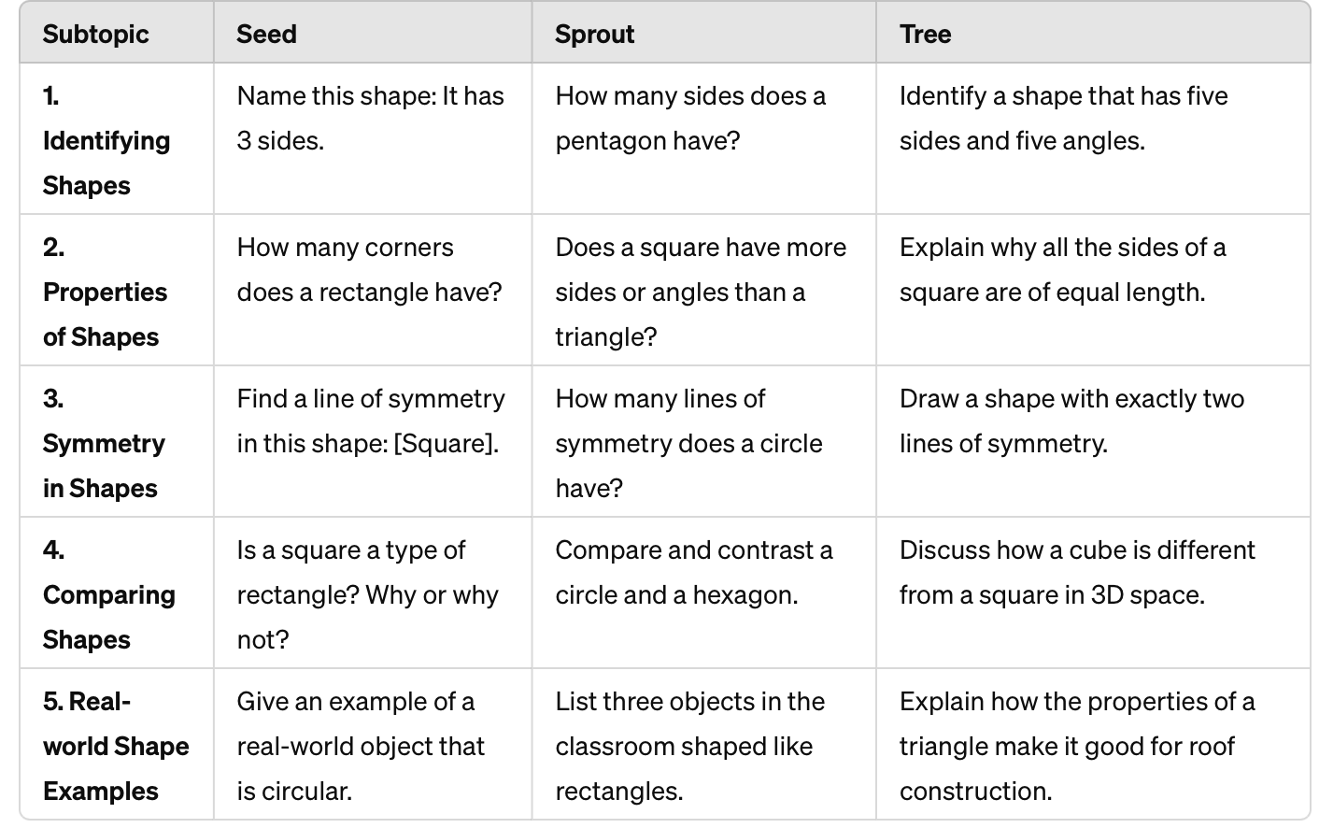

Slide 9
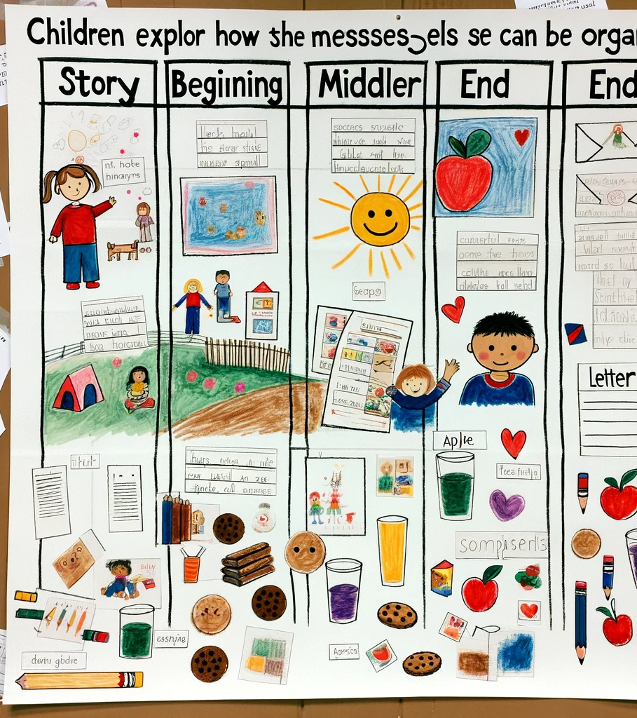
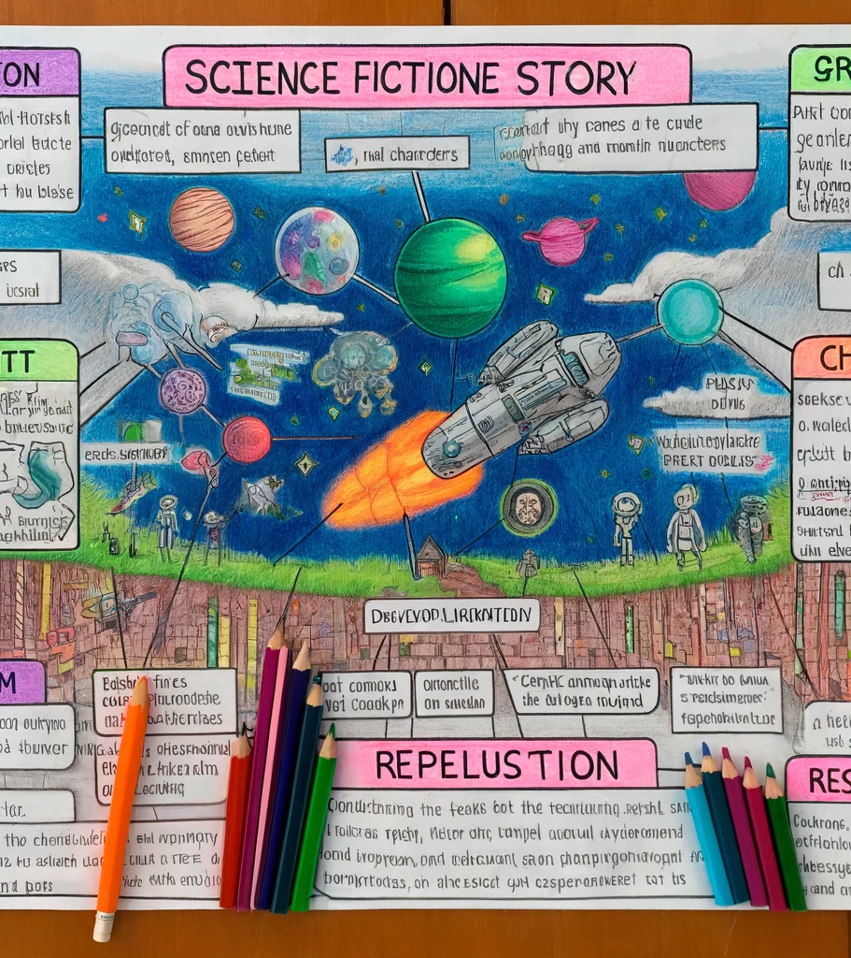

Slide 10

What is mastery?
On this outcome, what does mastery look like at your grade level?

Slide 11
Outcome continuum
Beginning
Progressing
mastery
What does 50% achievement of this outcome look like?
How might a student show they are progressing with this outcome?
What does true mastery of the outcome look like?

Slide 12

How might students show mastery?
What are all the different ways that a student could show they have mastered this outcome?

Slide 13
East Lake Continuum
Vertical Alignment: add one sentence to the continuum (for your grade), describing outcome mastery

Slide 14

Exemplar: Mastery
Create your own exemplar that demonstrates mastery of the outcome.

Slide 15

Exemplar: Mastery
Look at the outcome
continuum
exemplars
Discuss as a grade team
Reference the cross-grade continuum
Add to the existing exemplars with your own example that could demonstrate grade level mastery of the outcome

Slide 16

Team plan
When/How will students add to the
Learning celebration walls?

