Slide 1

UDL for EALL
Joshua LaFleur
Readesign.pro

Slide 2

AdSuMuDi

Slide 3







Slide 4
Why was that UDL?
What could make it more universal & beneficial?
How does it support EAL learners?

Slide 5

Fluency
Routine

Slide 6
Reading
Games
Learning
Fluency
Practicing

Slide 7
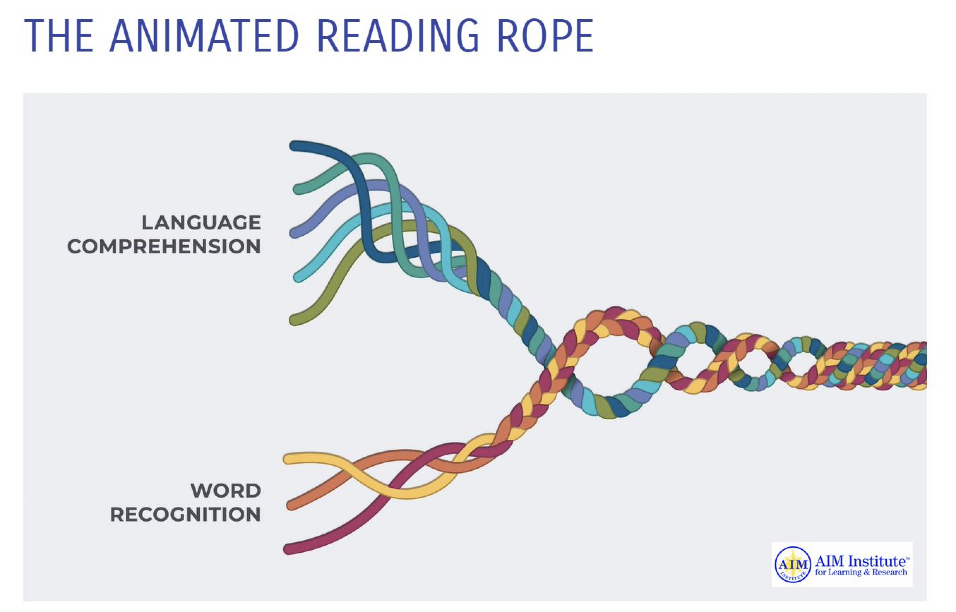

Slide 8

Teacher notices (phonics/vocabulary)
Teacher reads aloud
Choral reading (Teacher voice loudest)
Whisper reading time (connect with students)
Fun reading

Slide 9
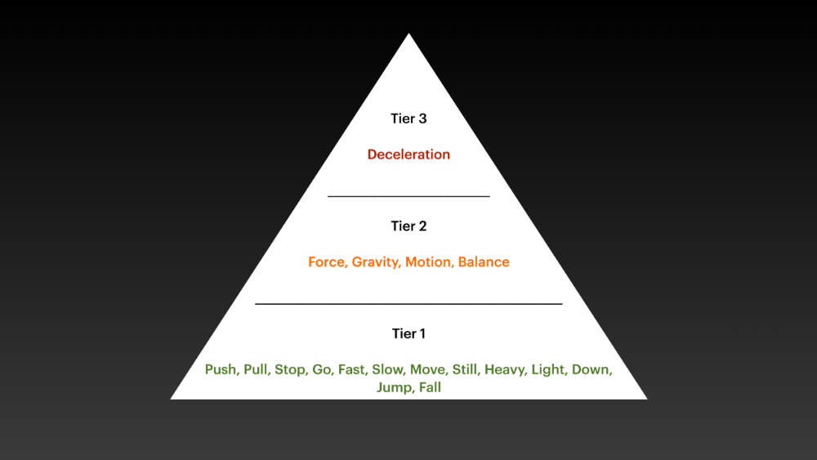

Slide 10
Sure, here's a catchy chorus in the style of Taylor Swift that's designed to help grade four students learn about gravity, using simple vocabulary and including a few words with a long O sound:
(Chorus)
Oh, gravity, you keep me on the ground,
Without you, I'd be floating around.
You pull me close when I jump high,
Gravity, oh gravity, you're why I don't fly.
With every apple that falls from a tree,
It's your force that brings it close to me.
Gravity, oh gravity, so strong and bold,
Holding us all, young and old.

Slide 11
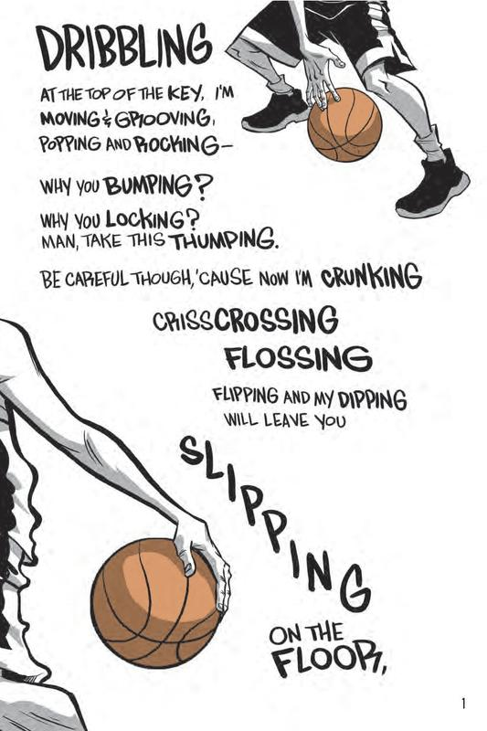

Slide 12






Voice Note
Film Your Thoughts
Share Ideas
Ask Me Questions
Sketch-Note It
Journal

Slide 13



Thank you
ReaDesign.pro

