Slide 1
Playful Design
Using the science of Learning

Slide 2
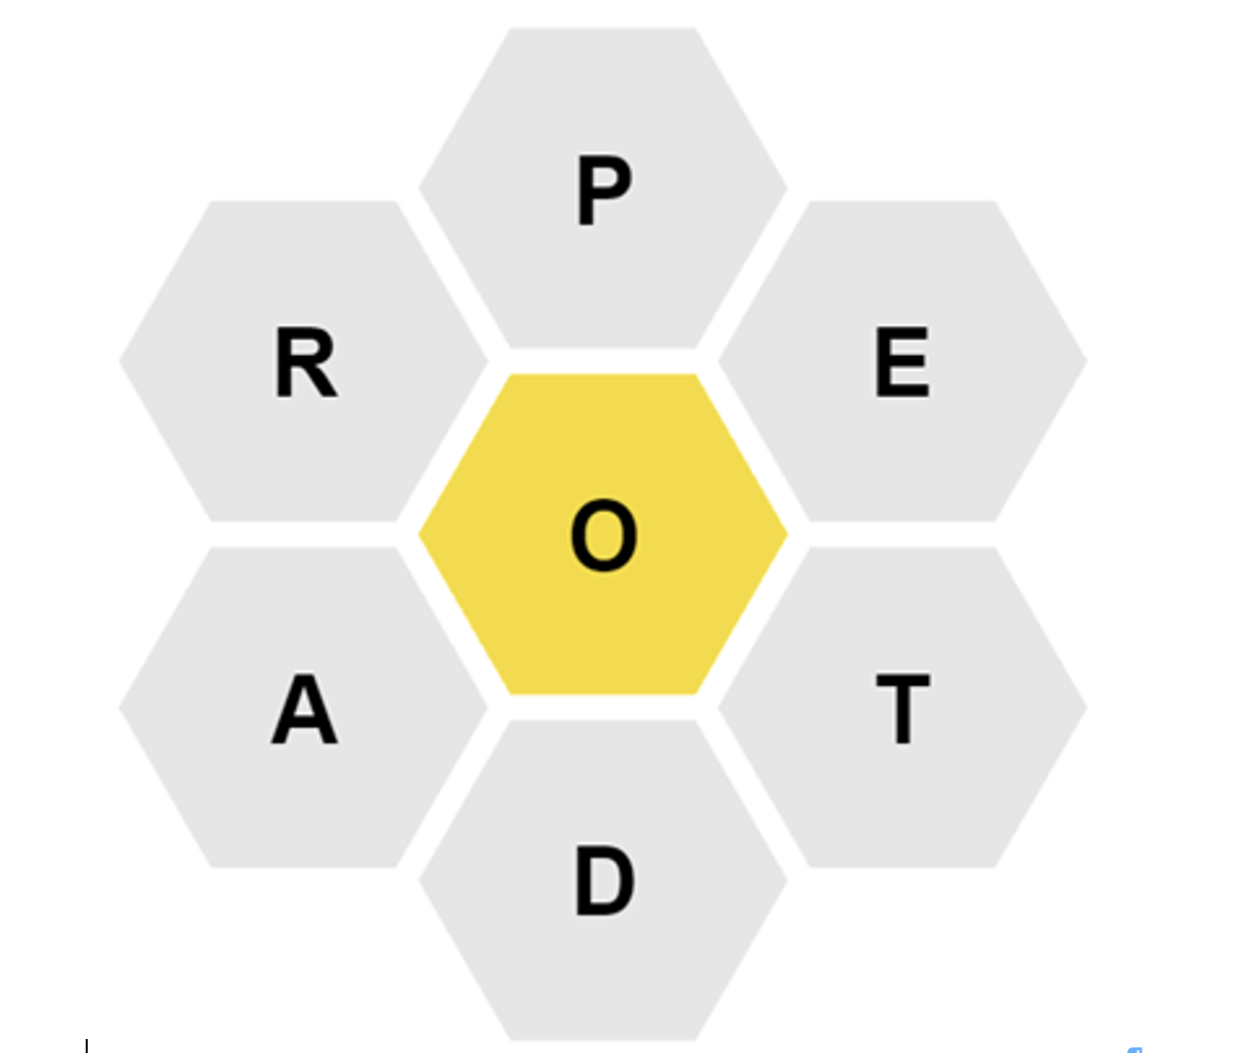

Slide 3
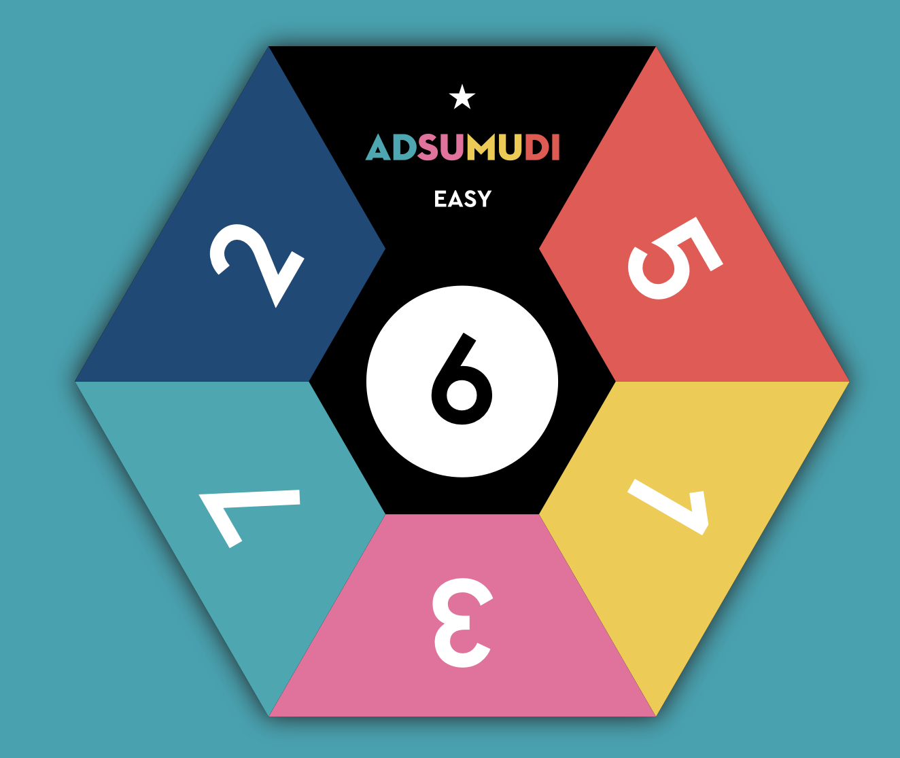

Slide 4
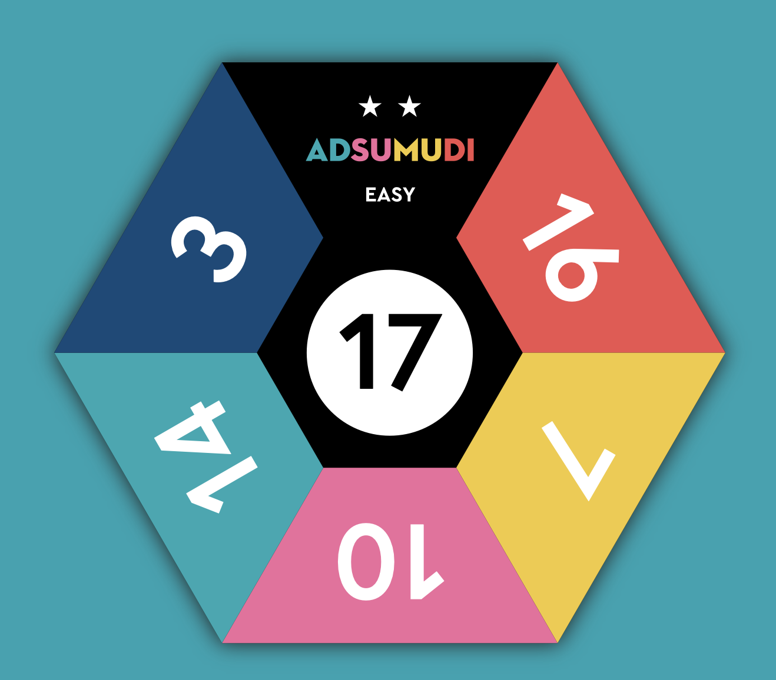
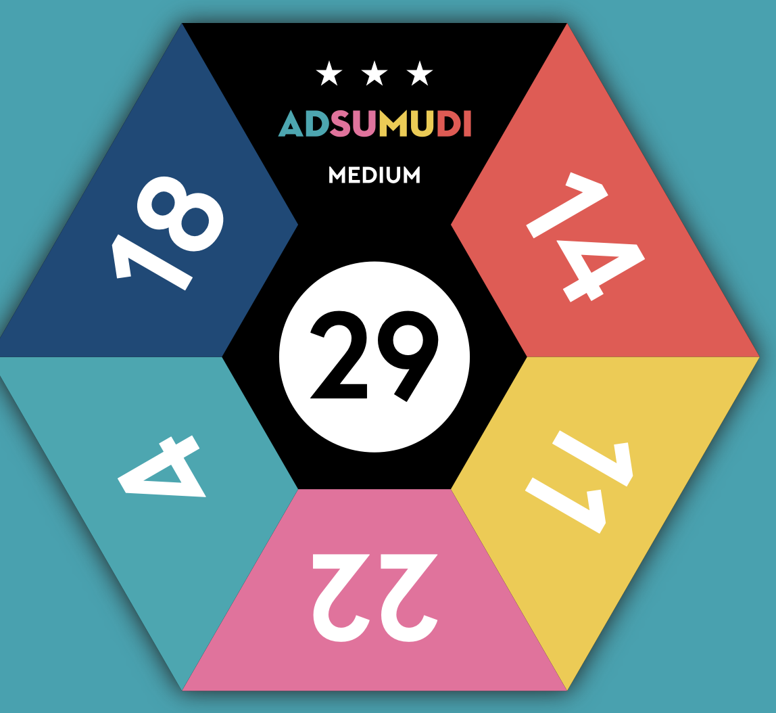

Slide 5
Negative
Interactions
Positive
interactions
Trade
Control
Competition
Colonization
Barter
Exploitation
Interaction
Exchange

Slide 6

First Letter
Last Letter
# Syllables
Part of Speech
Synonym
Antonym
Definition
Example / Comparison

Slide 7
Collaborative Notetaking:
Games
Small Groups
Retrieval

Slide 8

Thank you!

