Slide 1
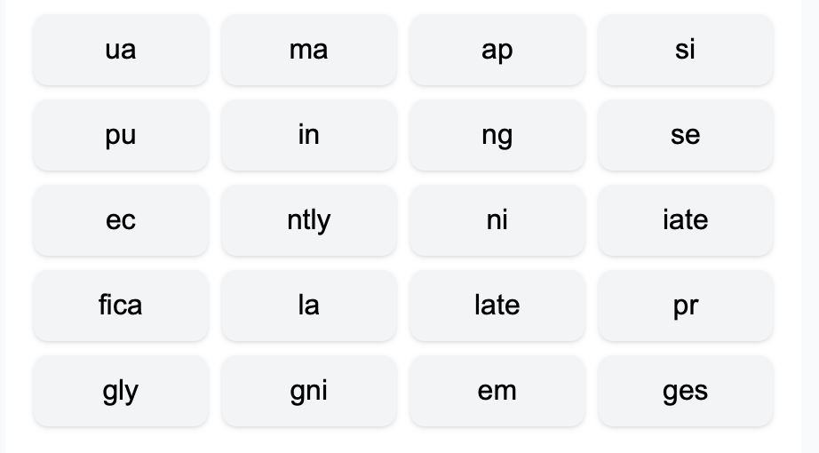
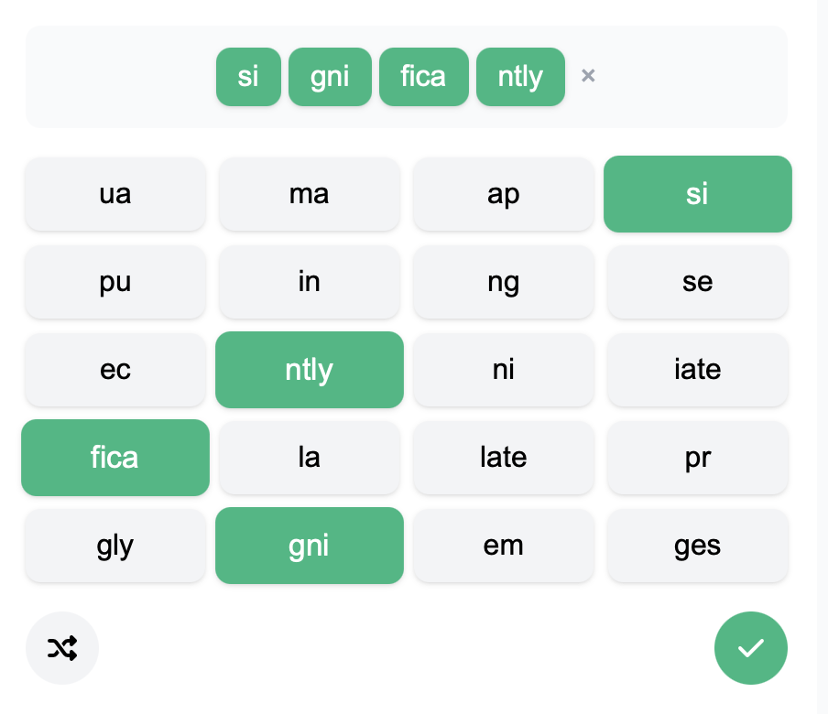
Morphology and Writing
BTC Style

Slide 2
Morphology
Sentence Writing
Short Story Writing

Slide 3
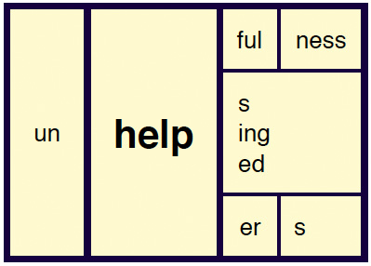
Reference: https://www.shanahanonliteracy.com/blog/what-should-morphology-instruction-look-like

Slide 4
SPECT

Slide 5
DUC
(Duct/Duce)

Slide 6
DUC

Slide 7
Duke
Communicate
Evict
Celebration
Reduces
Produce
Eliminate
Conduction
E
(OUT OF)
DUC
(TO LEAD)
ATE
(VERB)
ION
(NOUN)
Reference: Serravallo, J. (2024). Teaching Reading Across The Day, Grades k-8. Corwin.

Slide 8



Please download and install the Slido app on all computers you use
How does morphology help unlock meaning?
ⓘ Start presenting to display the poll results on this slide.

Slide 9

See
Hear
Feel
Do

Slide 11

See
Hear
Feel
Do

Slide 12
Dear Landry,
I had the most amazing experience walking in the forest today.

Slide 13
Mild:
The Fox: Postcard from the forest
Medium:
A postcard about your convention
Spicy:
Postcard to make someone smile

Slide 14

Somebody
Wanted
But
So
Then

Slide 15

Somebody
Wanted
But
So
Then

Slide 16
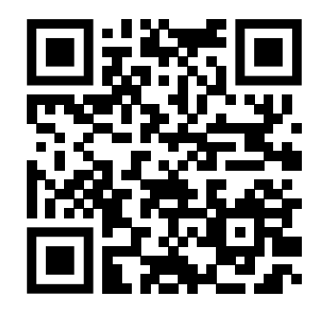
Thank you!
Slides found here and at readesign.pro

