Slide 1
Can your group find a reason
That each word is different from the other 3?
Hopping
Racing
Cried
Looked
Welcome
Word Study in Action

Slide 2
Word Study + BTC
Vocabulary work in science/social

Slide 3
Harder to spell correctly
Easy to spell correctly
Infrequently used
Everyday use

Slide 4
Harder to spell correctly
Committing
Cancelled
Worshipping
Planning
Travelling
Benefitted
Dragged
Occurring
Enrolled
Easy to spell correctly
Everyday use
Infrequently used

Slide 5
1
2
3
Planning
Travelling
Racing
Easy to spell correctly
Harder to spell correctly
Racing
Planning
Travelling
3
1
2

Slide 6
What is the rule?
When is a consonant doubled?
Example
Words
Exceptions
To the rule
Trick to remember the rule

Slide 7
When the base word ends in a ‘silent e’
Drop the ‘e’ to add ‘ing’.
Caring
Coming
Skating
Two vowels go walking, the first does the talking,
and when a new vowel comes to play the e can run away.
Traceable
Courageous

Slide 8
What is the rule?
When is a consonant doubled?
Example
Words
Exceptions
To the rule
Trick to remember the rule

Slide 9
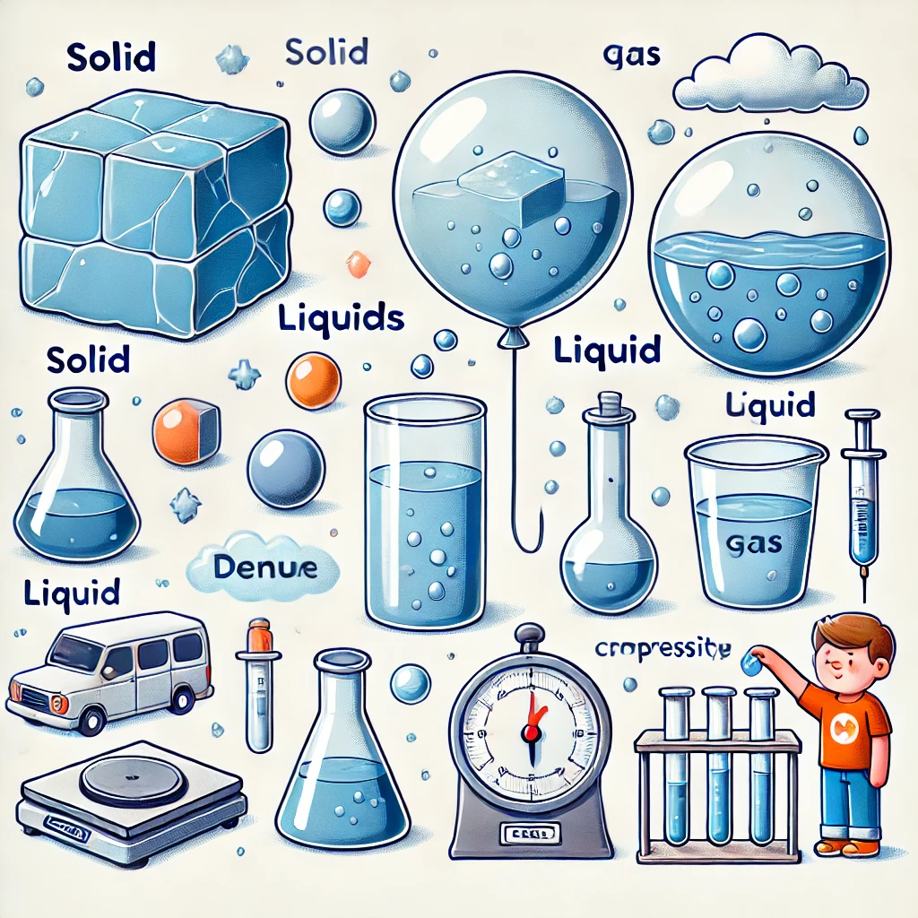

Slide 10
Abstract
description
Solid
Liquid
Gas
Mass
Volume
Density
Float
Particle
Compressibility
Concrete description
Everyday use
Science specific use

Slide 11
How is it measured
Or observed?
Connection
To another subject
Labelled
Diagram
Common uses

Slide 12

Merchant ships – social studies
U-boats – Social studies
Swimming – PE
Ice cream floats – cooking class
Placing the object on water.
Float
Helium
Ice cubes
Bath toys

Slide 13
How is it measured
Or observed?
Connection
To another subject
Density
Labelled
Diagram
Common uses

Slide 14
The Great Balloon Mystery at the Zoo! 🎈
It was a bright, sunny day at the city zoo, and Mia couldn’t wait to explore. But before she even saw the elephants or the tigers, something floating above the gift shop caught her eye—balloons!
She rushed over and picked a bright red one. The balloon was filled with gas, which made it rise high into the air. "Why does it do that?" Mia asked the vendor.
"Great question!" the vendor smiled. "It’s all about density. The helium inside your balloon is less dense than the air around it, so it floats. But if you filled a balloon with water, it would be too dense and would sink instead!"
Mia held the balloon string tightly and looked around. A boy next to her had a cold solid ice cream cone, slowly melting into a liquid. "Ice cream changes state?" she asked.
"That’s right!" said the vendor. "When it's frozen, it's a solid, but as it warms up, it turns into a liquid. And if we heated it enough, it could even turn into a gas—but I don’t think you'd want to drink evaporated ice cream!"
Mia giggled and took a sip of her lemonade. She knew it had mass and volume, just like her balloon, but the lemonade took the shape of her cup because it was a liquid.
Suddenly, a little girl let go of her balloon, and it compressed slightly as it soared into the sky. "Whoa! Why did it do that?" Mia asked.
"That’s compressibility in action!" the vendor explained. "Gases can be squeezed into a smaller space. That’s why balloons shrink when you squeeze them but pop if you press too hard!"
Mia stared at her balloon, now understanding the particles inside were moving all around, keeping it inflated.
With her new knowledge of solids, liquids, and gases, she smiled and ran off to see the giraffes—holding her balloon tightly, of course!

Slide 15
Main Idea
Quote
Article Analysis
Picture with a caption
Definition

Slide 16

Thank you!
Slides found here and at readesign.pro

