Slide 1

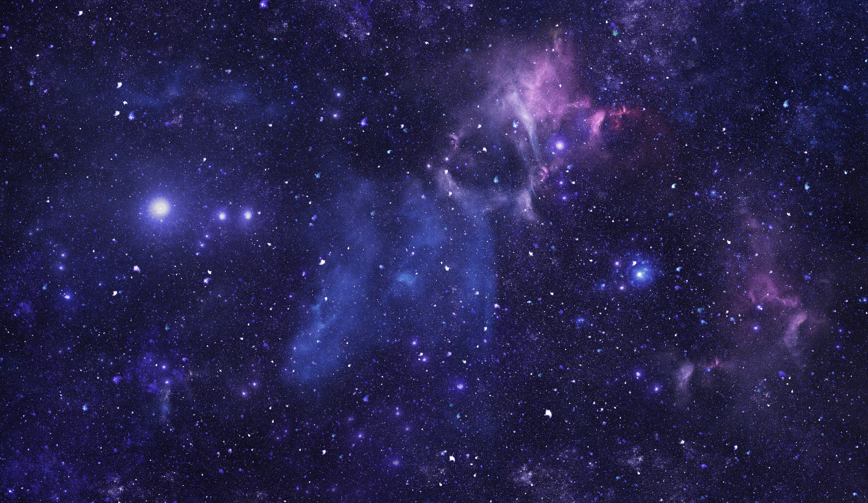

READESIGN.PRO
GRADE SIX
SPACE
PRE-TEACHING VOCABULARY

Slide 2


SEQUENCE
01
02
03
04
Semantic Gradient
Hexagonal Thinking
PWIM
Connections
05
06
07
08
Hot Seat
Frayer Models
Article Analysis
Project

Slide 3

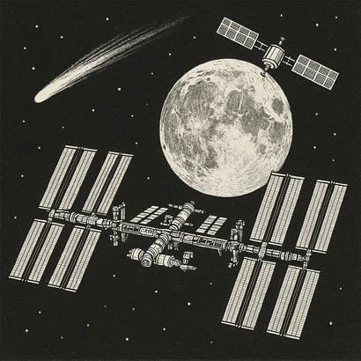
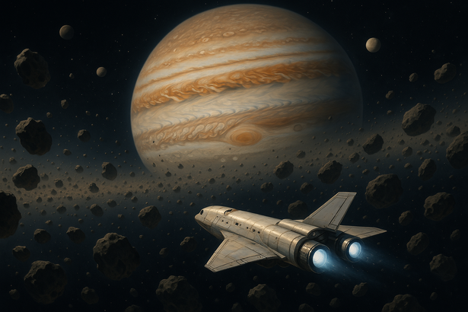

PWIM
Picture word induction model
Pulling words from the picture allows students to familiarize themselves with the vocabulary before reading/writing or even hearing about it. It helps with decoding and comprehension and allows them to start making personal connections to these tier three words.
  Whole Class
  TPS
  BTC
Finding vocabulary
Think Pair Share
Random Groups
Project the image. Label nouns in black, adjectives in red, verbs in green and synonyms under the drawing.
Get students to act out the key words (eg. holding up an imaginary telescope).
Groups title the image and label the vocabulary, then come up with actions for the vocabulary to share with the class.
Bonus: come up with a class dance that includes all the key words.
Get partners to come up with a title, and then think of all the vocabulary they see in the image. Scribe what partners came up with for the class.

Slide 4

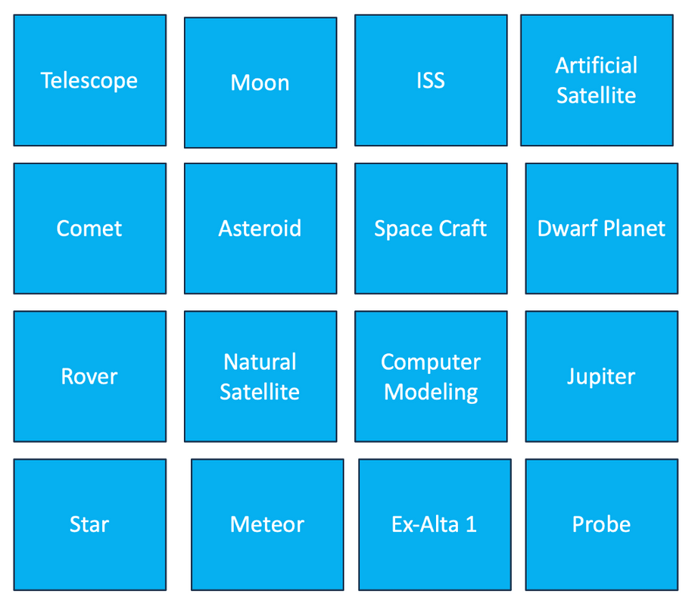
CONNECTIONS
In random groups at whiteboards, students will put these 16 words into four groups of four words.
Extensions:
  Give a title to each group
  Add a fifth word to each group
  Create their own fifth group of words

Slide 5
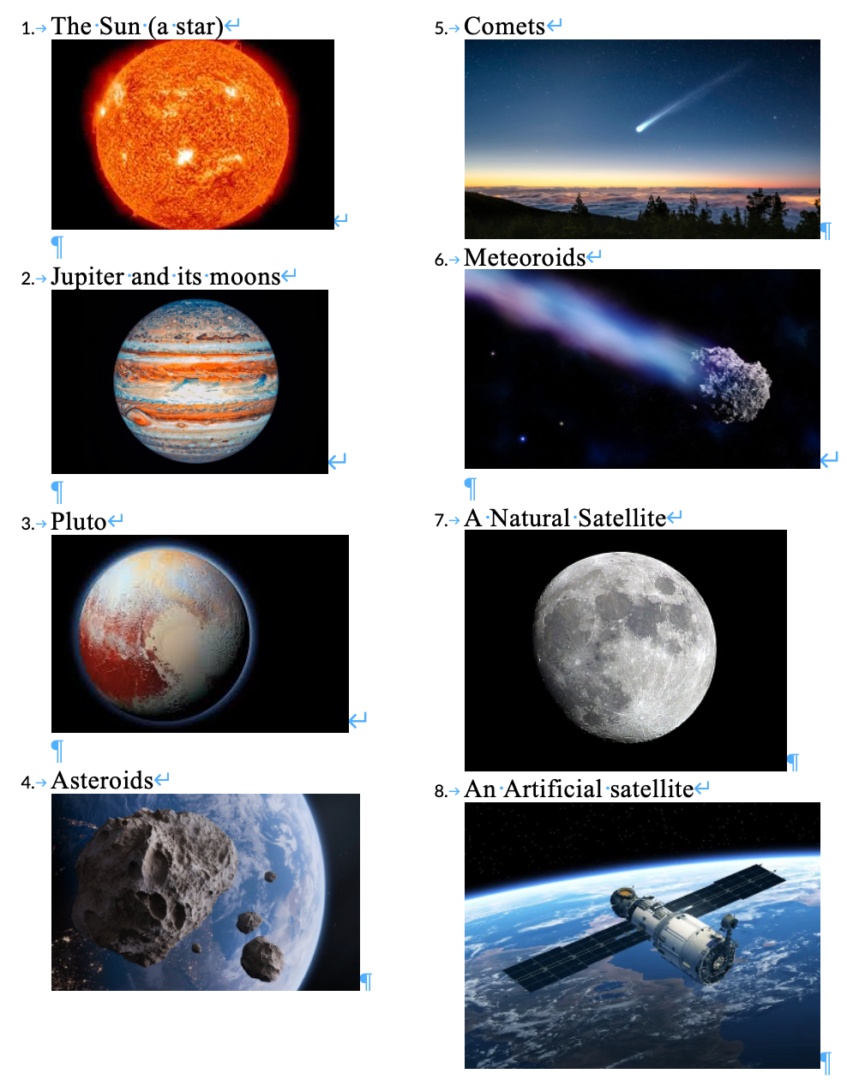

SEMANTIC GRADIENT
01
02
Top to Bottom
Left to Right
Random groups organize the words from Biggest to Smallest.
Keeping their Y axis (top to bottom) position, students re-write the words to correspond to the new X axis: distance to earth (closest to farthest).
03
04
05
Missing Vocabulary
Quantify
Coordinates
Groups add numerical values to each axis. (Is big to small a 0-10, or 0-10000000?)
A final extension for some groups will be to give each word a coordinate on the cartesian plane.
Students add words in the empty spaces on their white boards

Slide 6
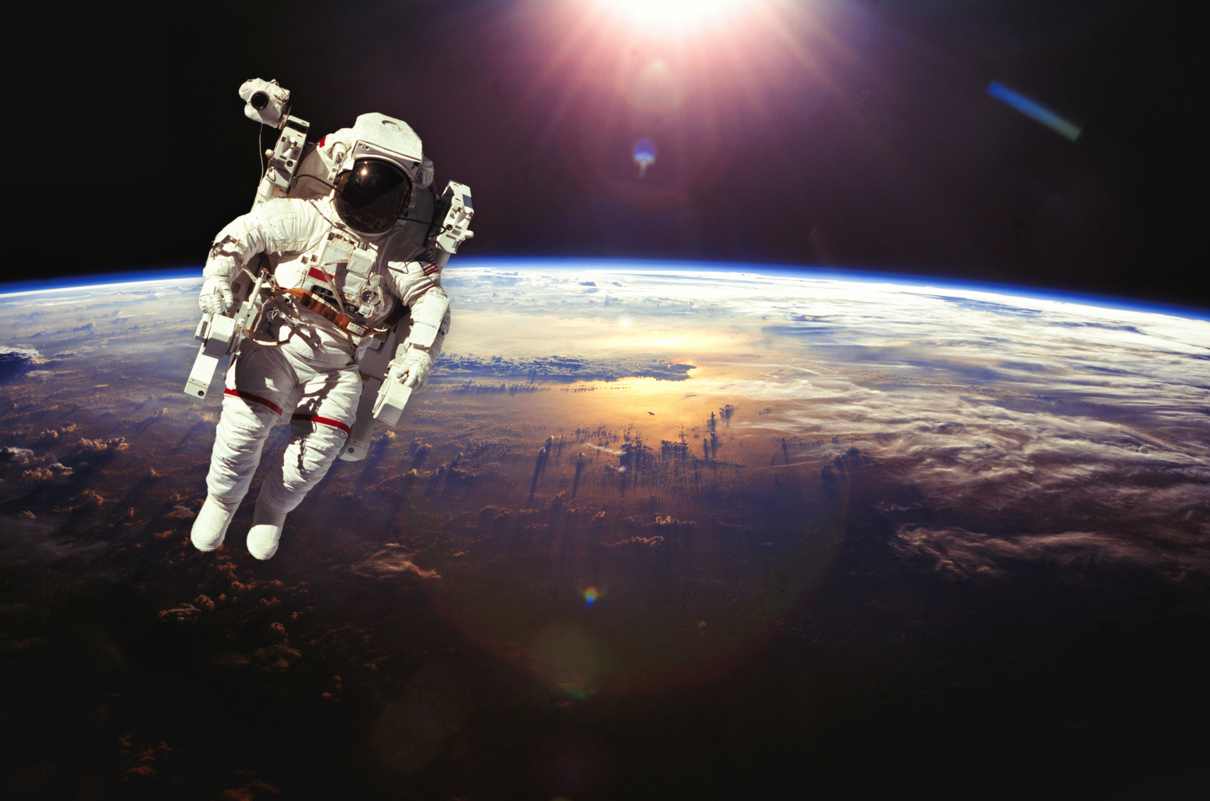
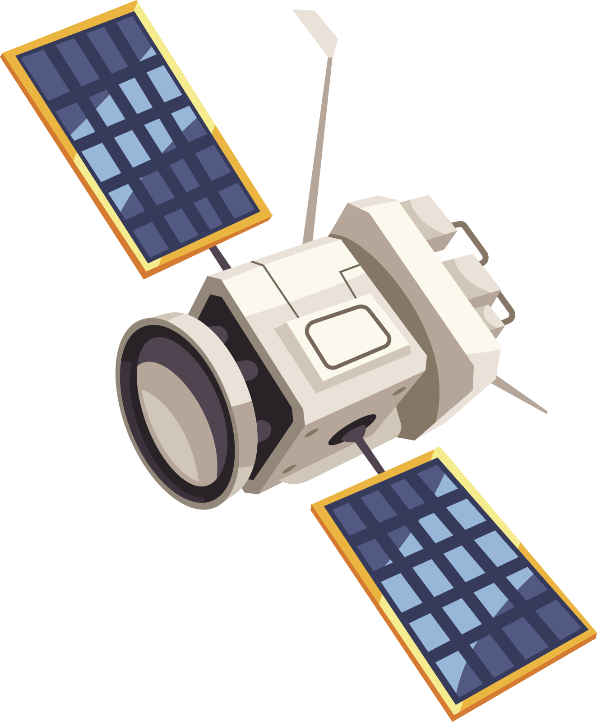


HEXAGONAL THINKING
Groups organize the vocabulary.
Each word is placed in a hexagon. Groups need to decide how the hexagons will be arraged.
Will they make a straight line, perhaps representing a timeline of technological development? Or will they look more like a constellation representing a series of unique connections?
Once arranged, students will individually create their preferred arrangement and then give a subtitle for each connection between two hexagons.

Slide 7
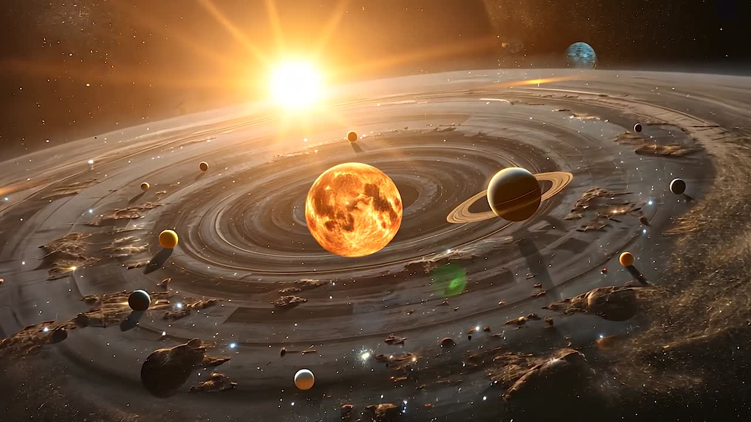


HOT SEAT
One Student in the hot seat
A student faces the class
A vocabulary word is written behind them.
The class gives them clues to help them guess the word.
Two students in the hot seat
Two students face the class
They take turns asking for hints from the class

Slide 8


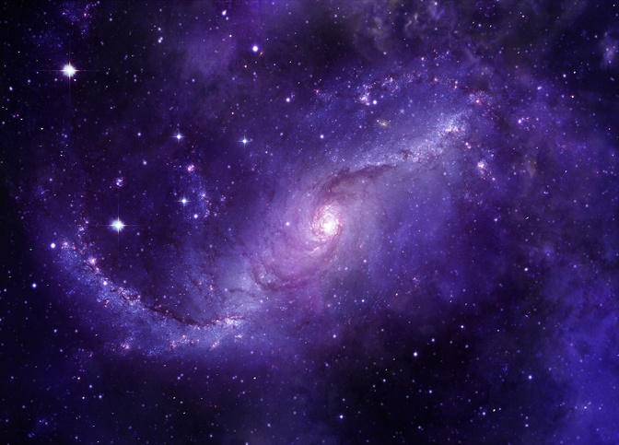
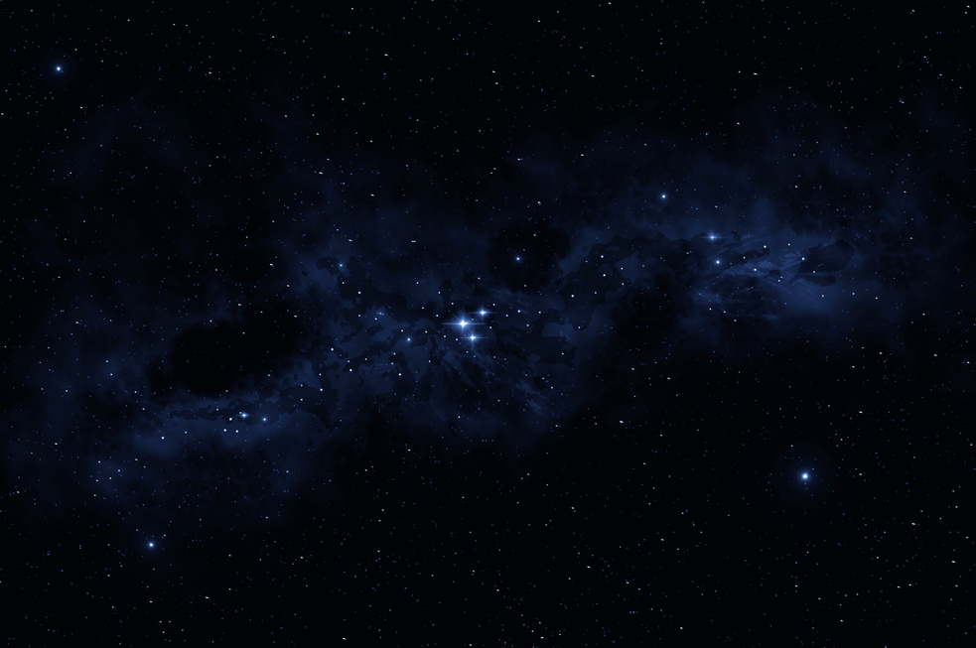
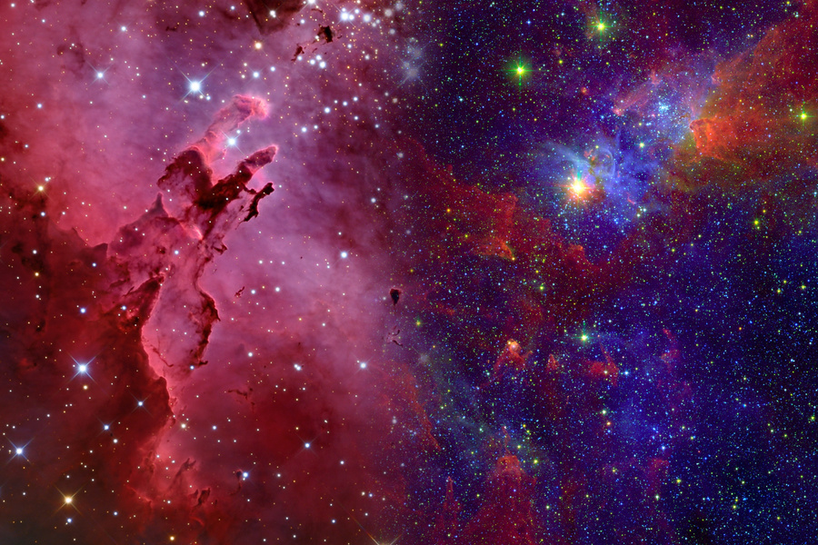
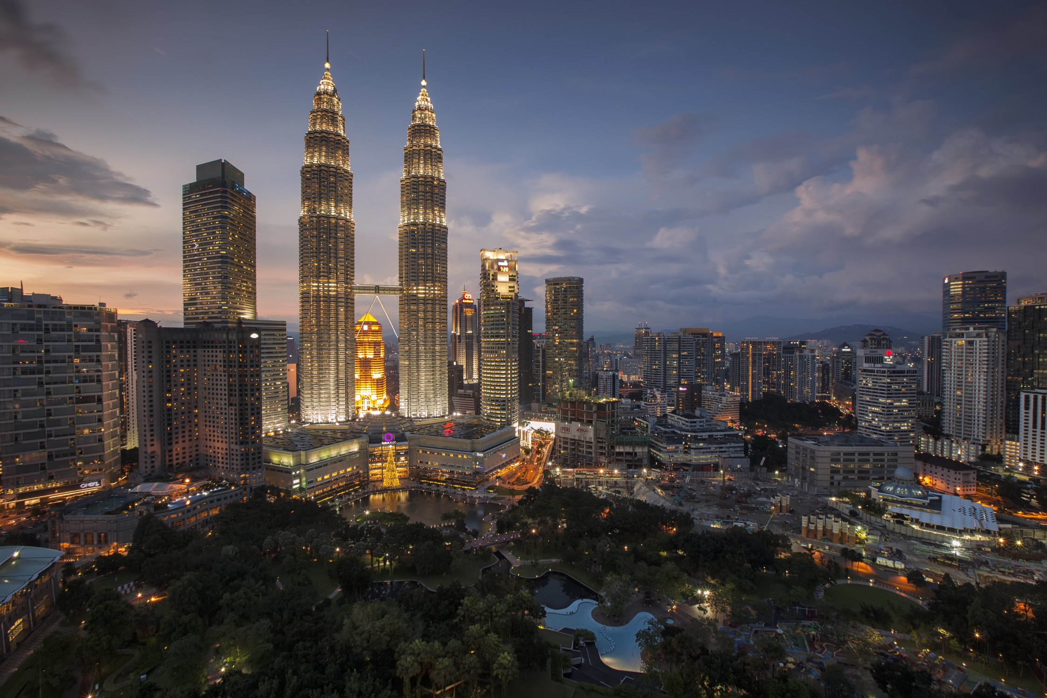
FRAYER MODEL
Whole Class
Together
Model creating a Frayer Model of a vocab word. Creating a drawing, definition, personal connection and example on a white board.
Step 2, give the class a moment to Think Pair Share, then decide on a definition, examples, personal connections and a definition for a new word.
Random Groups
Individual
In groups students make their frayer models of a new word. Divide the words so that as a class all the key words are being completed.
Students create their own 4-part frayer model. On one sheet of paper they do a frayer model for four different words, one in each corner, and write a title connecting the four in the middle.

Slide 9
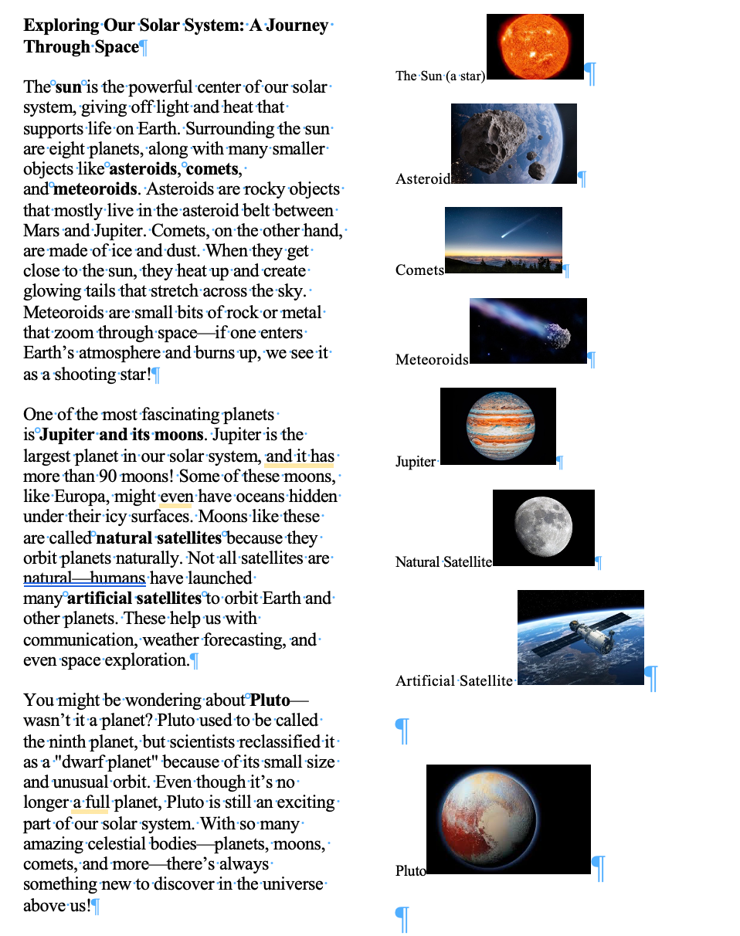
ARTICLE ANALYSIS
01
02
Co reading
Key ideas
Groups read the article together.
For each paragraph, they decide on the What/Who the paragraph is about, and highlight the word.
03
04
05
Supporting evidence
Annotation
Notes
Groups write a summary sentence about each paragraph using their highlighted and underlined words.
Groups come up with an image for the article, the main idea, definition of one of the words in bold and a question.
Groups underline the words in each paragraph that explain the key idea.

Slide 10

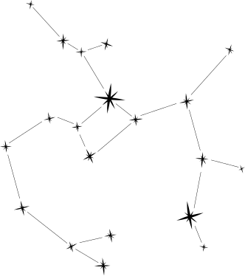

REASEARCH PROJECT
Students create a website to showcase their learning. They will have a page for each skill and key understanding of the unit.
Students post videos or podcasts of themselves discussing the technological and environmental barriers to living in space.
Students post a magazine article with pictures about their research on celestial bodies.
Students post an infographic comparing natural and artificial satellites.
Living in Space
Satellites
Celestial bodies

