Slide 1

Playful literacy
March 24, 2025

Slide 2



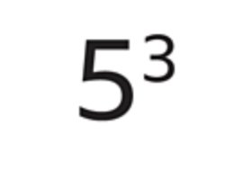
Which one doesn’t belong?
Addition
Multiplication
Soustraction
Exposants

Slide 3
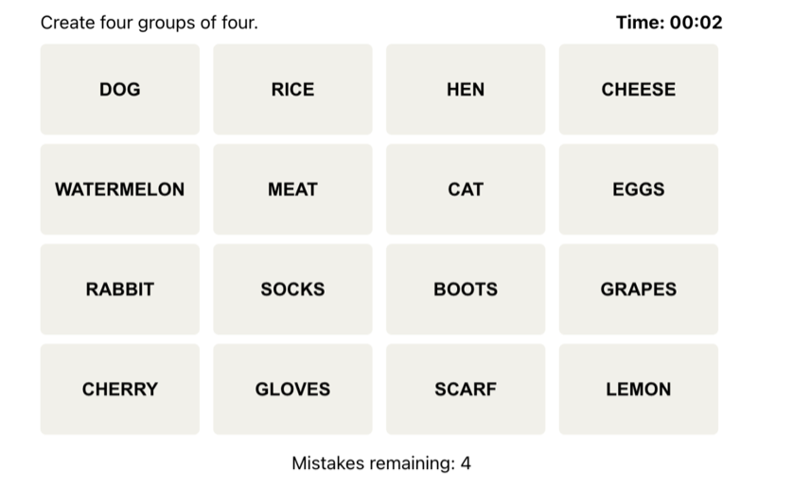
Example: Connections
Group 1
Group 2
Group 3
Group 4

Slide 4
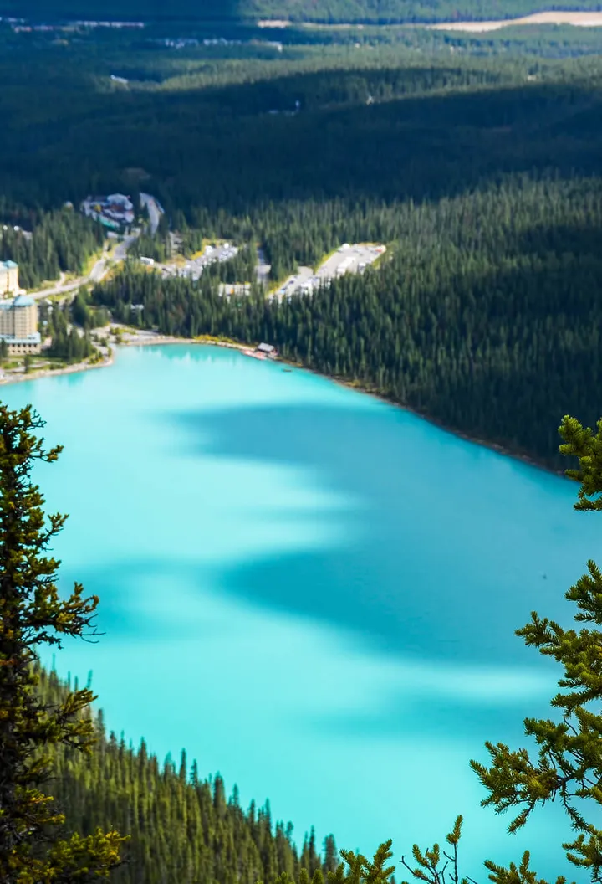
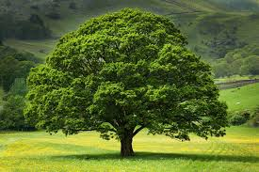
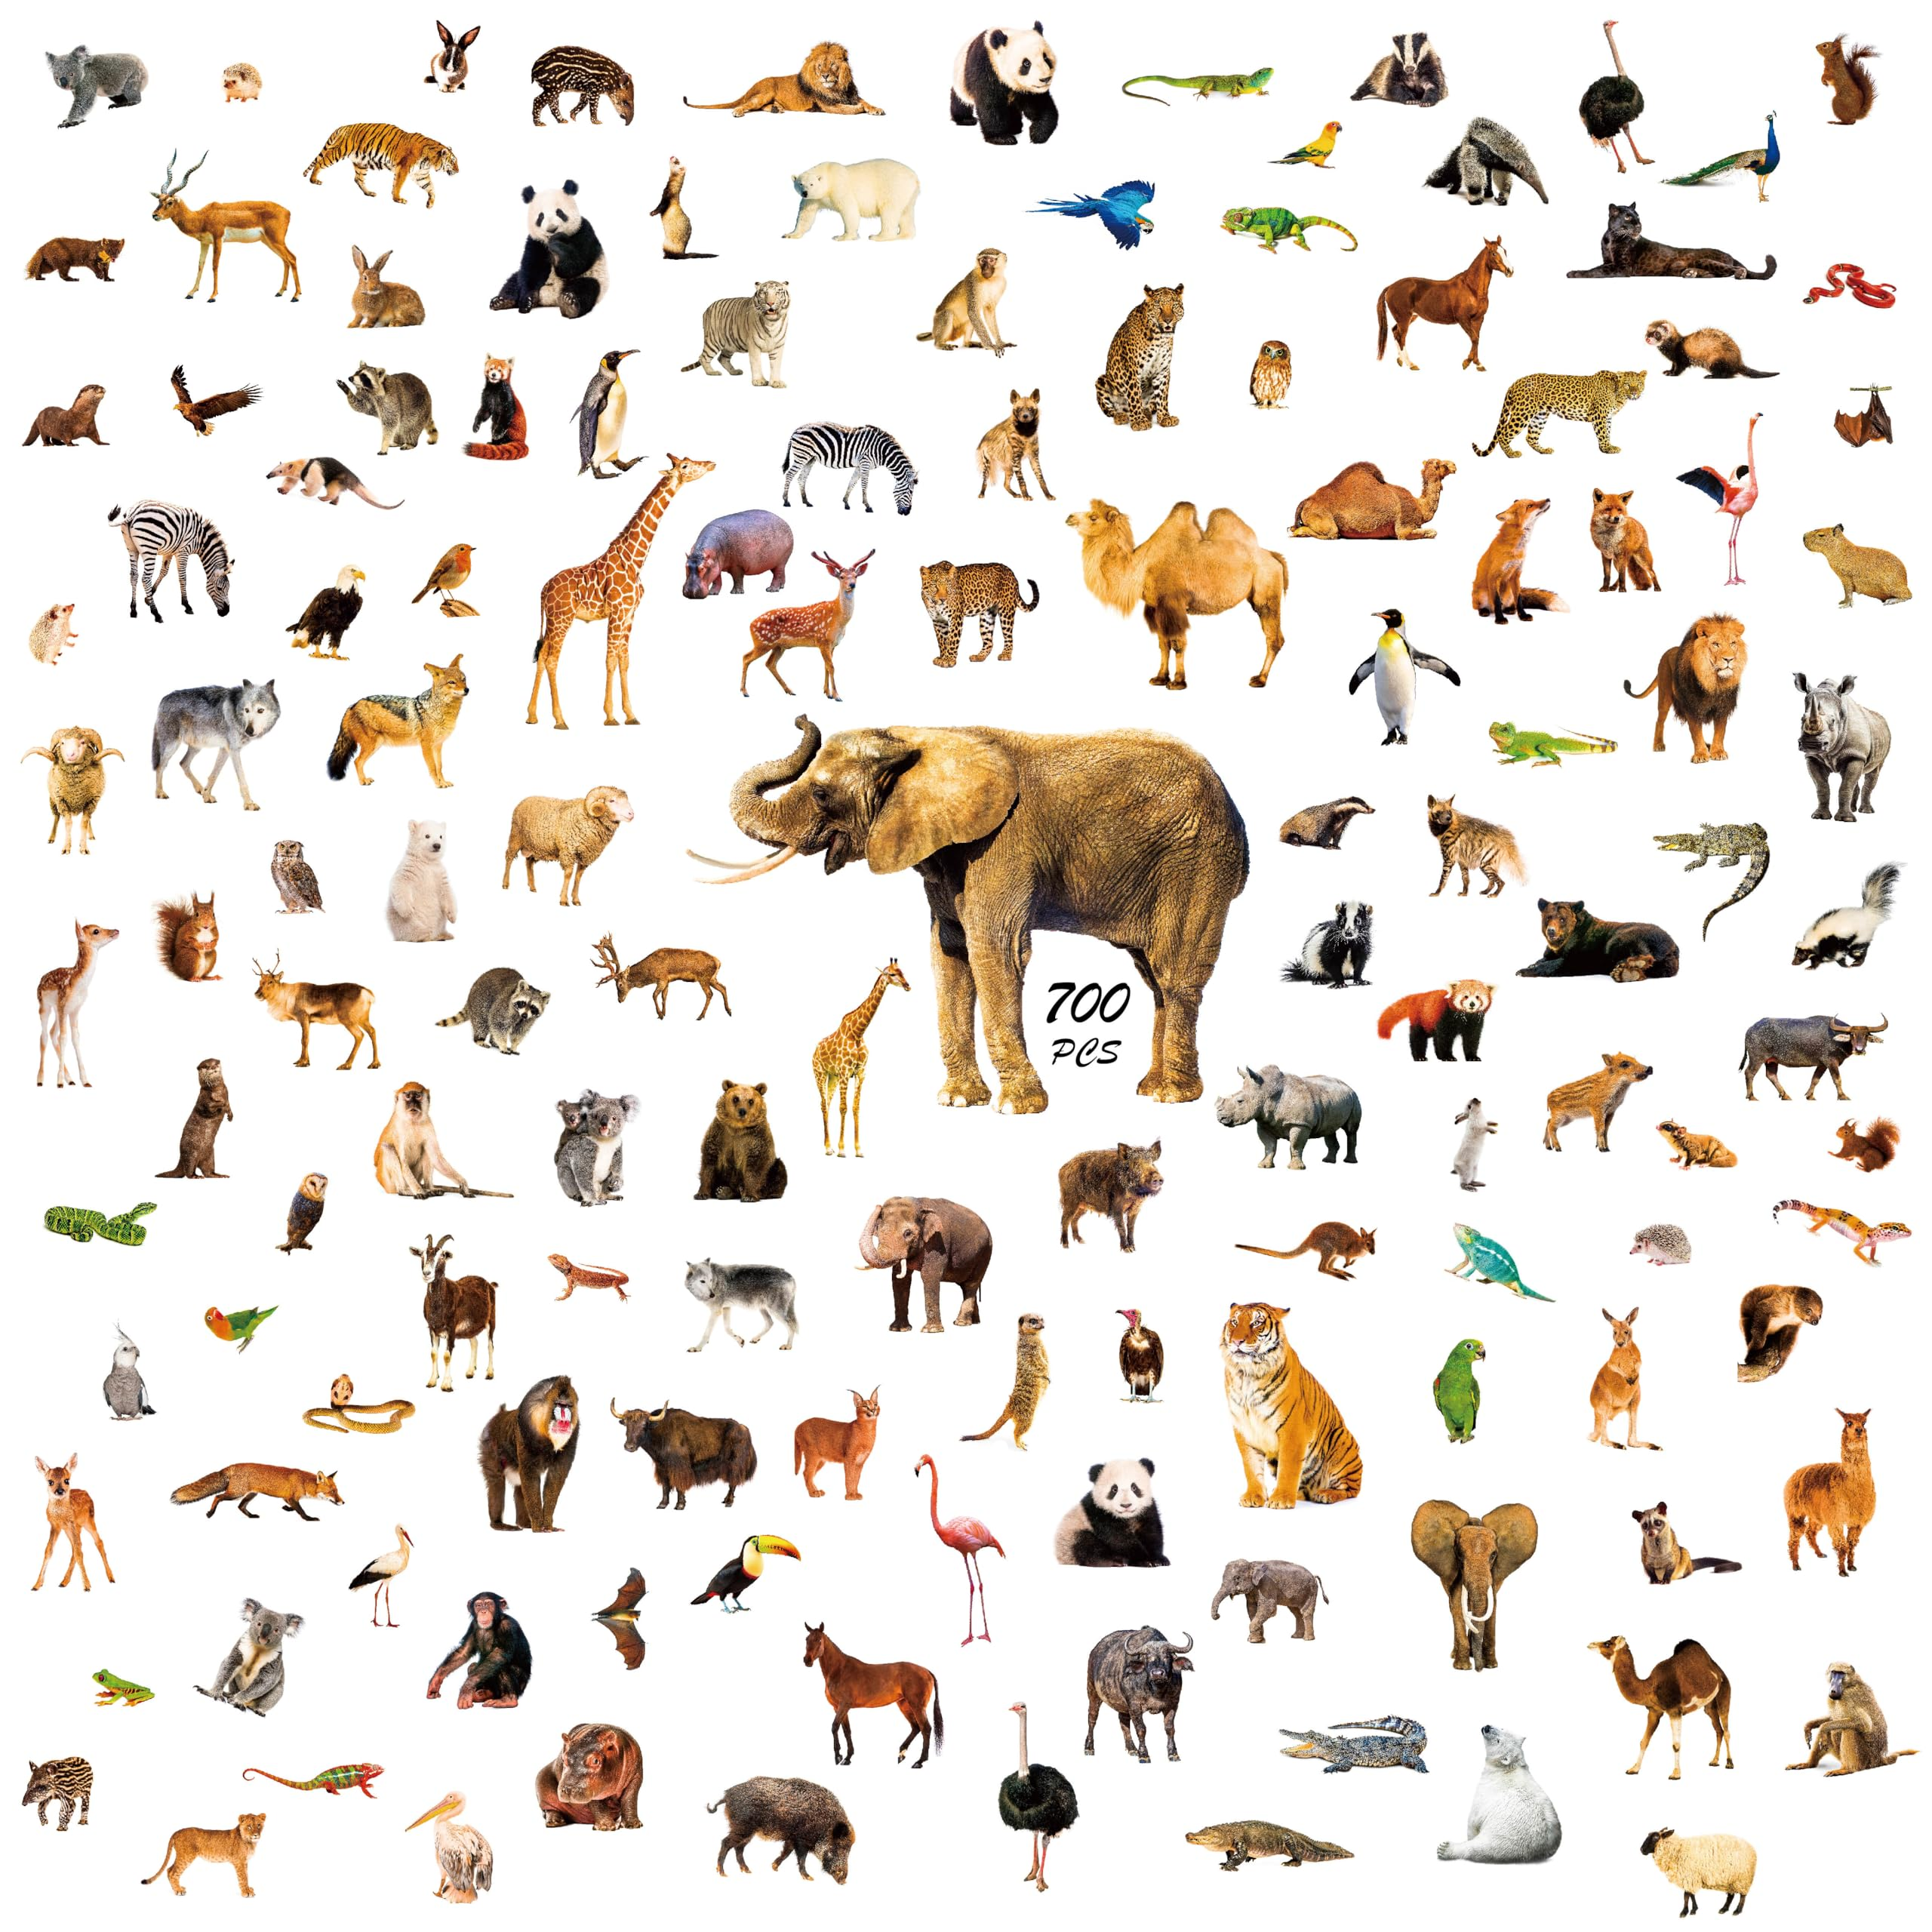
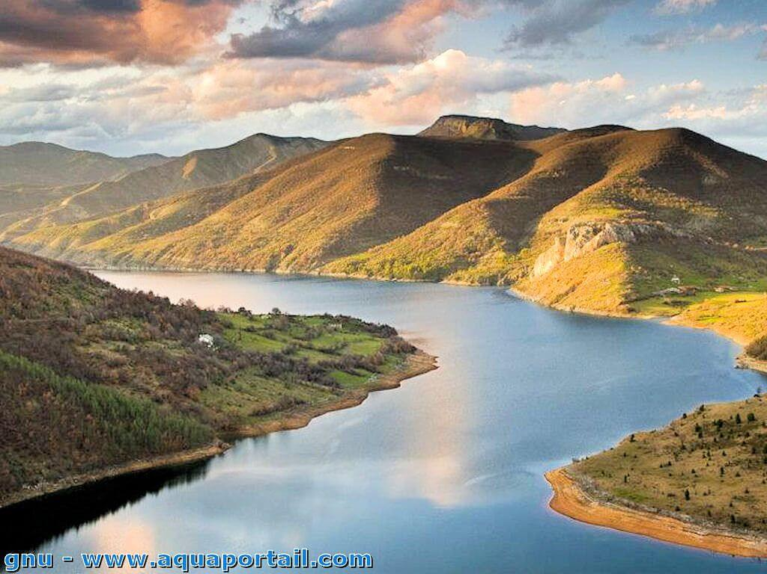
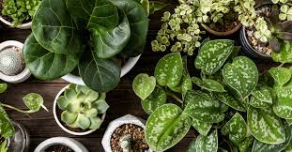
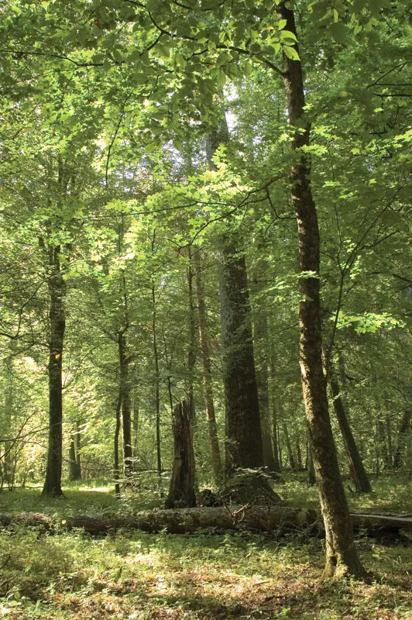
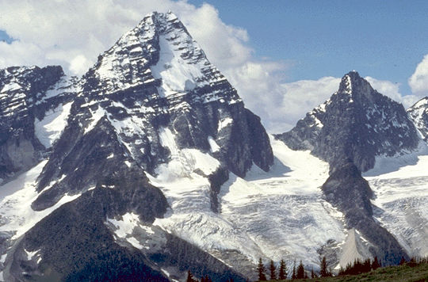
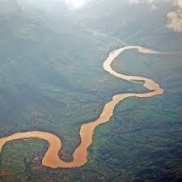

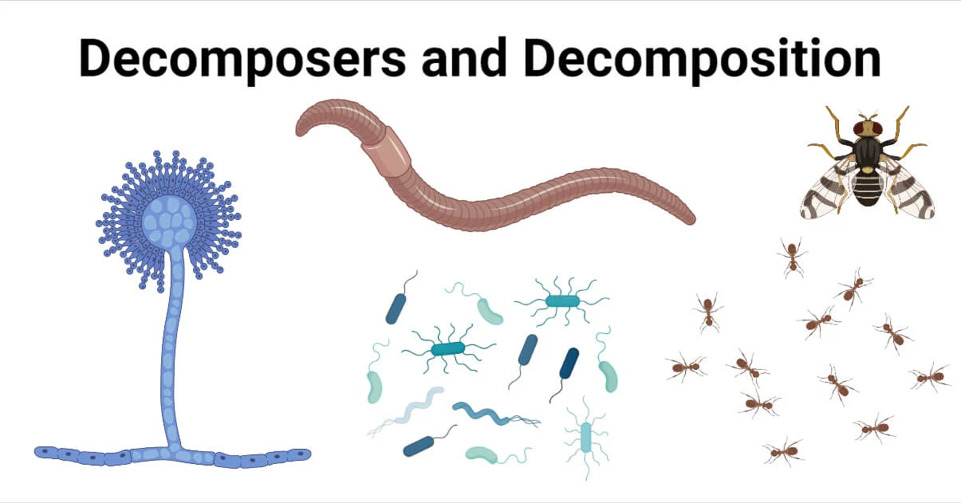
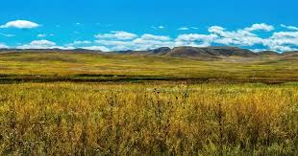
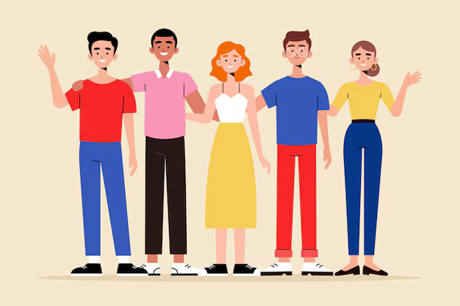
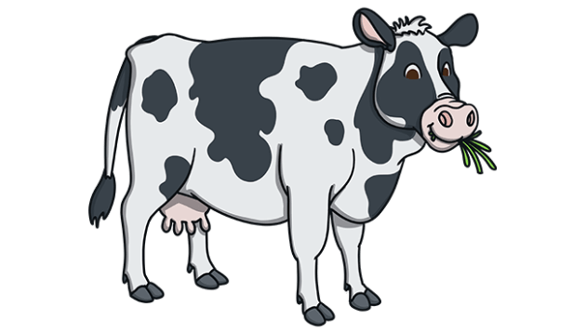
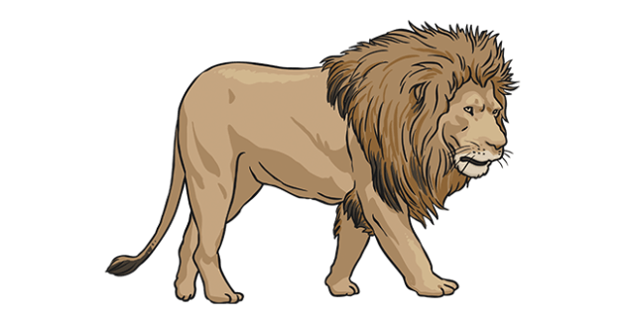
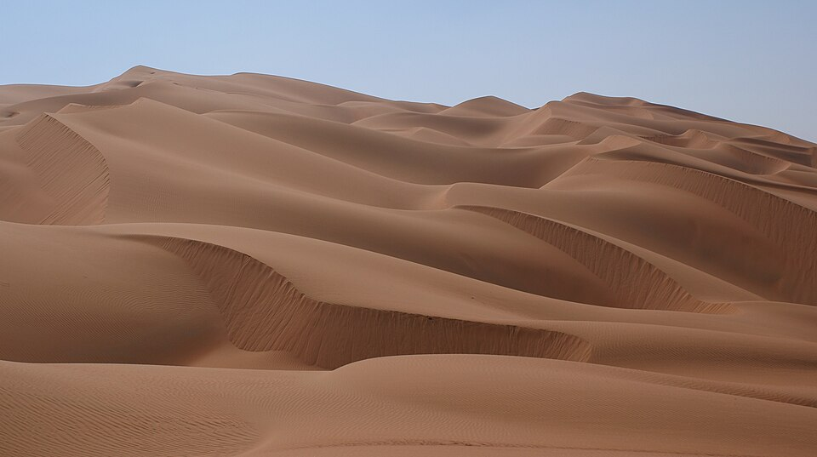
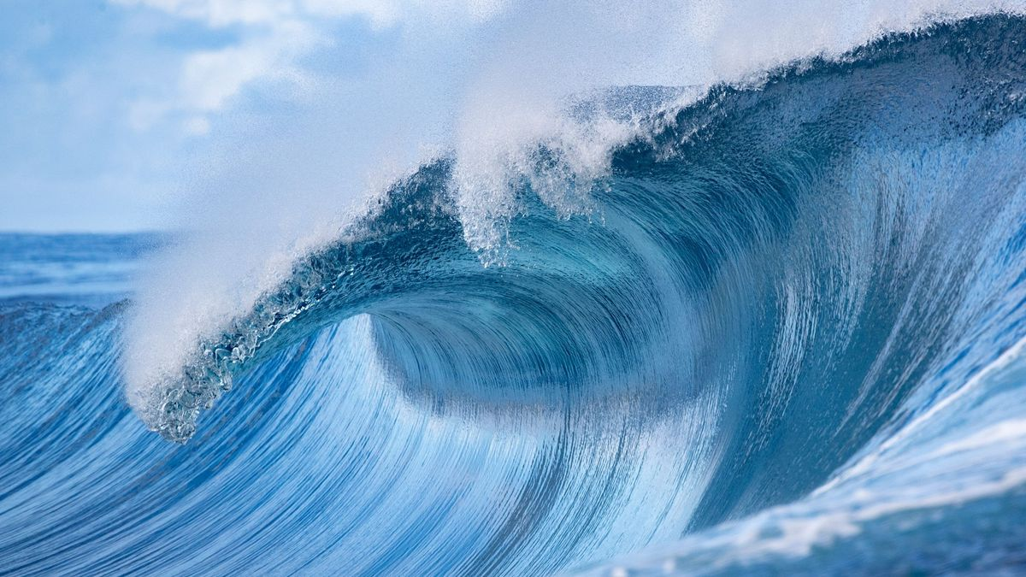
Lac
Arbre
Fleuve
Animeaux
Montaigne
Rivière
Plantes
Forêt
Decomposeurs
Prairie
Personnes
Omnivores
Herbivores
Océan
Carnivores
Desert

Slide 5
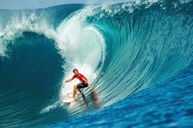
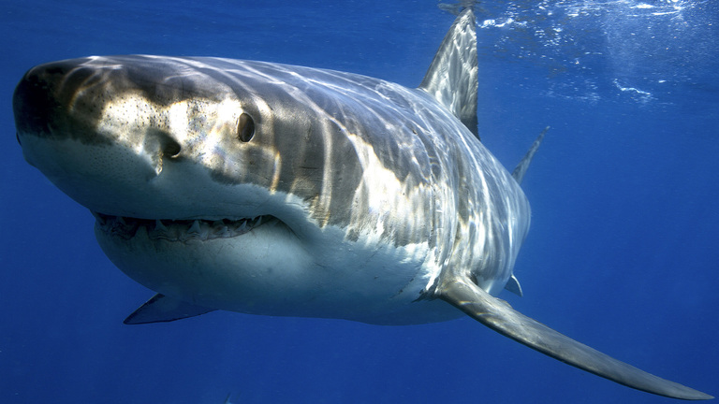
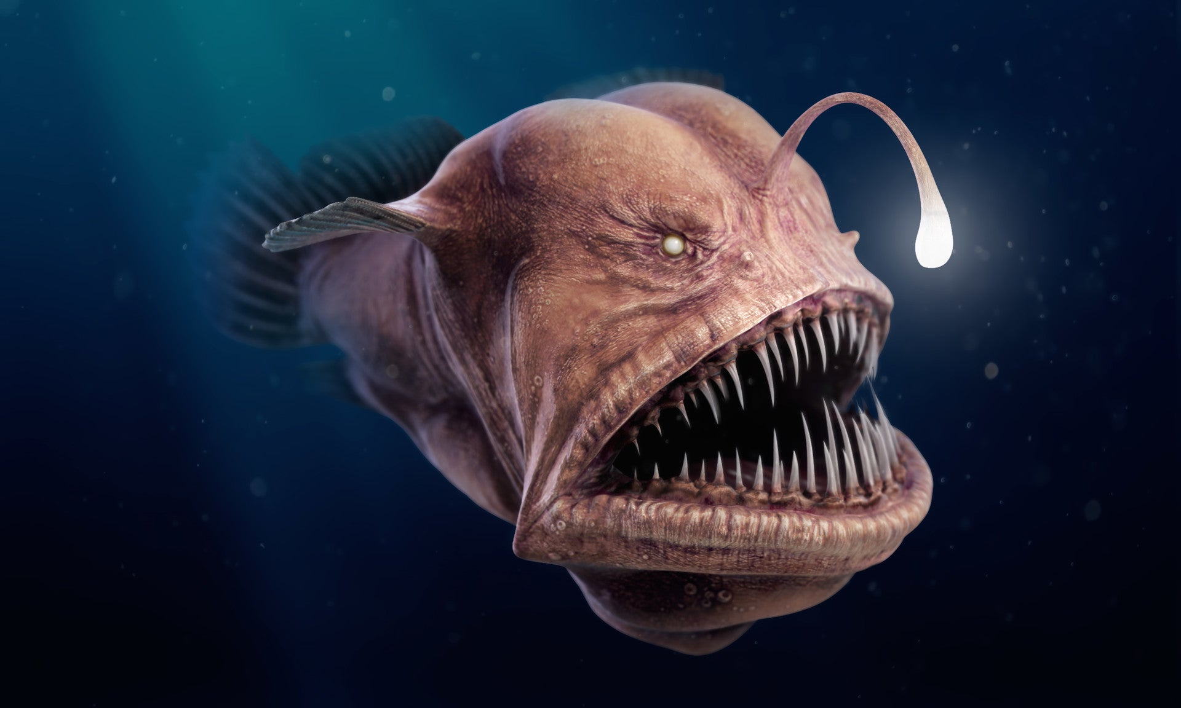
Haut
Surfeur
Requin
Beaudroie
Bas

Slide 6
Montaigne
Haut
Océan
Bas

Slide 7
Lac
Forêt
Desert
Océan
Montaigne
Rivière

Slide 8
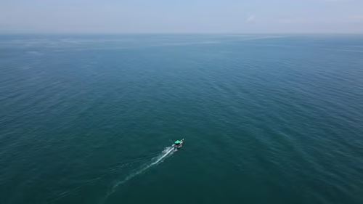
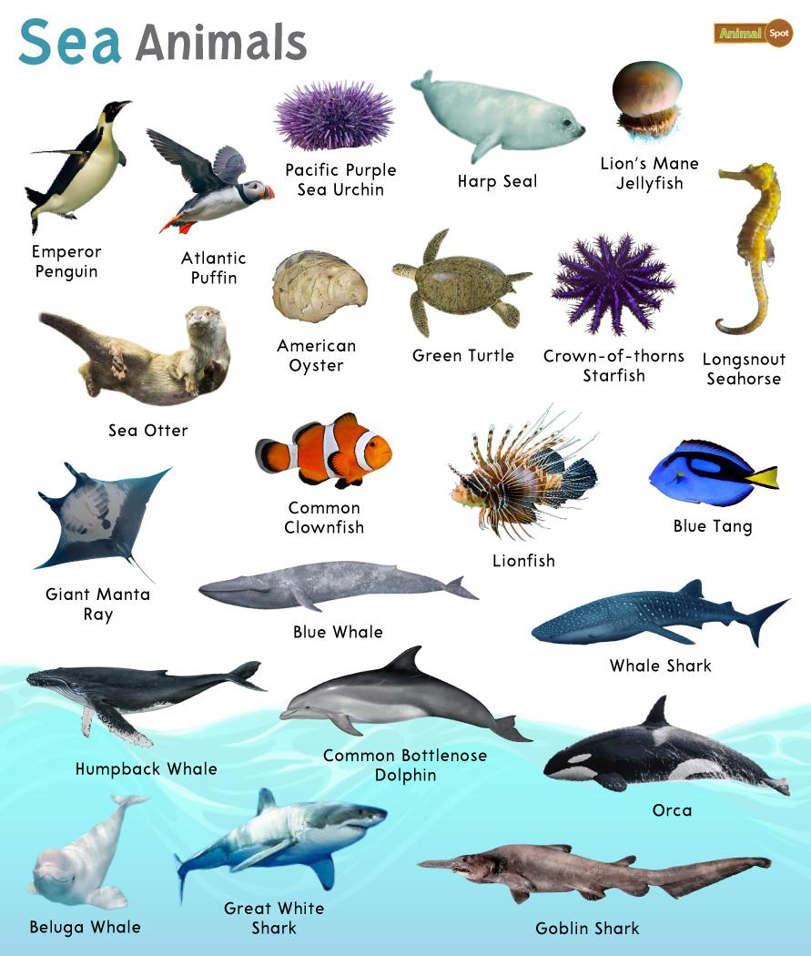
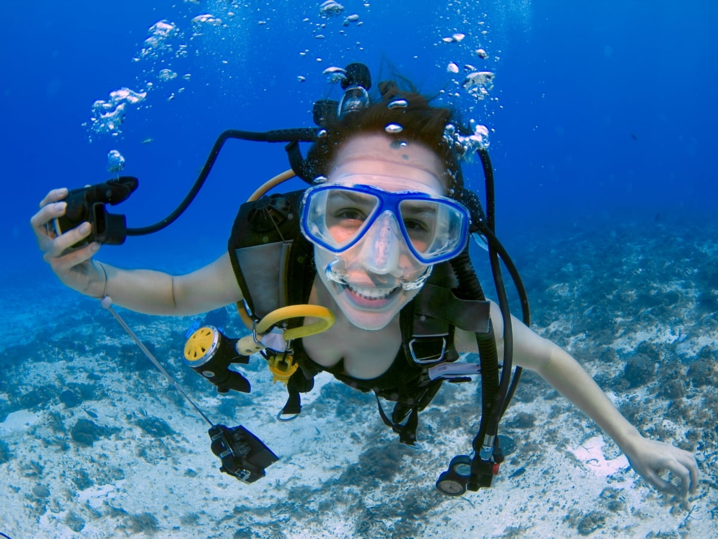
L’océan est grand.
Il a beaucoup d’animeaux qui vivent dans l’océan.
J’aime explorer l’océan.

Slide 9
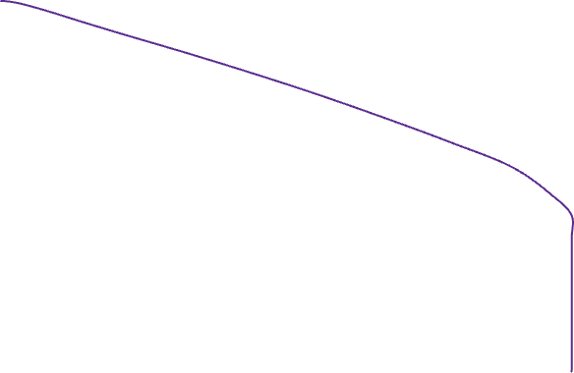
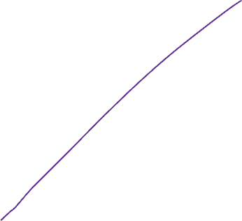
Grand Idée
Photo
Connections
Personelles

Slide 10
Pre-teaching vocabulary
It helps students to…
Semantic Gradient
What is it?
How does it help students?
Where could you use it?
Small random groups
I liked that…
Playful learning
I noticed…
I felt…
I want to try…

Slide 11

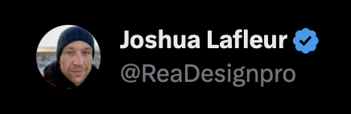
Thank you
Slides at ReaDesign.pro

