Slide 1

Multilingual Learner Success
June 30, 2025

Slide 2



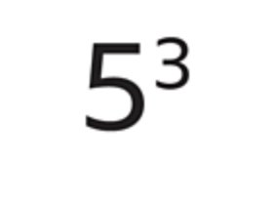
Which one doesn’t belong?
Addition
Multiplication
Soustraction
Exposants

Slide 3
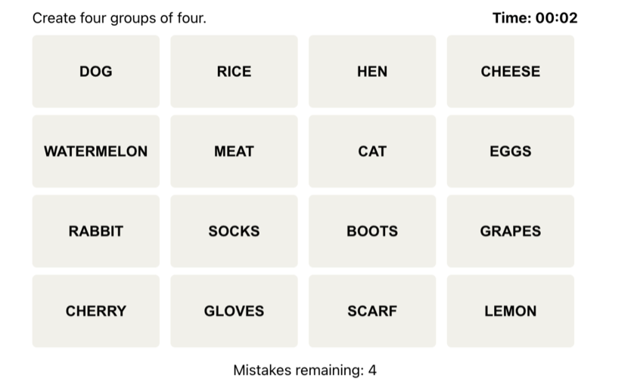
Example: Connections
Group 1
Group 2
Group 3
Group 4

Slide 4
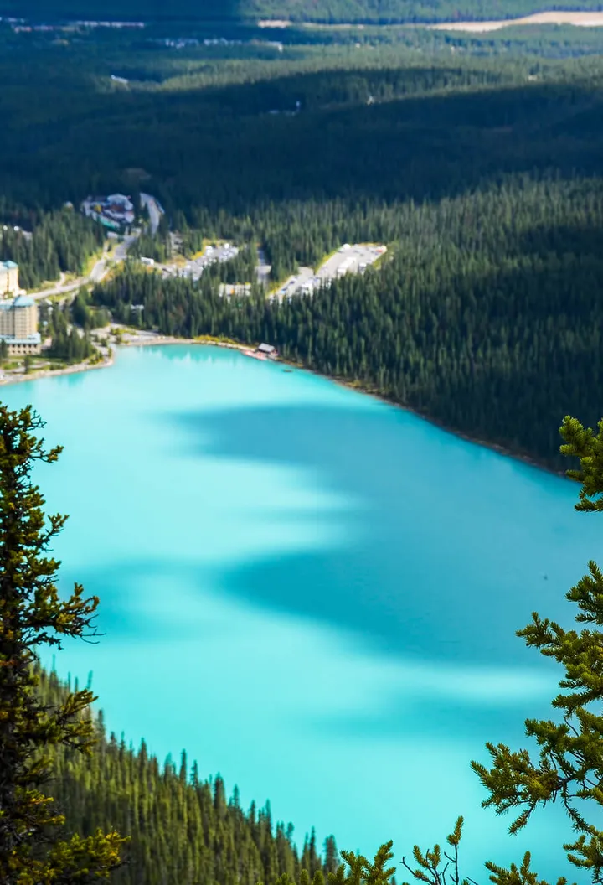
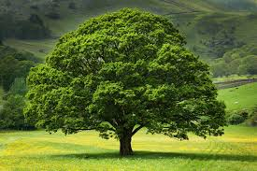
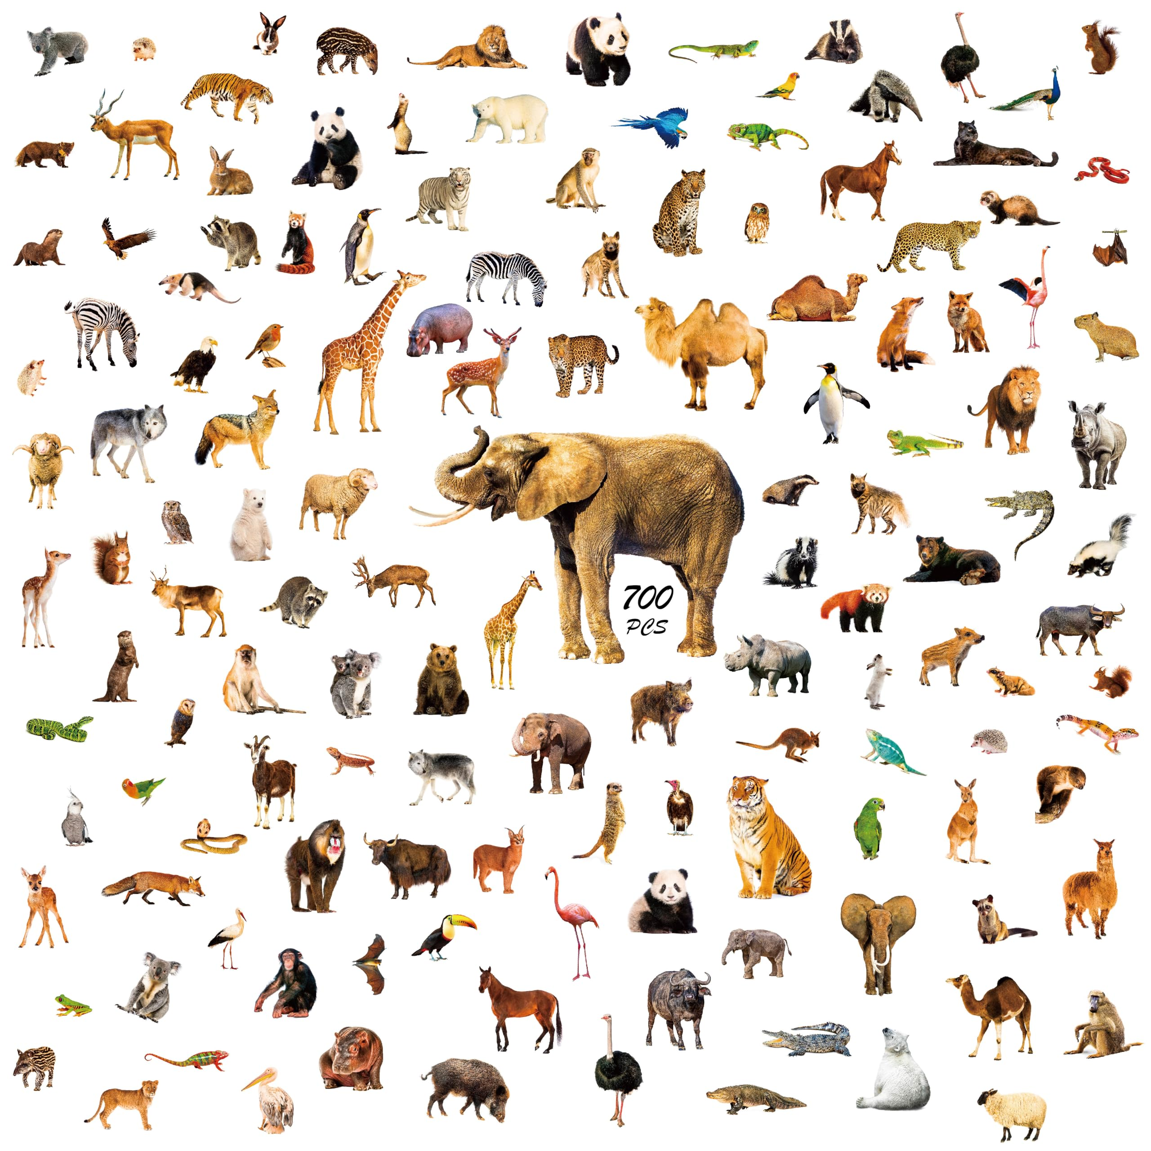
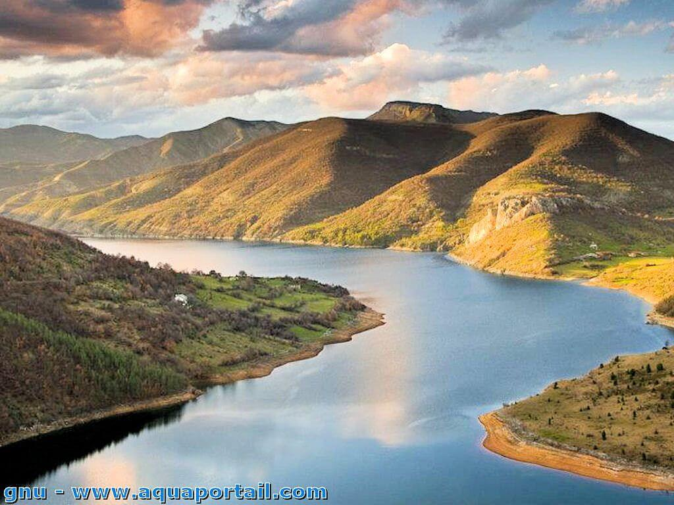
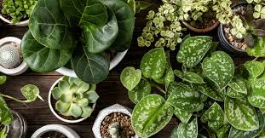
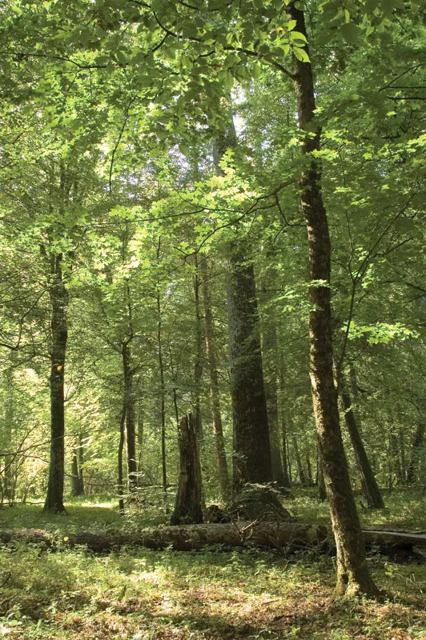
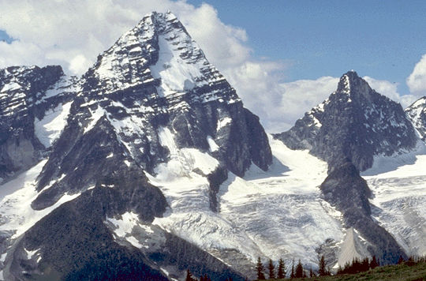
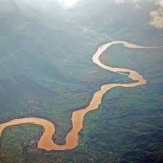

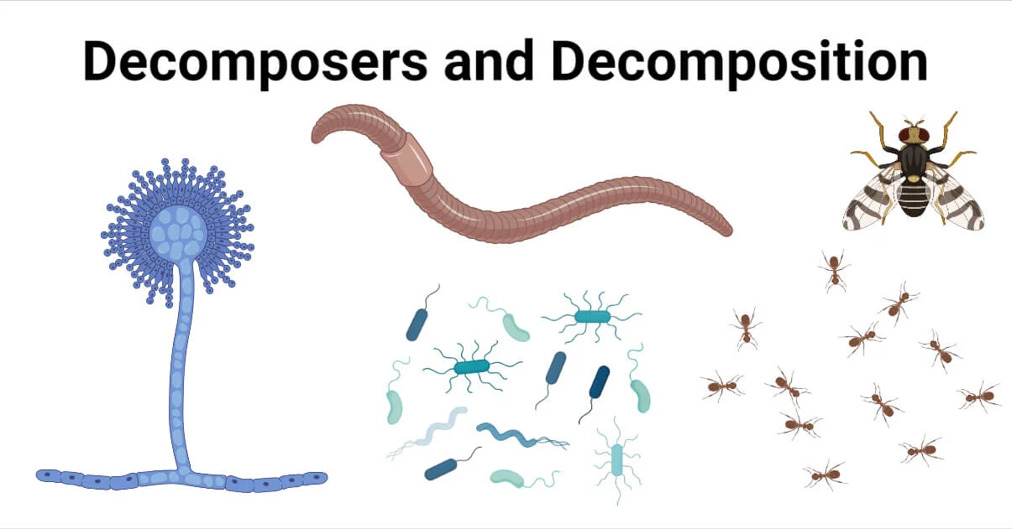
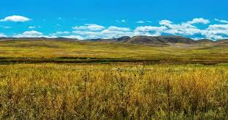
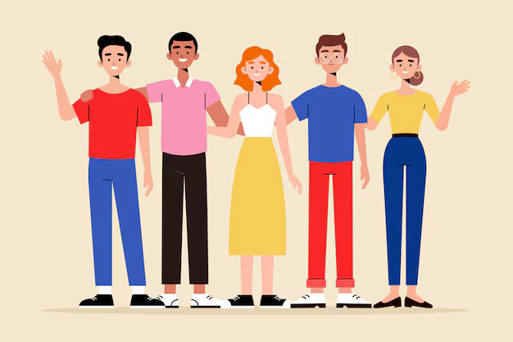
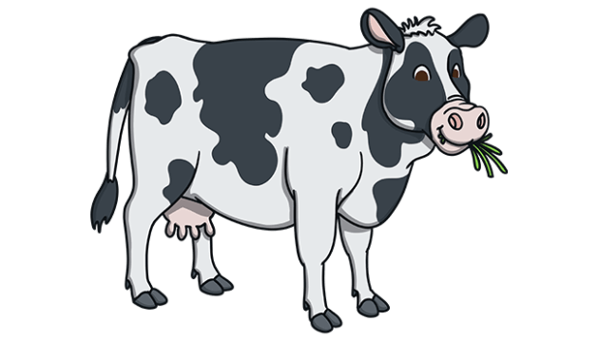
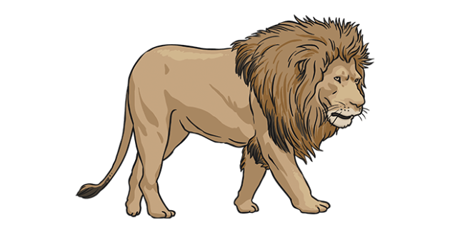
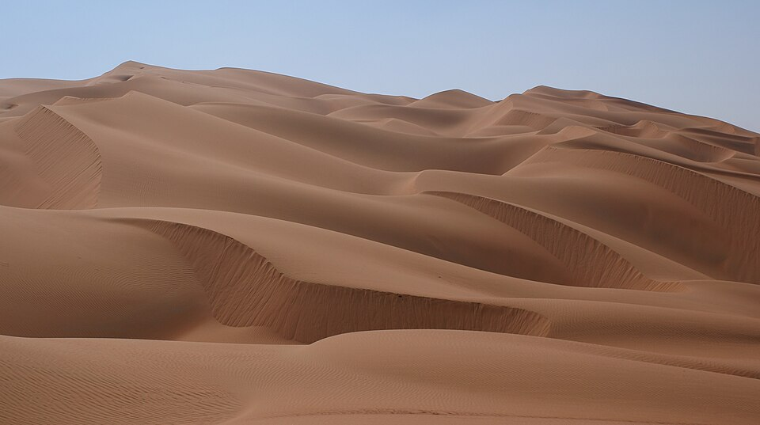
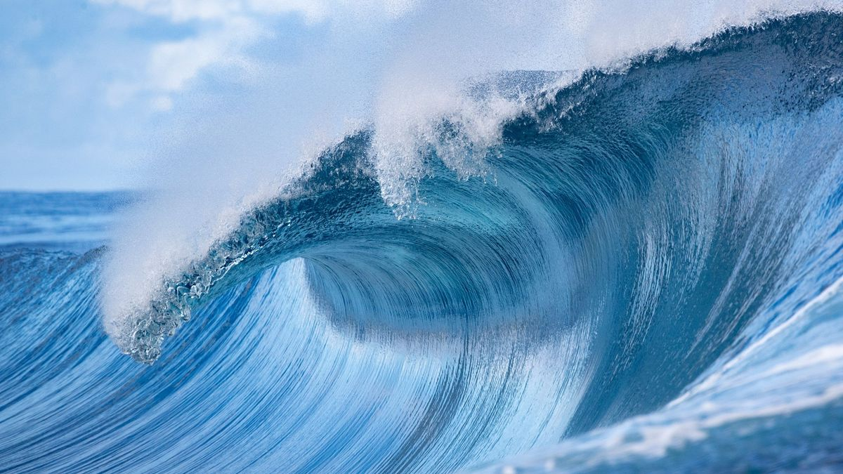
Lac
Arbre
Fleuve
Animeaux
Montaigne
Rivière
Plantes
Forêt
Decomposeurs
Prairie
Personnes
Omnivores
Herbivores
Océan
Carnivores
Desert

Slide 5
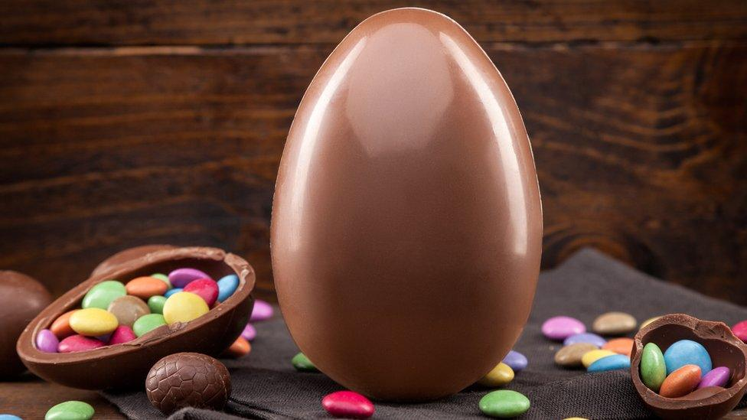
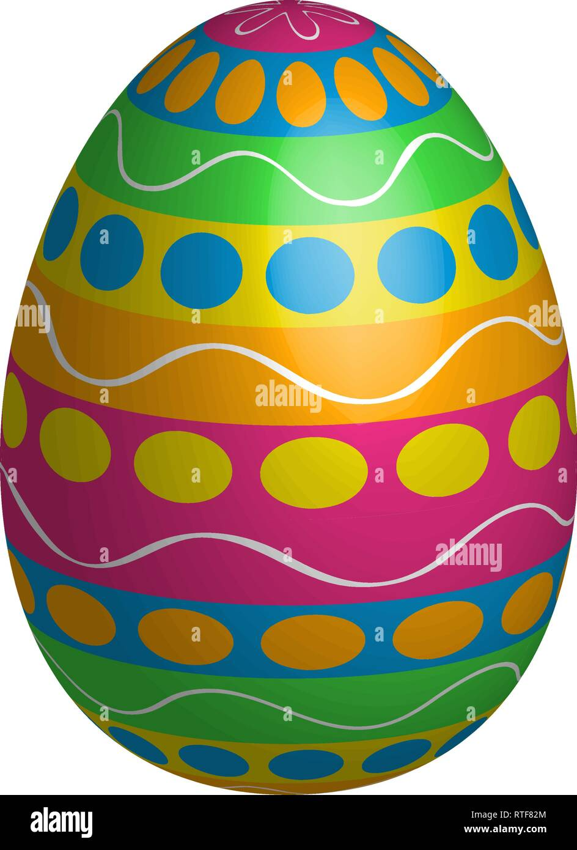
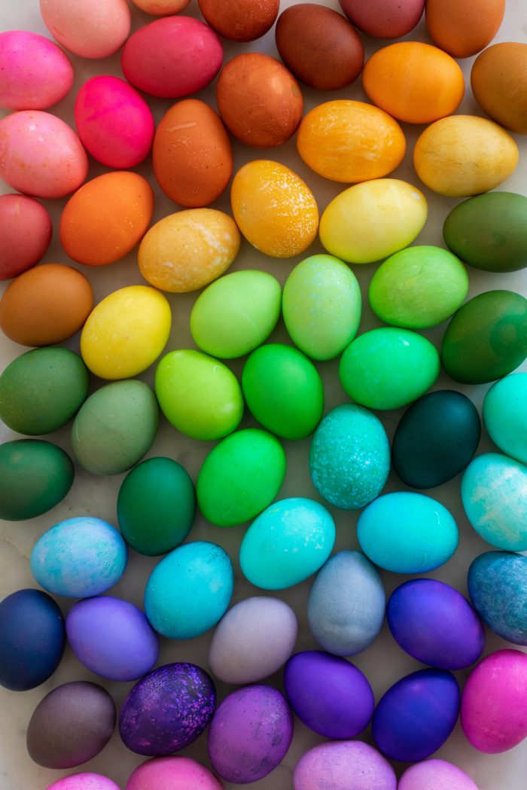


Large
Very colorful
Small
monochromatic

Slide 6

Found in higher altitude
Big in size
Small in Size
Low Altitude

Slide 7
Lac
Prairie
Forêt
Desert
Fleuve
Océan
Montaigne
Rivière

Slide 8
Pre-teaching vocabulary
It helps students to…
I could use this by…
Semantic Gradient
What is it?
How does it help students?
Where could you use it?
Other
Playful learning
I noticed…
I felt…
I want to try…

Slide 9
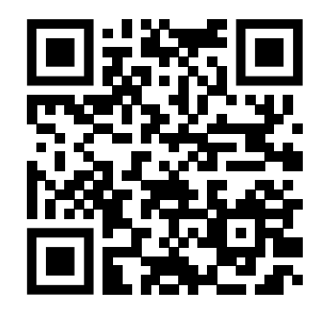
Thank you
Slides at ReaDesign.pro

