Slide 1

Engaging vocabulary lessons across content
Notes:
Welcome them, introduce yourself.

Slide 2
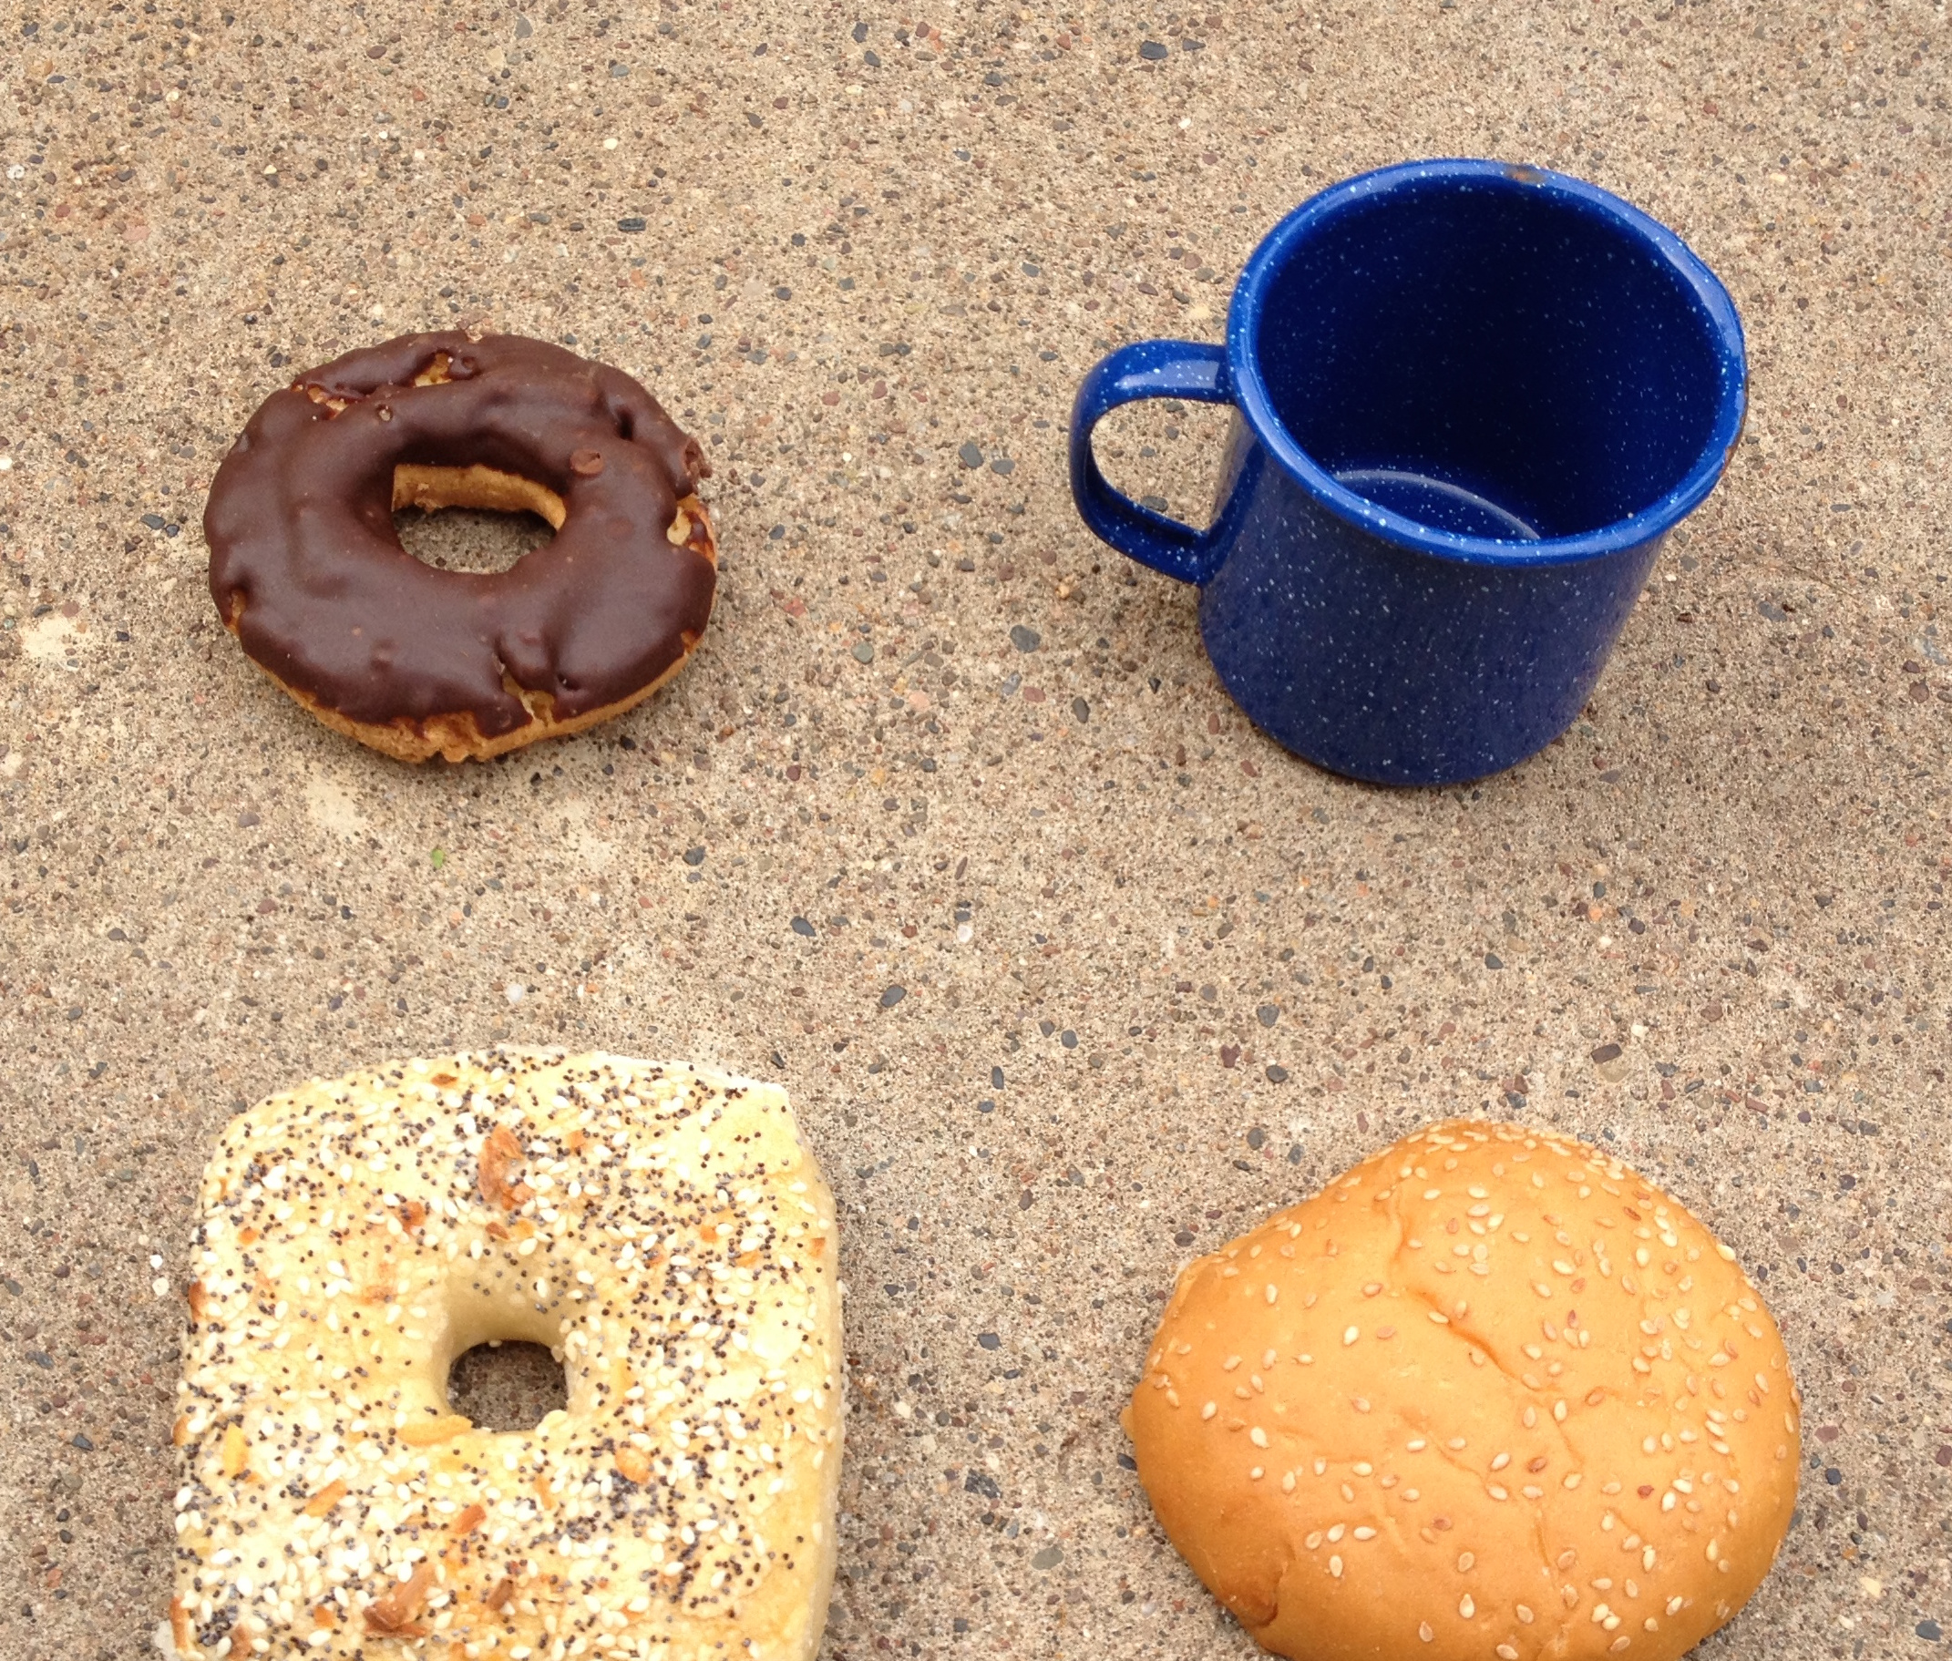
UFO
Unique From the Others
Notes:
Whole group – how is each of these four objects unique from the others?
Discuss.
This was “Which One Doesn’t BELONG” – and this feels more inclusive ☺
Put participants into random groups and send to whiteboards.

Slide 3
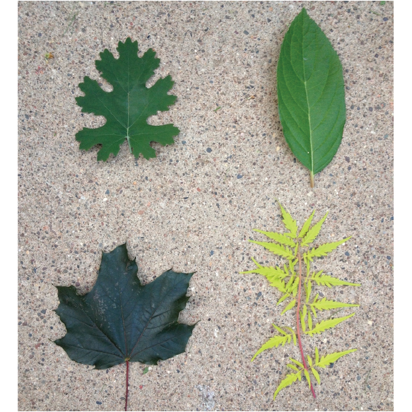
Notes:
They discuss in groups.
Bring everyone together in a blob/huddle
Ask how one is unique from others
Ask hands about the grades they teach
Ask about ideas for how this connects to vocabulary — preteaching, students sharing stories and bringing in outside knowledge.

Slide 4

Connections
Notes:
Games are amazing for vocabulary. Fun, lower risk, make connections.
Does anyone know game connections? Wordle?

Slide 5
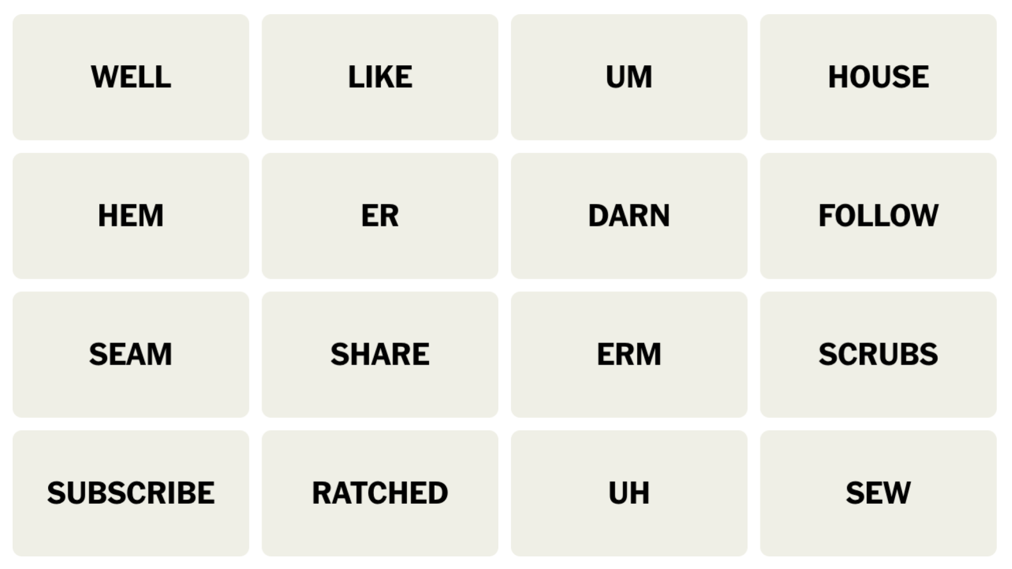
Notes:
This is an example of the game connections –
Can anyone explain how to play?
Need to make four groups of four words (all 16 words will be used once each).
What groups do we see here?

Slide 6
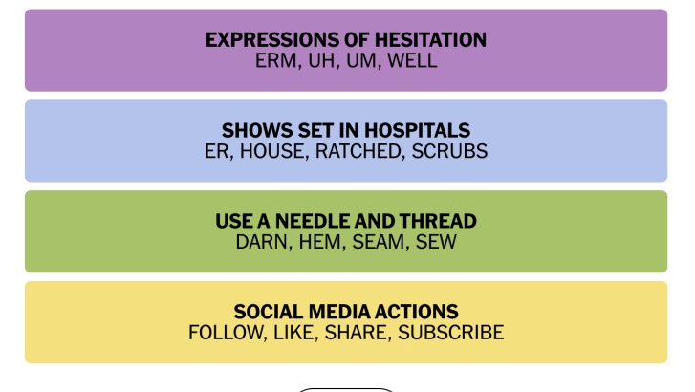
Notes:
These are the answers for the example – while the real game has answers, making this with students does not need answers because we are promoting critical thinking and discussion. So no one right way to do it.

Slide 7
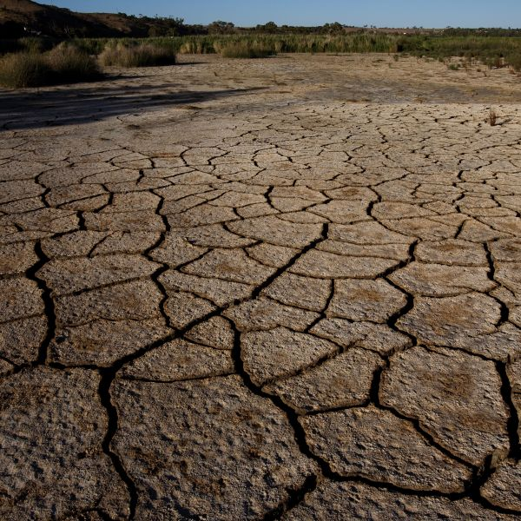
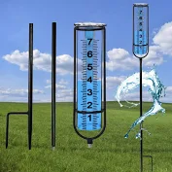
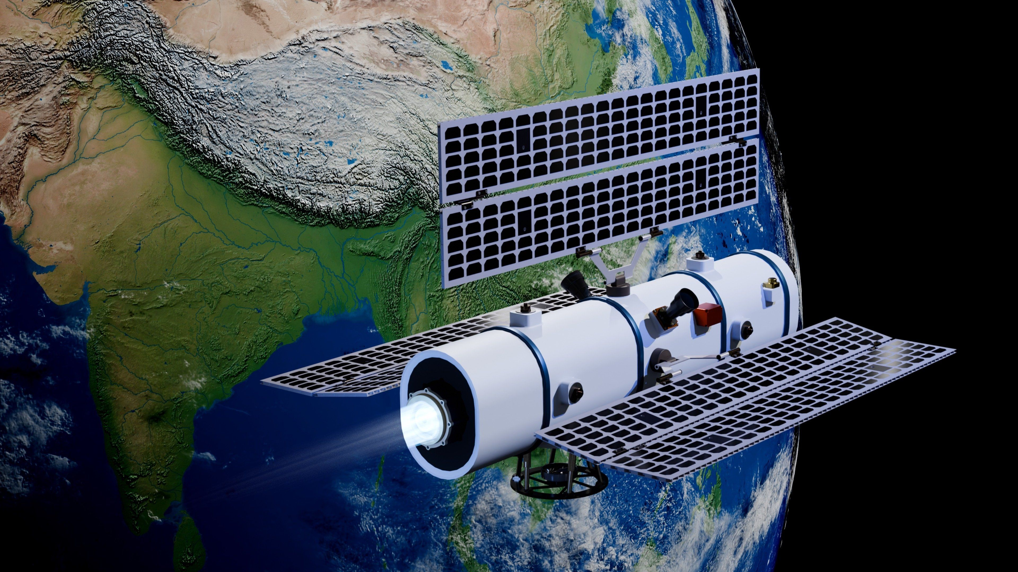
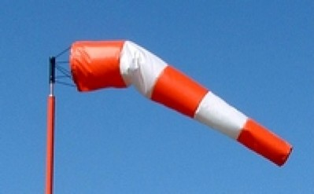
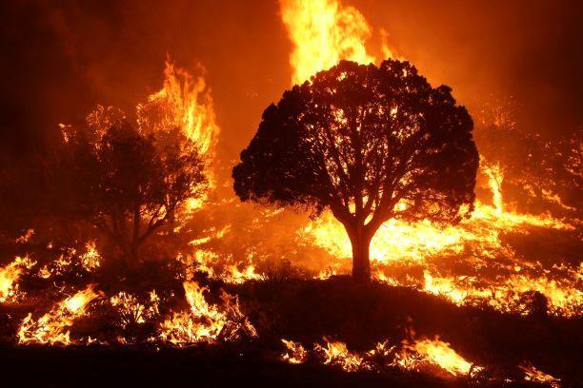
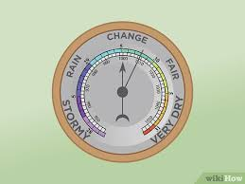
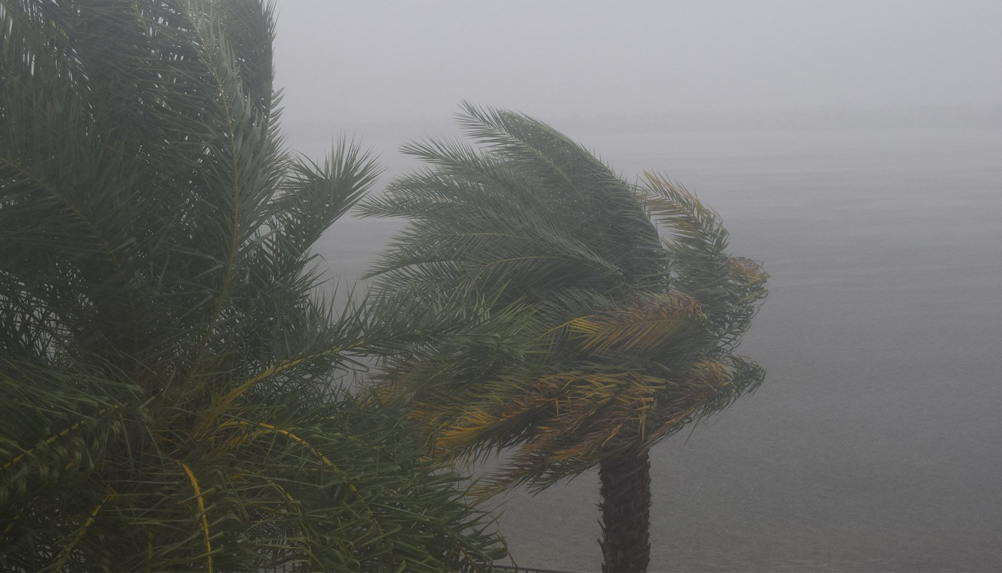

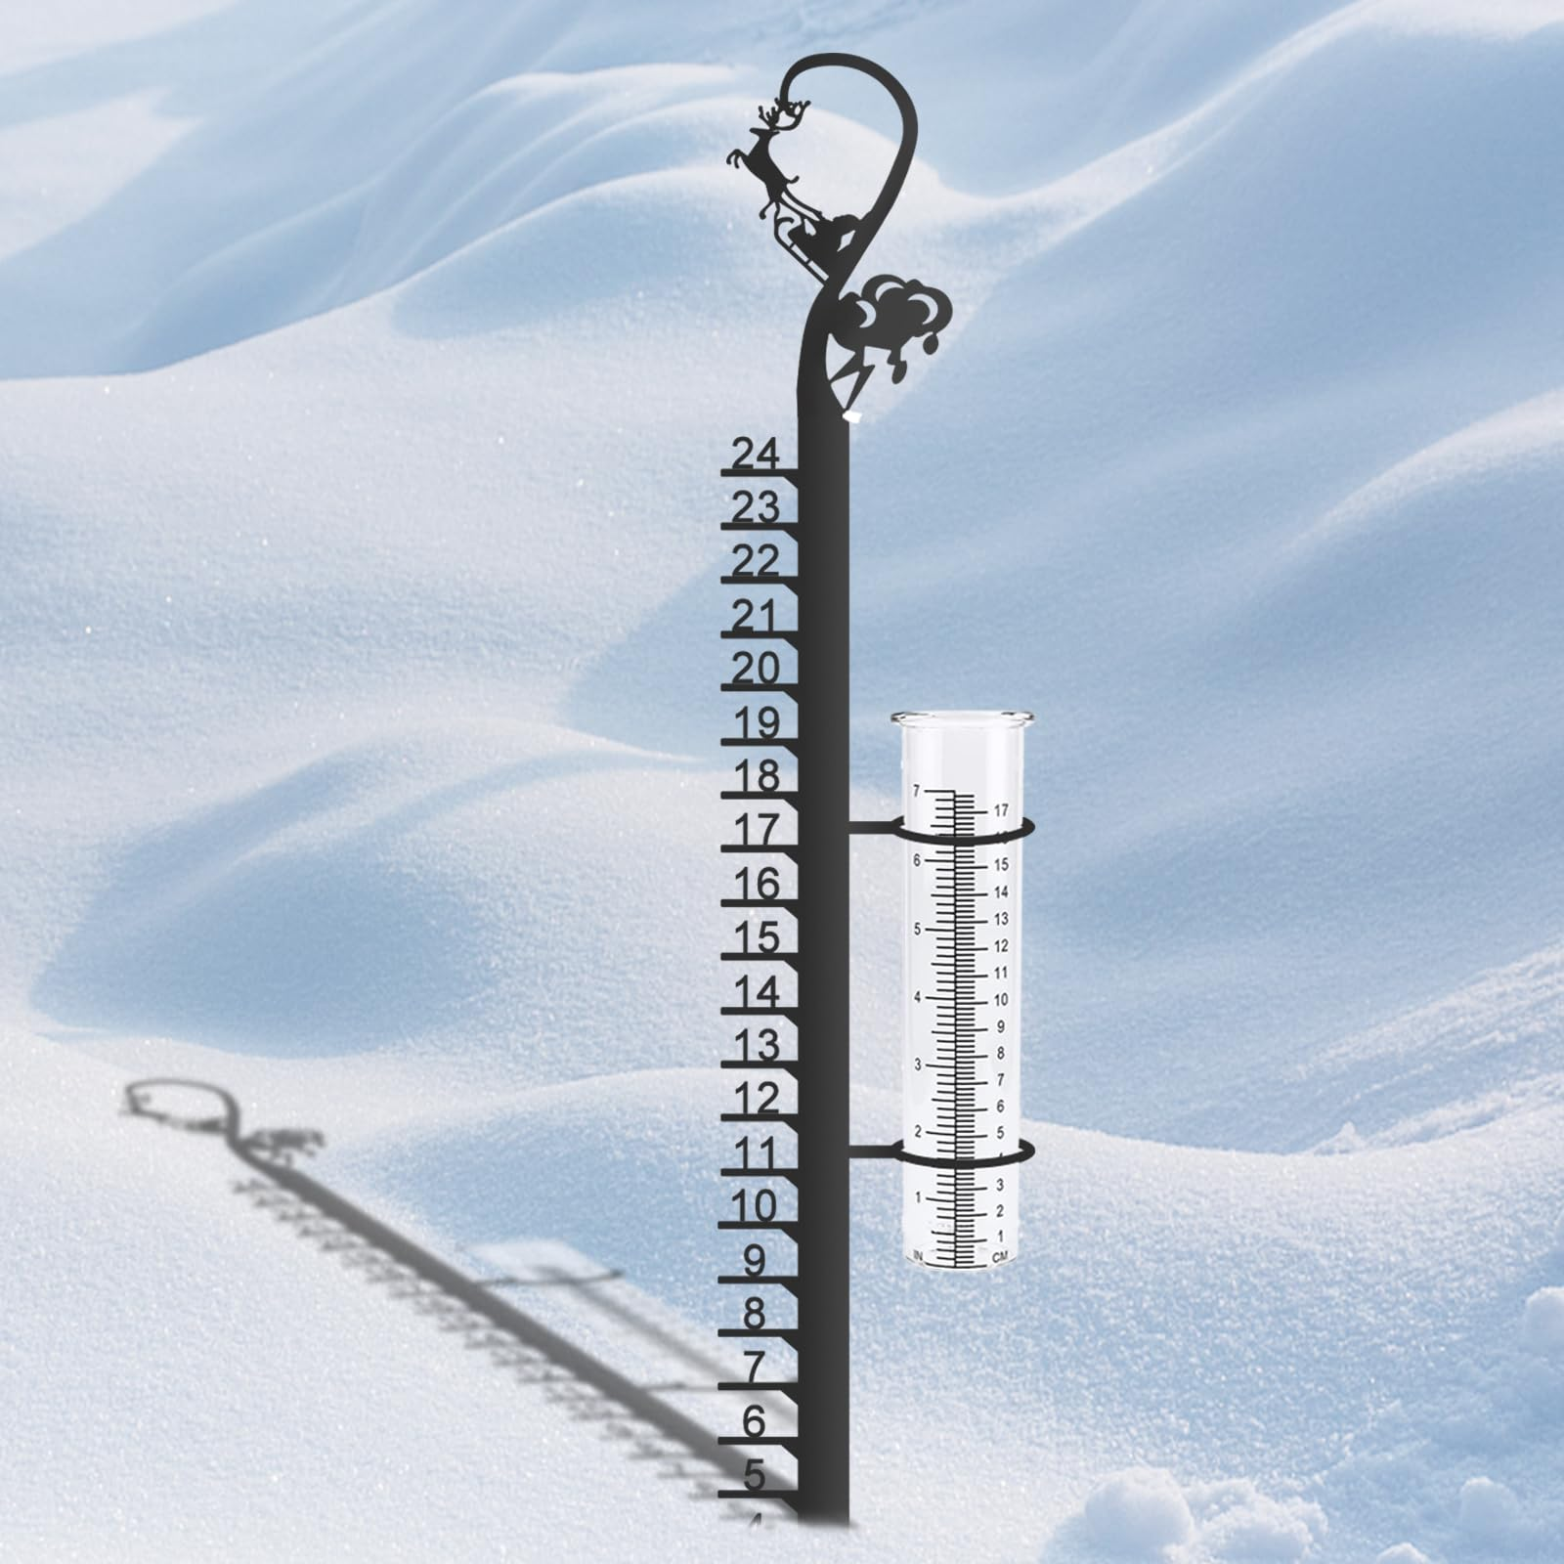
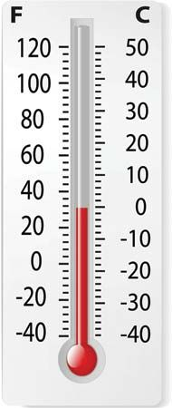

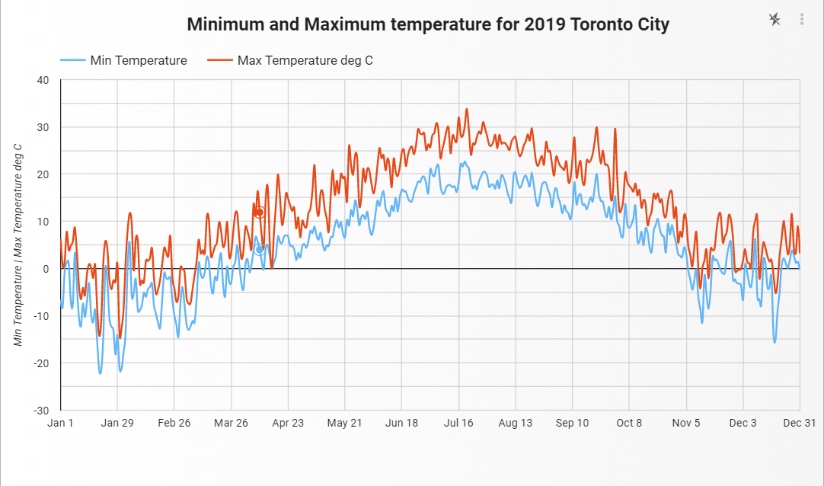
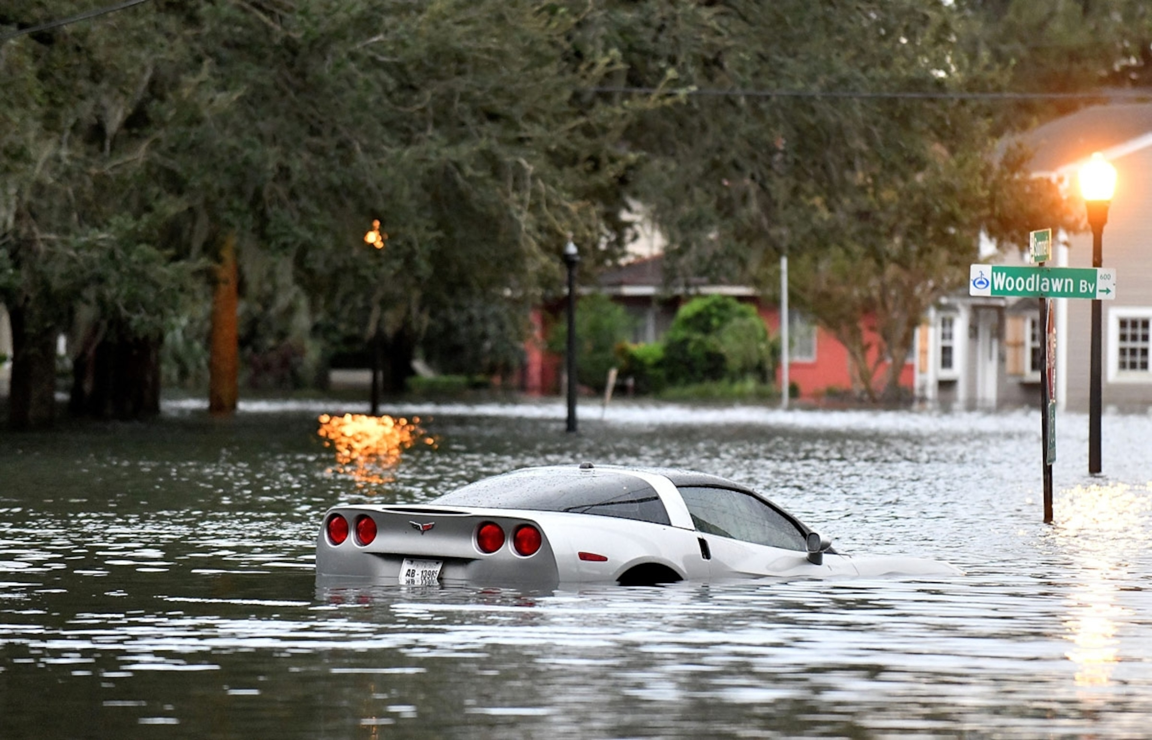
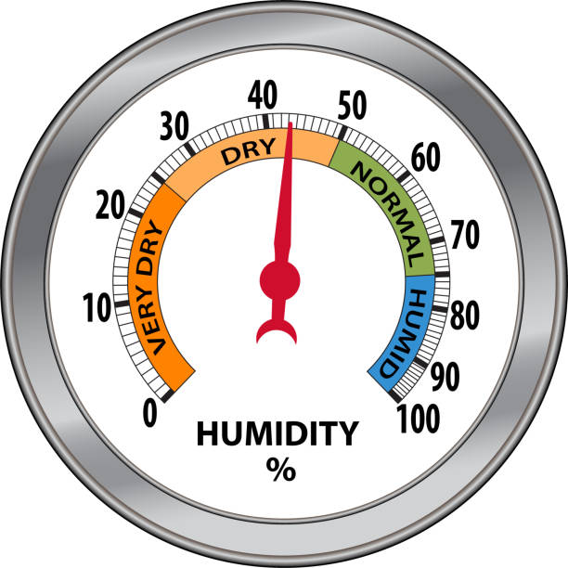
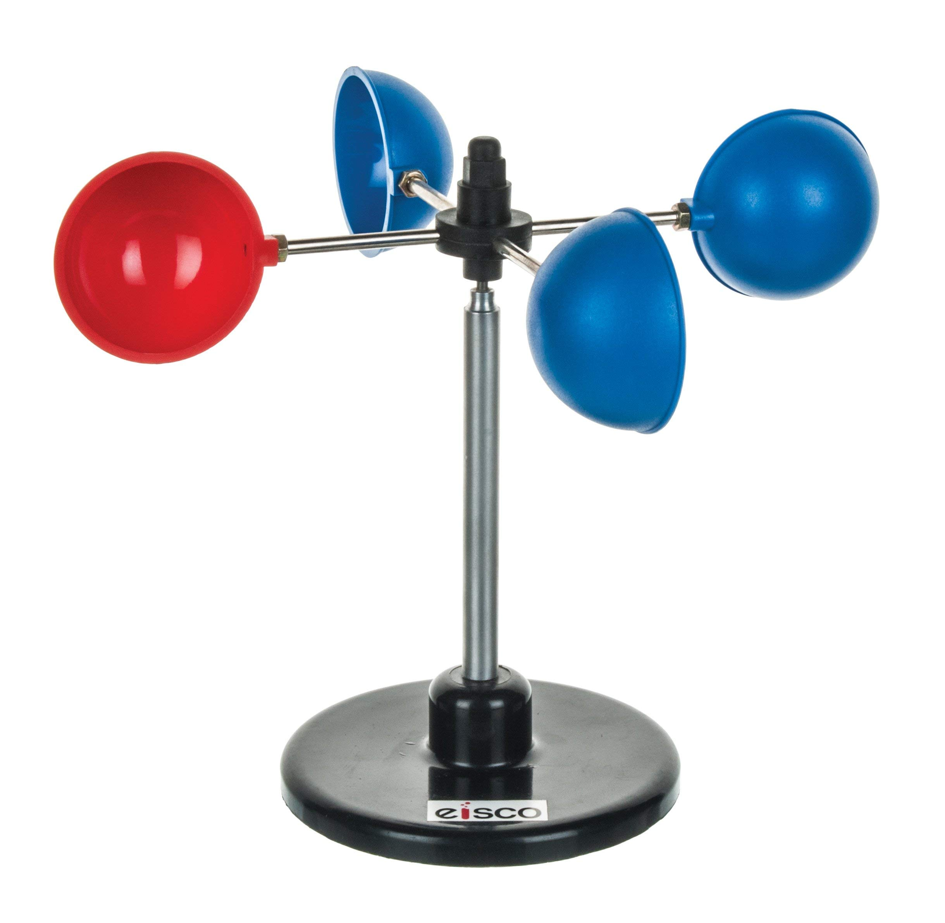

Windsocks | Drought | Satellite Imaging | Rain Gauge
Computer Modelling | Fires | Barometers | Windstorms
Snow Gauges | Historical Data | Thermometers | Wind Vanes
Traditional Indigenous Knowledge | Flooding | Hygrometer | Anemometers
Notes:
Back in random groups – sorting these words
These are grade five science words from a lesson with students.
When the teacher saw these she was worried, thinking about how she had not taught them any of the words and that they would not be able to do anything. She was happily surprised.

Slide 8
Come together
Notes:
Back together
First: what word might the grade five students have wanted to know more about?
Anemometer and barometer were big ones and we discussed them together like this… Whole body learning!
Sit down.

Slide 9
Turn and talk
Notes:
Think Pair Share: what are the benefits of what we have done so far

Slide 10
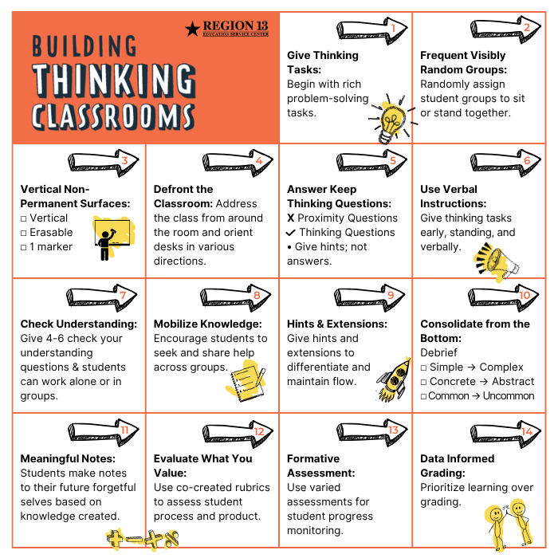
Notes:
Building Thinking Classrooms… have we heard of this book or these practices before?
Go over first 6 practices: what it looked like in what we did so far and a benefit for each
7th is Check your understanding… we are going to do that in a fun way right now... With a quick game:

Slide 12
GUESS WHO?

Slide 13
Windsocks | Drought | Satellite Imaging | Rain Gauge
Computer Modelling | Fires | Barometers | Windstorms
Snow Gauges | Historical Data | Thermometers | Wind Vanes
Traditional Indigenous Knowledge | Flooding | Hygrometer | Anemometers
Notes:
I have chosen one of these, and your job, like the game Guess Who is to try to eliminate the ones I am not thinking about.
For example, it NOT technology based…
What else could you ask me?
It was Fire.
Now with a neighbour, try playing guess who.

Slide 14
Semantic Gradient
Notes:
Semantic gradient
Semantic, words
Gradient: from hot pink to deep crimson.
So a word continuum

Slide 15
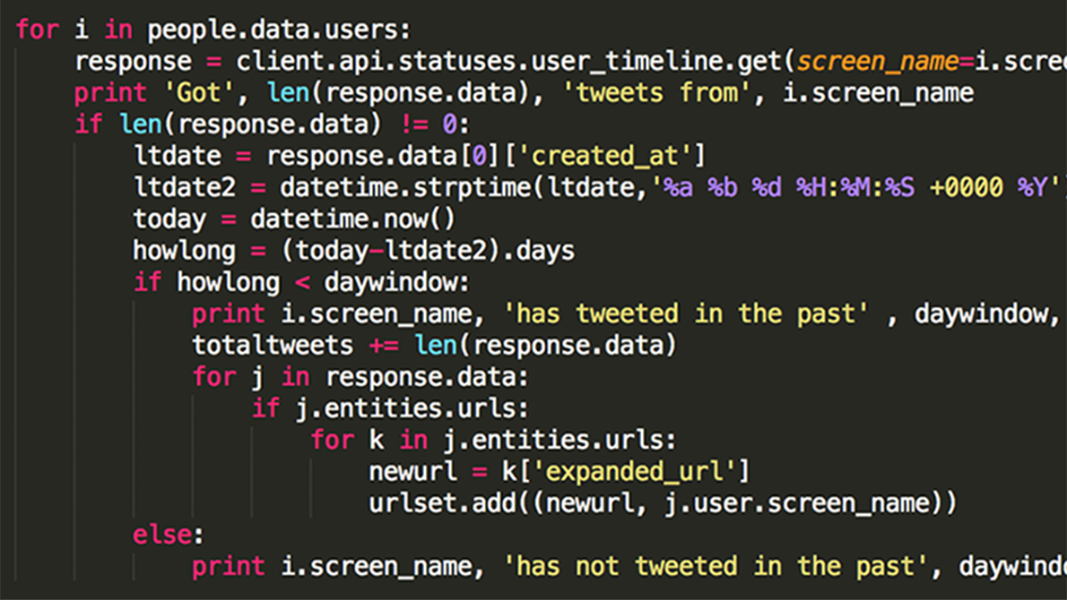
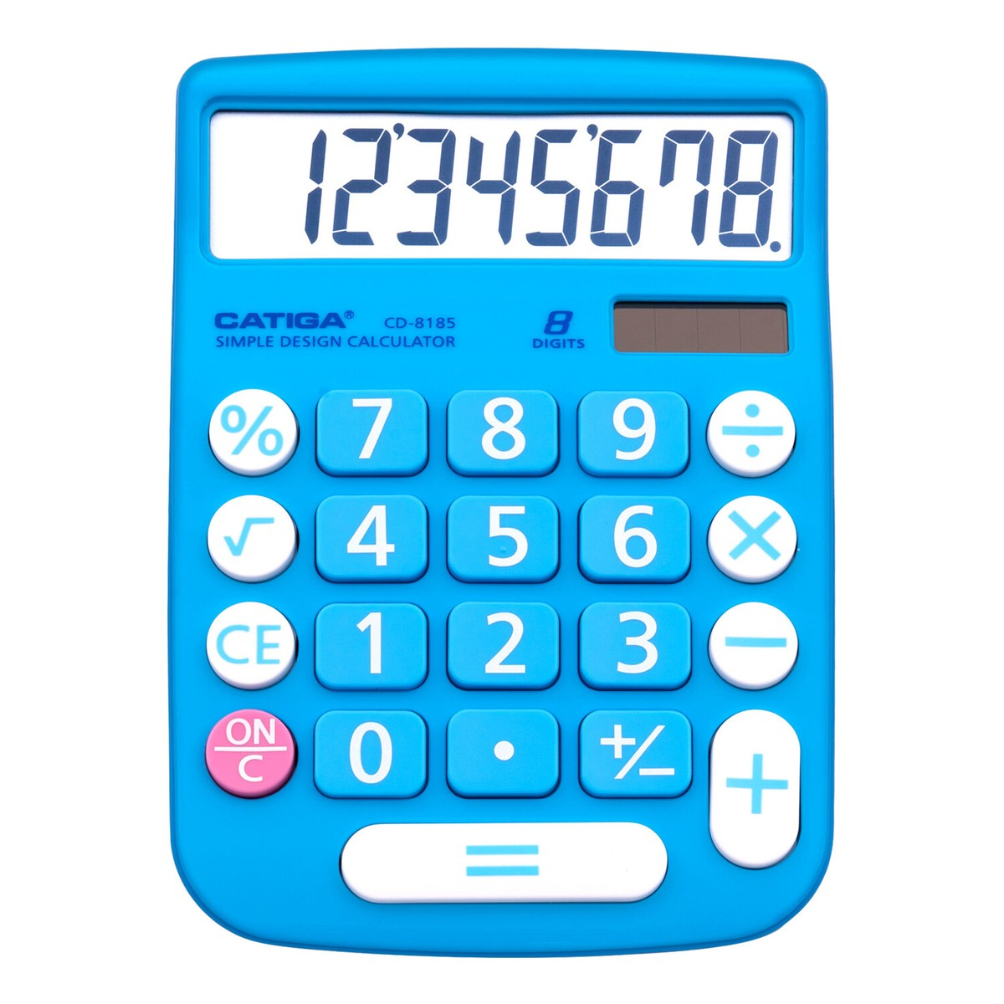
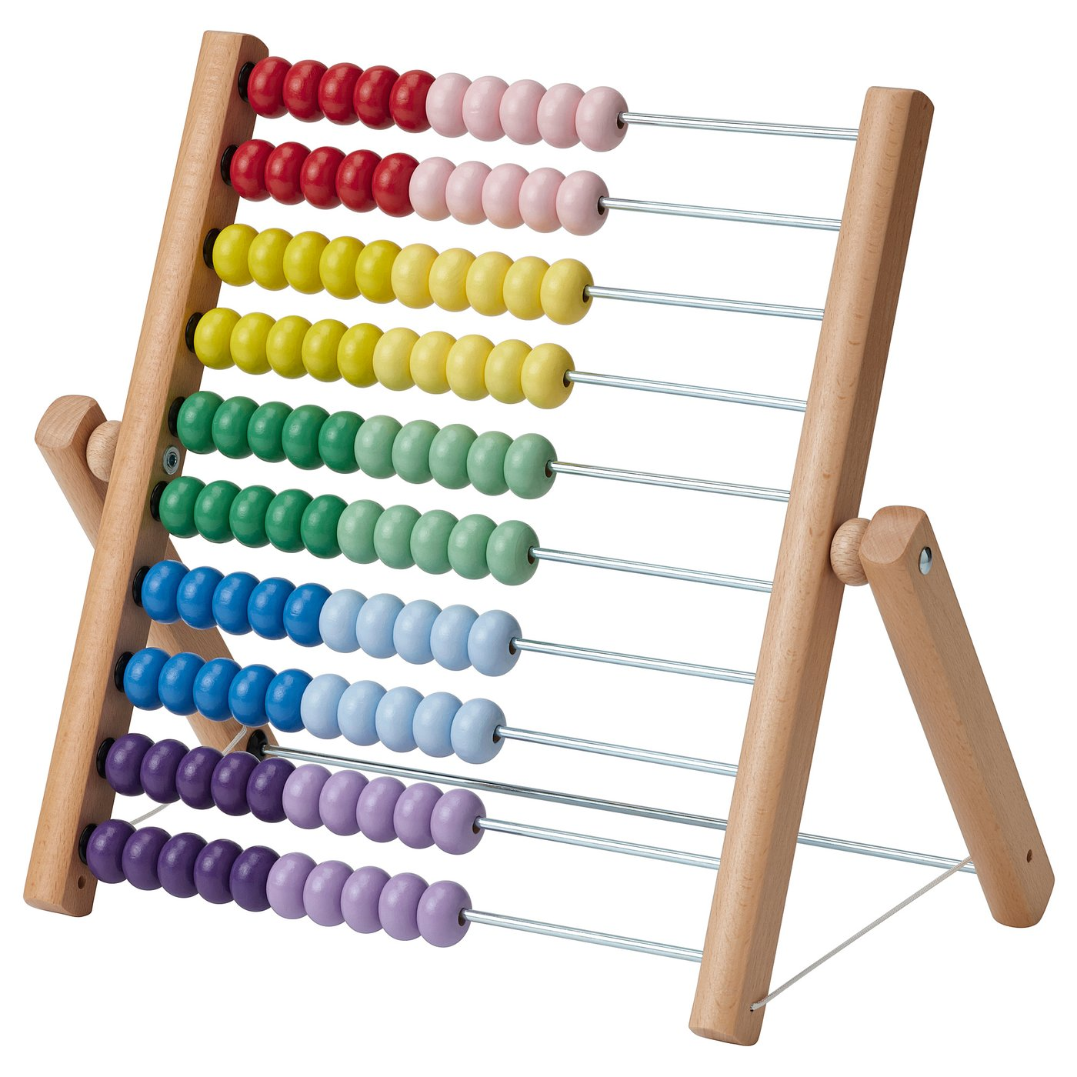
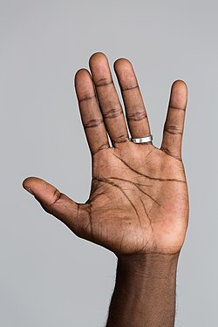
High tech
Low Tech
No training to use
Lots of training to use
Notes:
Our Semantic Gradient will have to layers to the continuua. An X and a Y
Y – level of technology
X – level of training needed to use the technology.

Slide 16
Thermometer | Barometer | Windsock
Anemometer | Rain Guage | Wind vane
Hygrometer | Snow gauge | Historical data
Notes:
Now back in your groups, you will do the same gradient – Y low to high tech; X level of training needed
Using this vocabulary from before.

Slide 17
Definition | Picture
Personal Connection | Where you might see one
Definition
Picture
Personal Connection
Notes:
Note making
Instead of taking notes, students get to write their ideas.
Give each group one of the vocabulary words – have them fill in the FRAYER MODEL.
If time left: play hot seat.

Slide 18
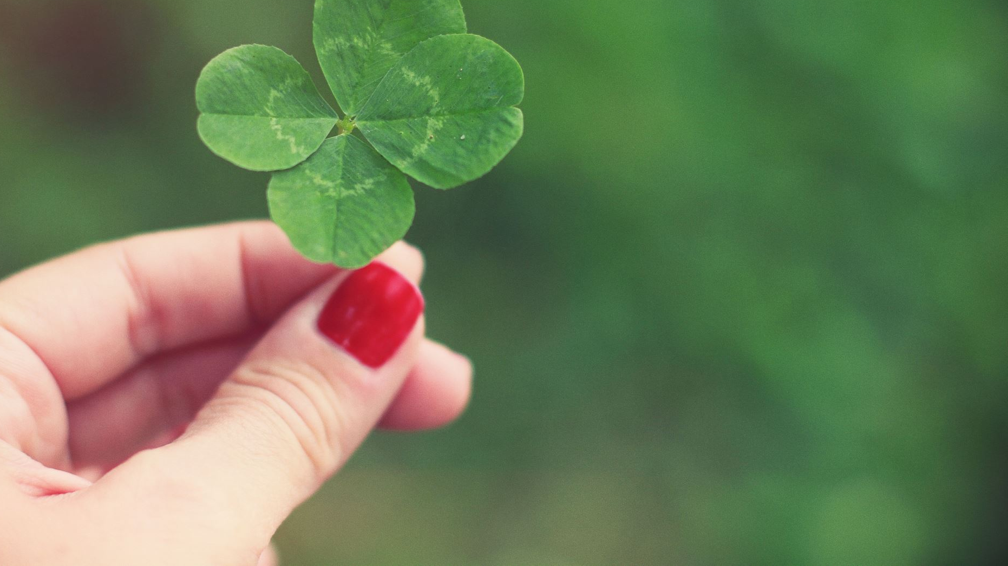
Have a great year and career!

