Slide 1

Assessing what you value
Rubrics, evidence, feedback

Slide 2
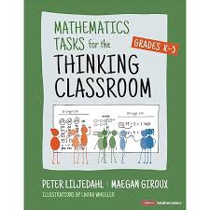

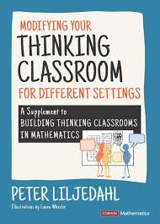
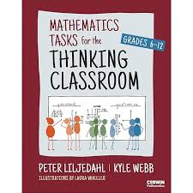

Slide 3


Slide 4
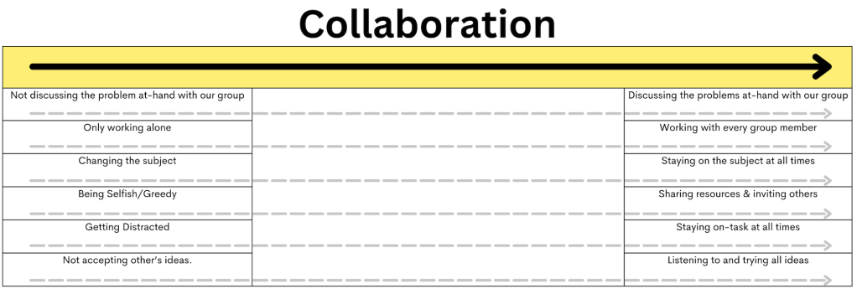

Slide 5
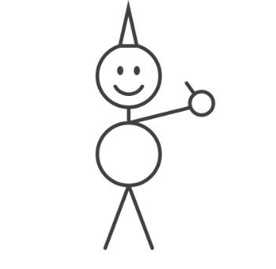
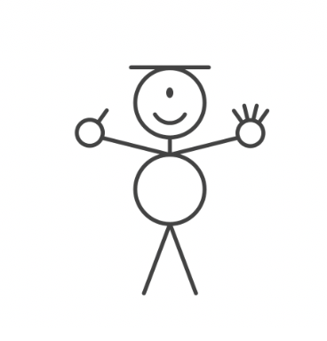

Slide 6
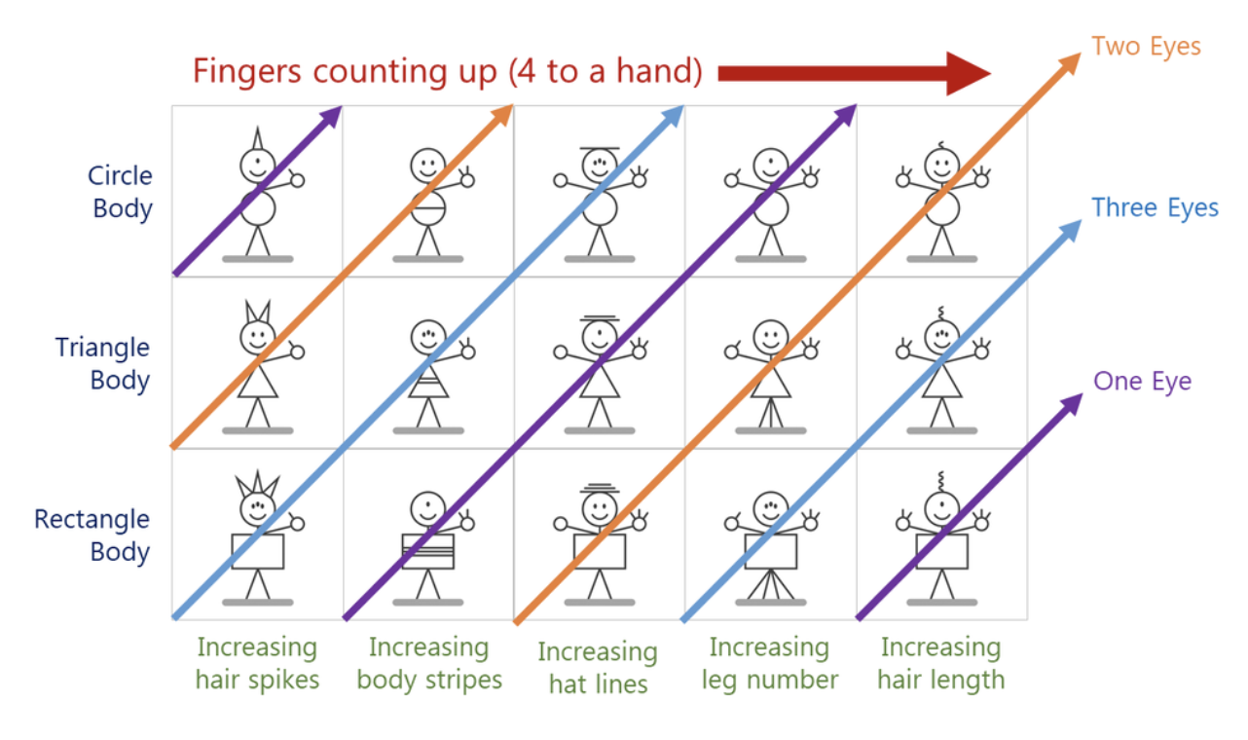

Slide 7


Slide 8

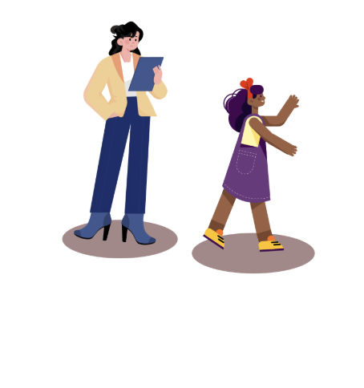


Slide 9
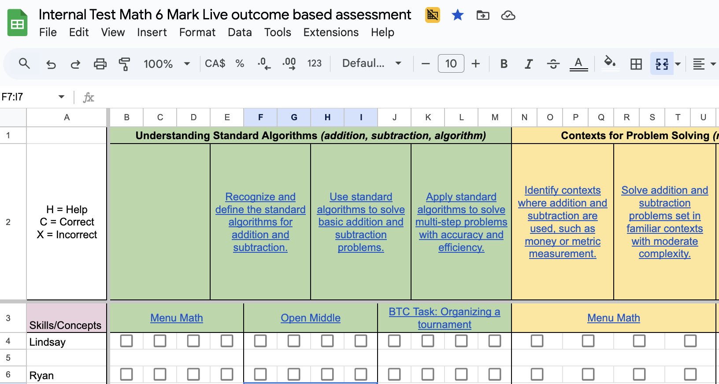

Slide 10
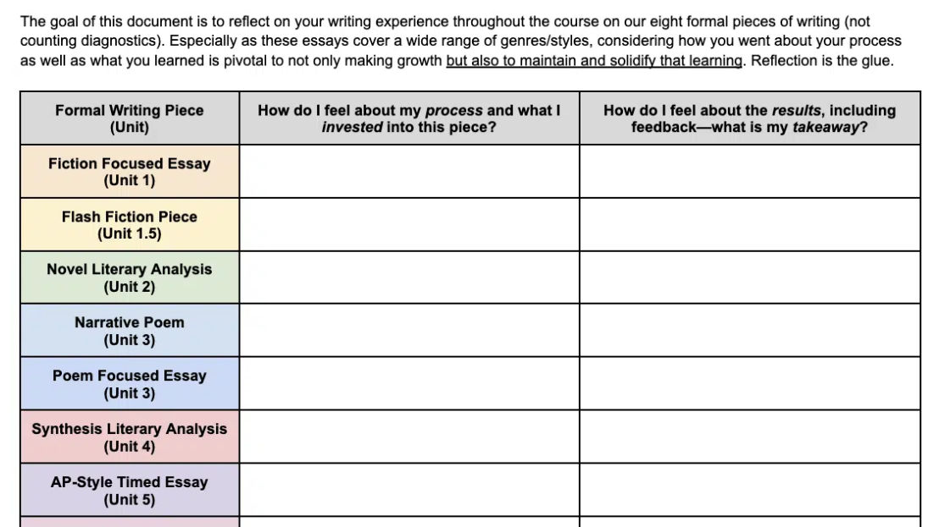

Slide 11
Thank you
Joshua@readesign.pro
Notes:
(torn, 2 activities deep, explain the nuance or 6 quick, Hope overall see BTC as easy and powerful, and with 7 find at least 1 for you.
If you want to go deeper into any of these: email. Love to work with your staff, …

