Slide 1
BTC + Vocabulary
Joshua LaFleur
Joshua@readesign.pro
Notes:
Name, job, BTC, sharing BTC outside math.
6 activities in 60-
First one is quick. At your boards: version of WODB, UFO – words… introduce selves, write each others names, Sweet or Spicy?

Slide 2
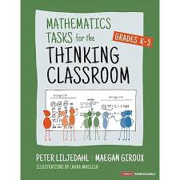
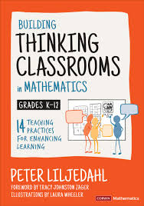
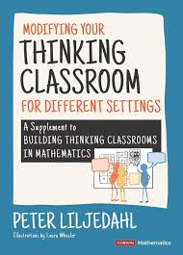
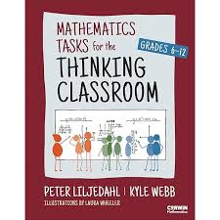

Slide 3

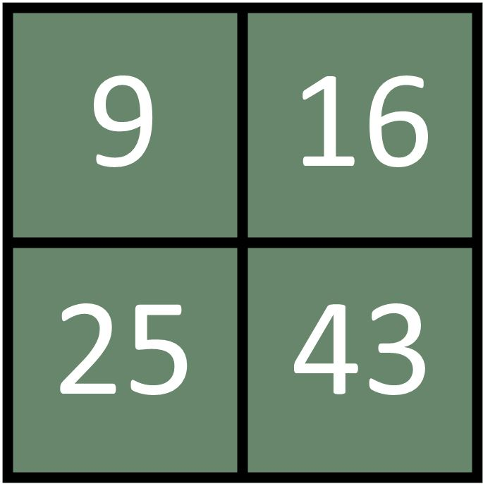
Notes:
Non curricular task, get us connected and thinking and chance to practice sharing the marker

Slide 4
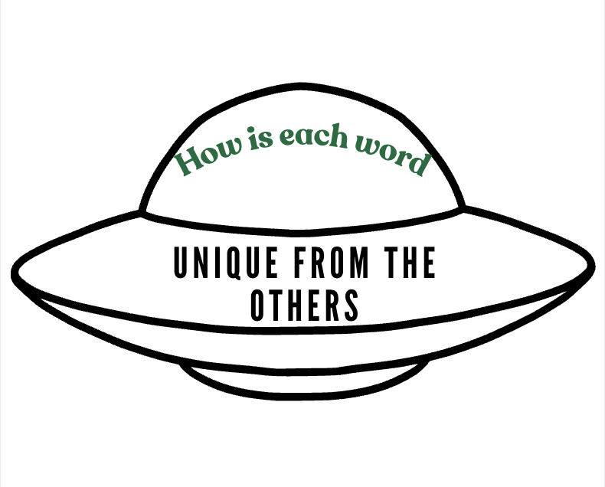
Almost
Level
Rhythm
Strength
Notes:
You found? Divergent thinking ! All answers correct today)
Almost = alphabetical letter order
Level = Pallindrome
Rhythm = no standard vowels (sometimes y)
Strength = one syllable.
Hard – no context - CURRICULUM WORDS

Slide 5

Connections
Notes:
Random groups of 3 at boards

Slide 6
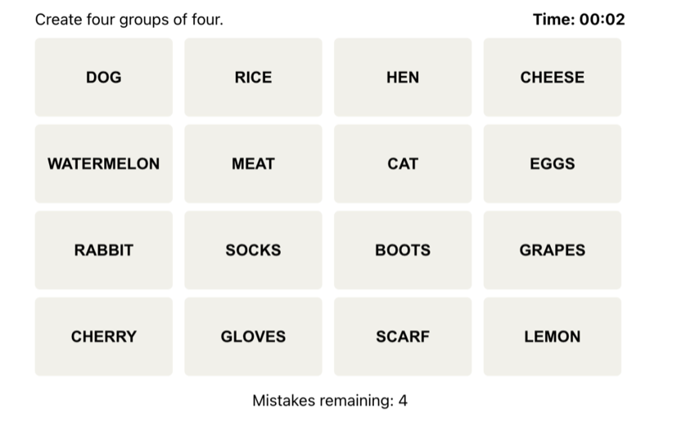
Notes:
Grade five science curriculum. Always right from curriculum . BEFORE Starting Unit.

Slide 7

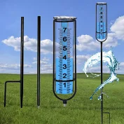

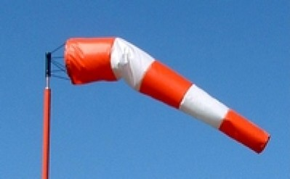
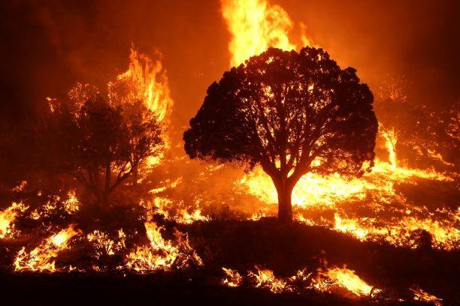
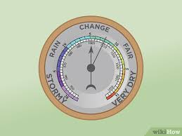
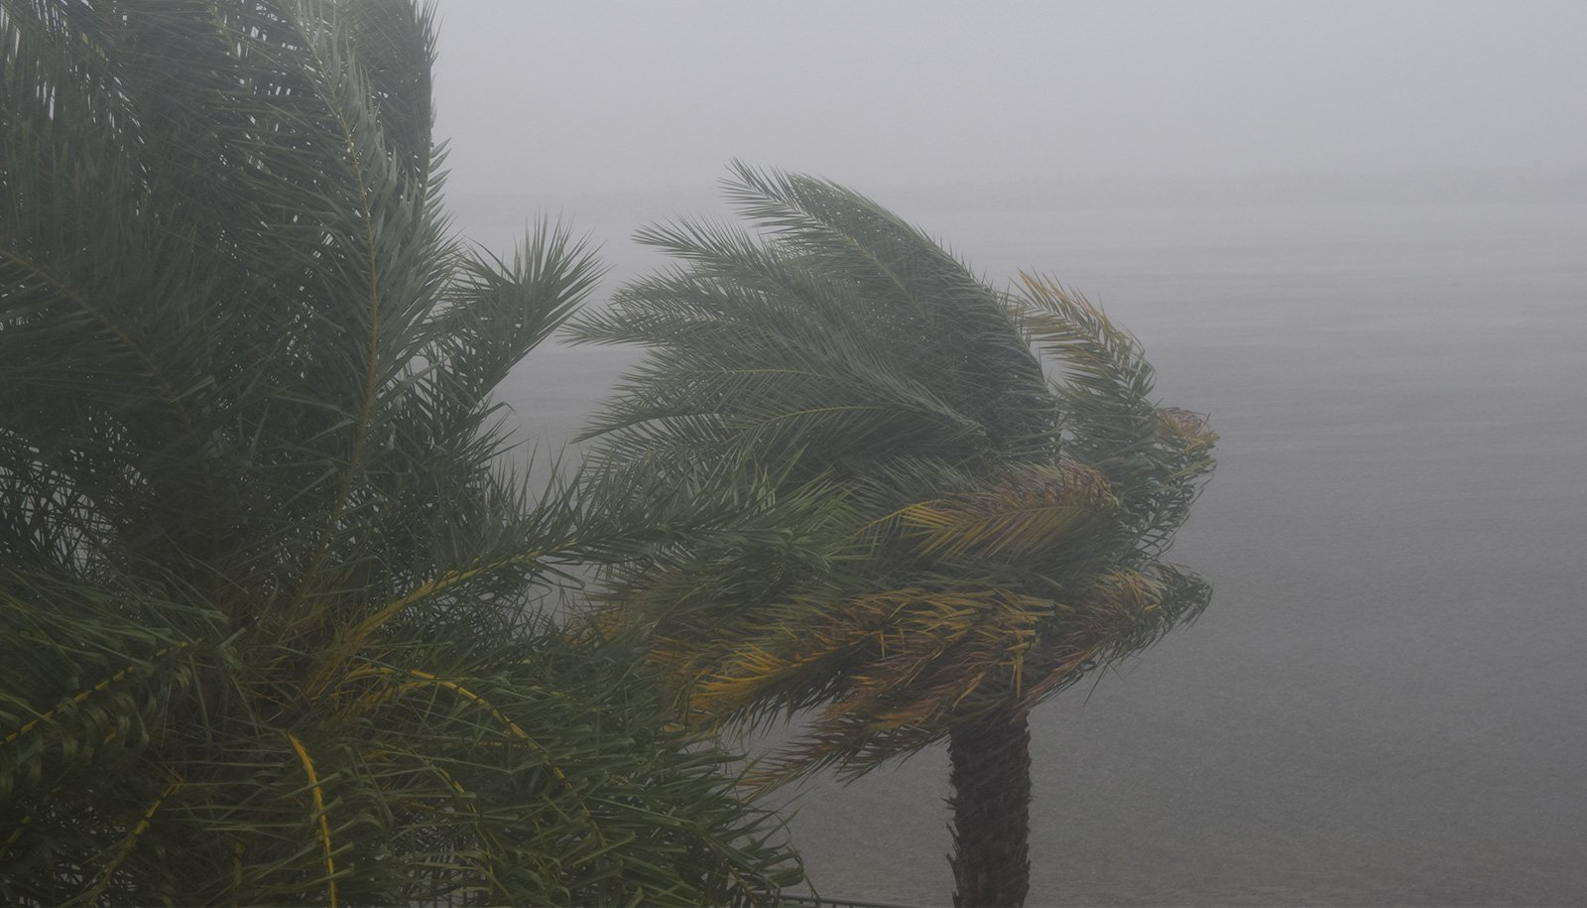

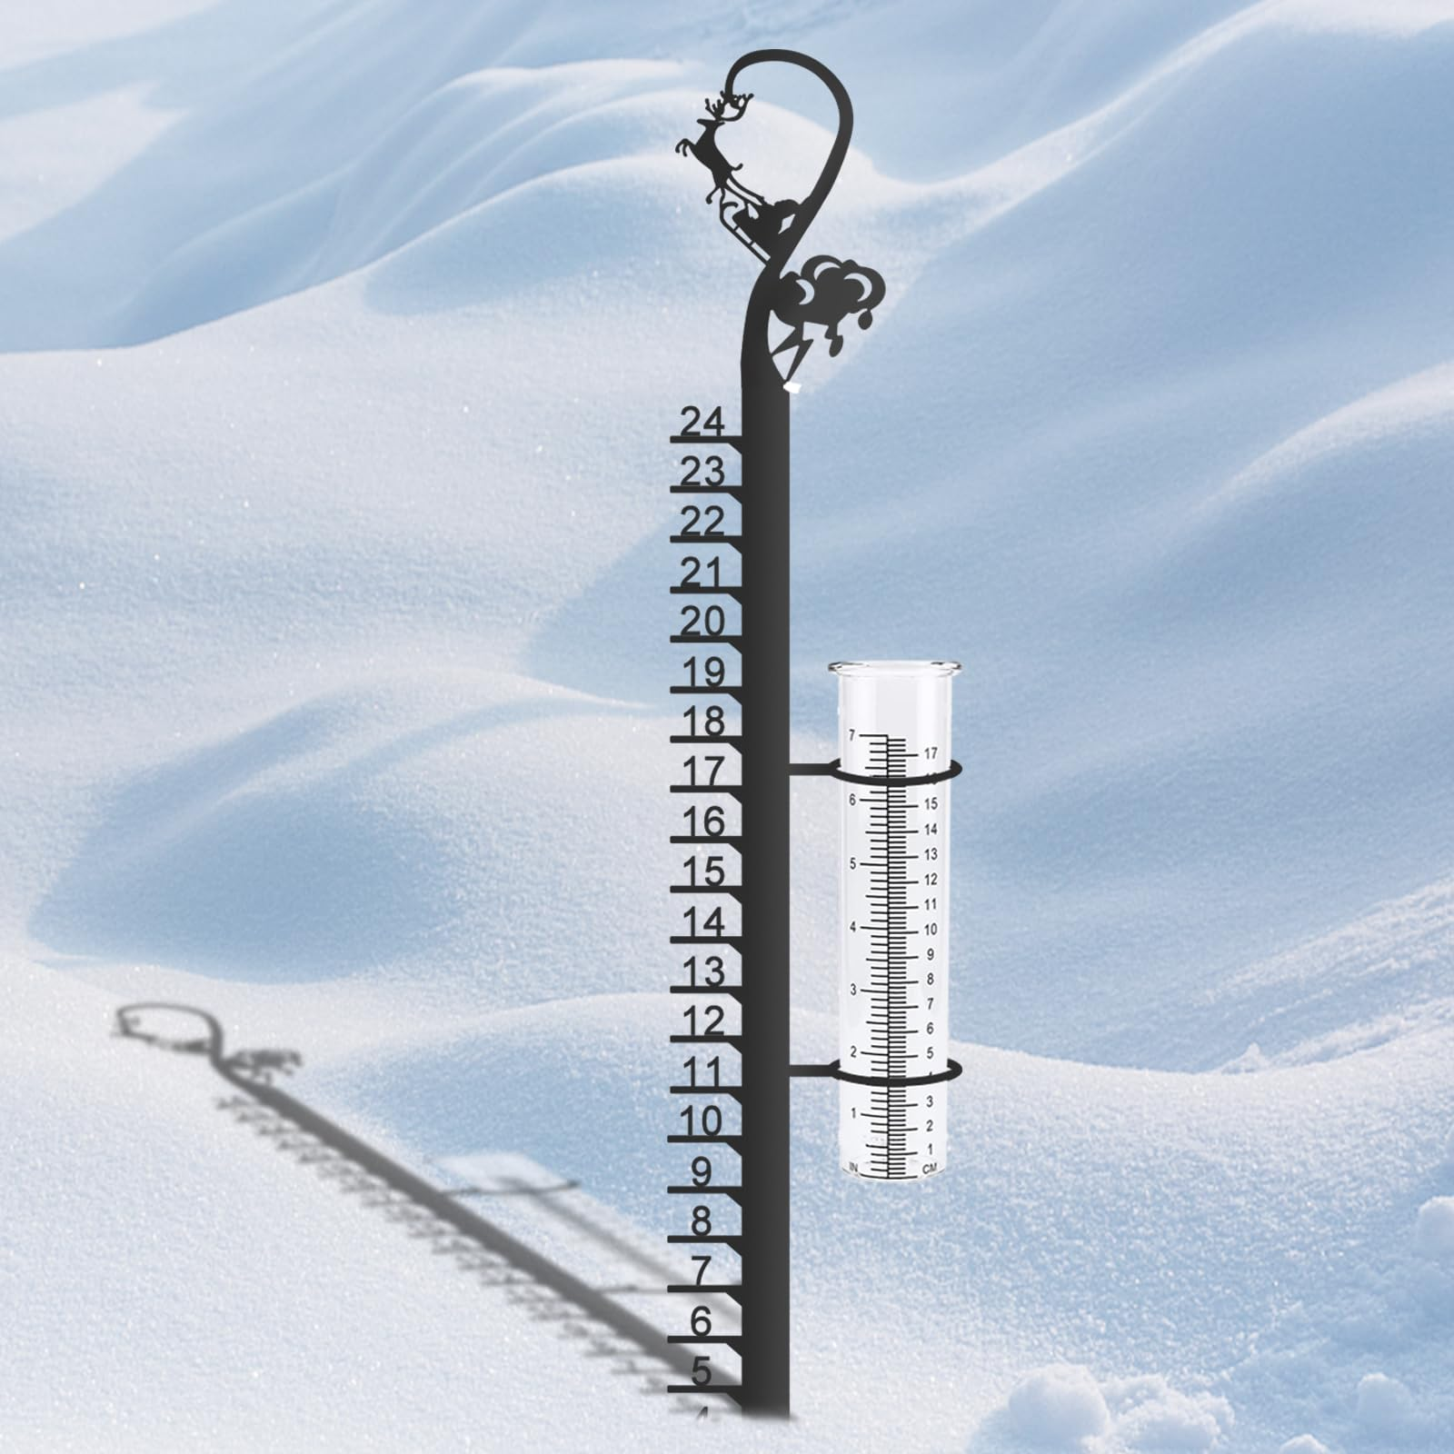
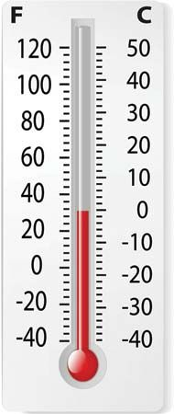

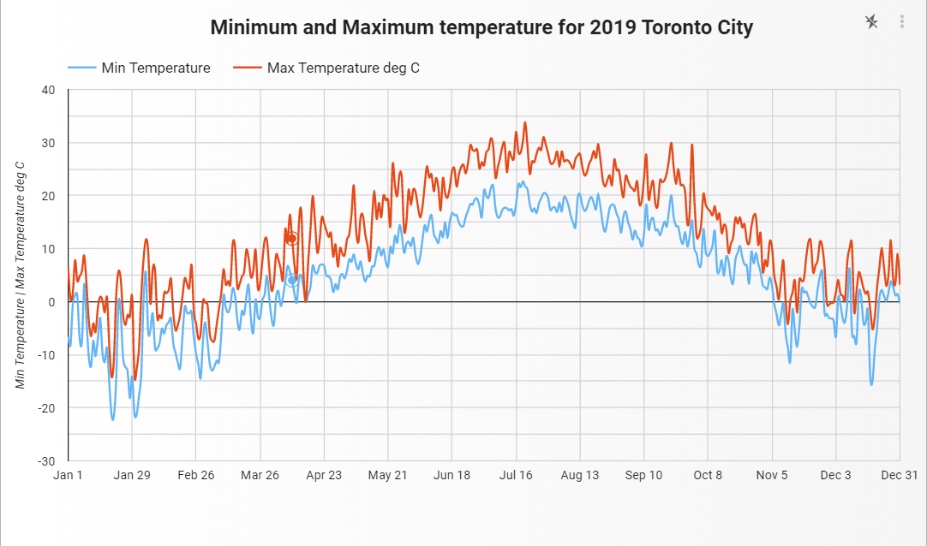
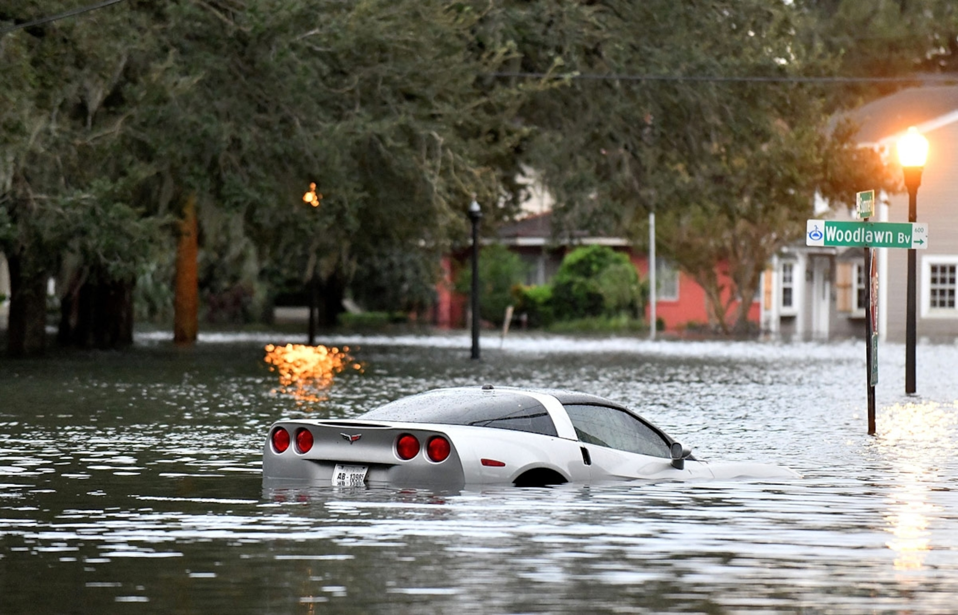
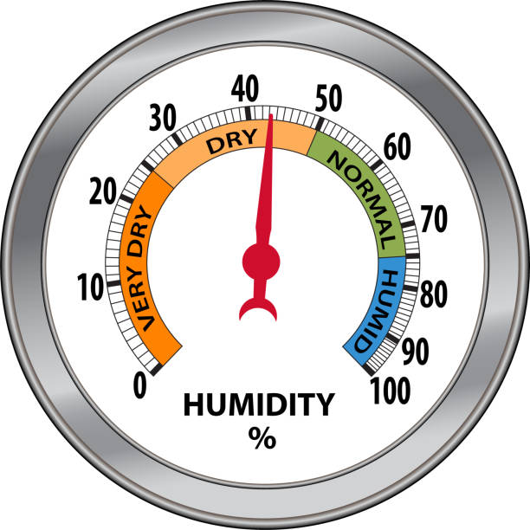
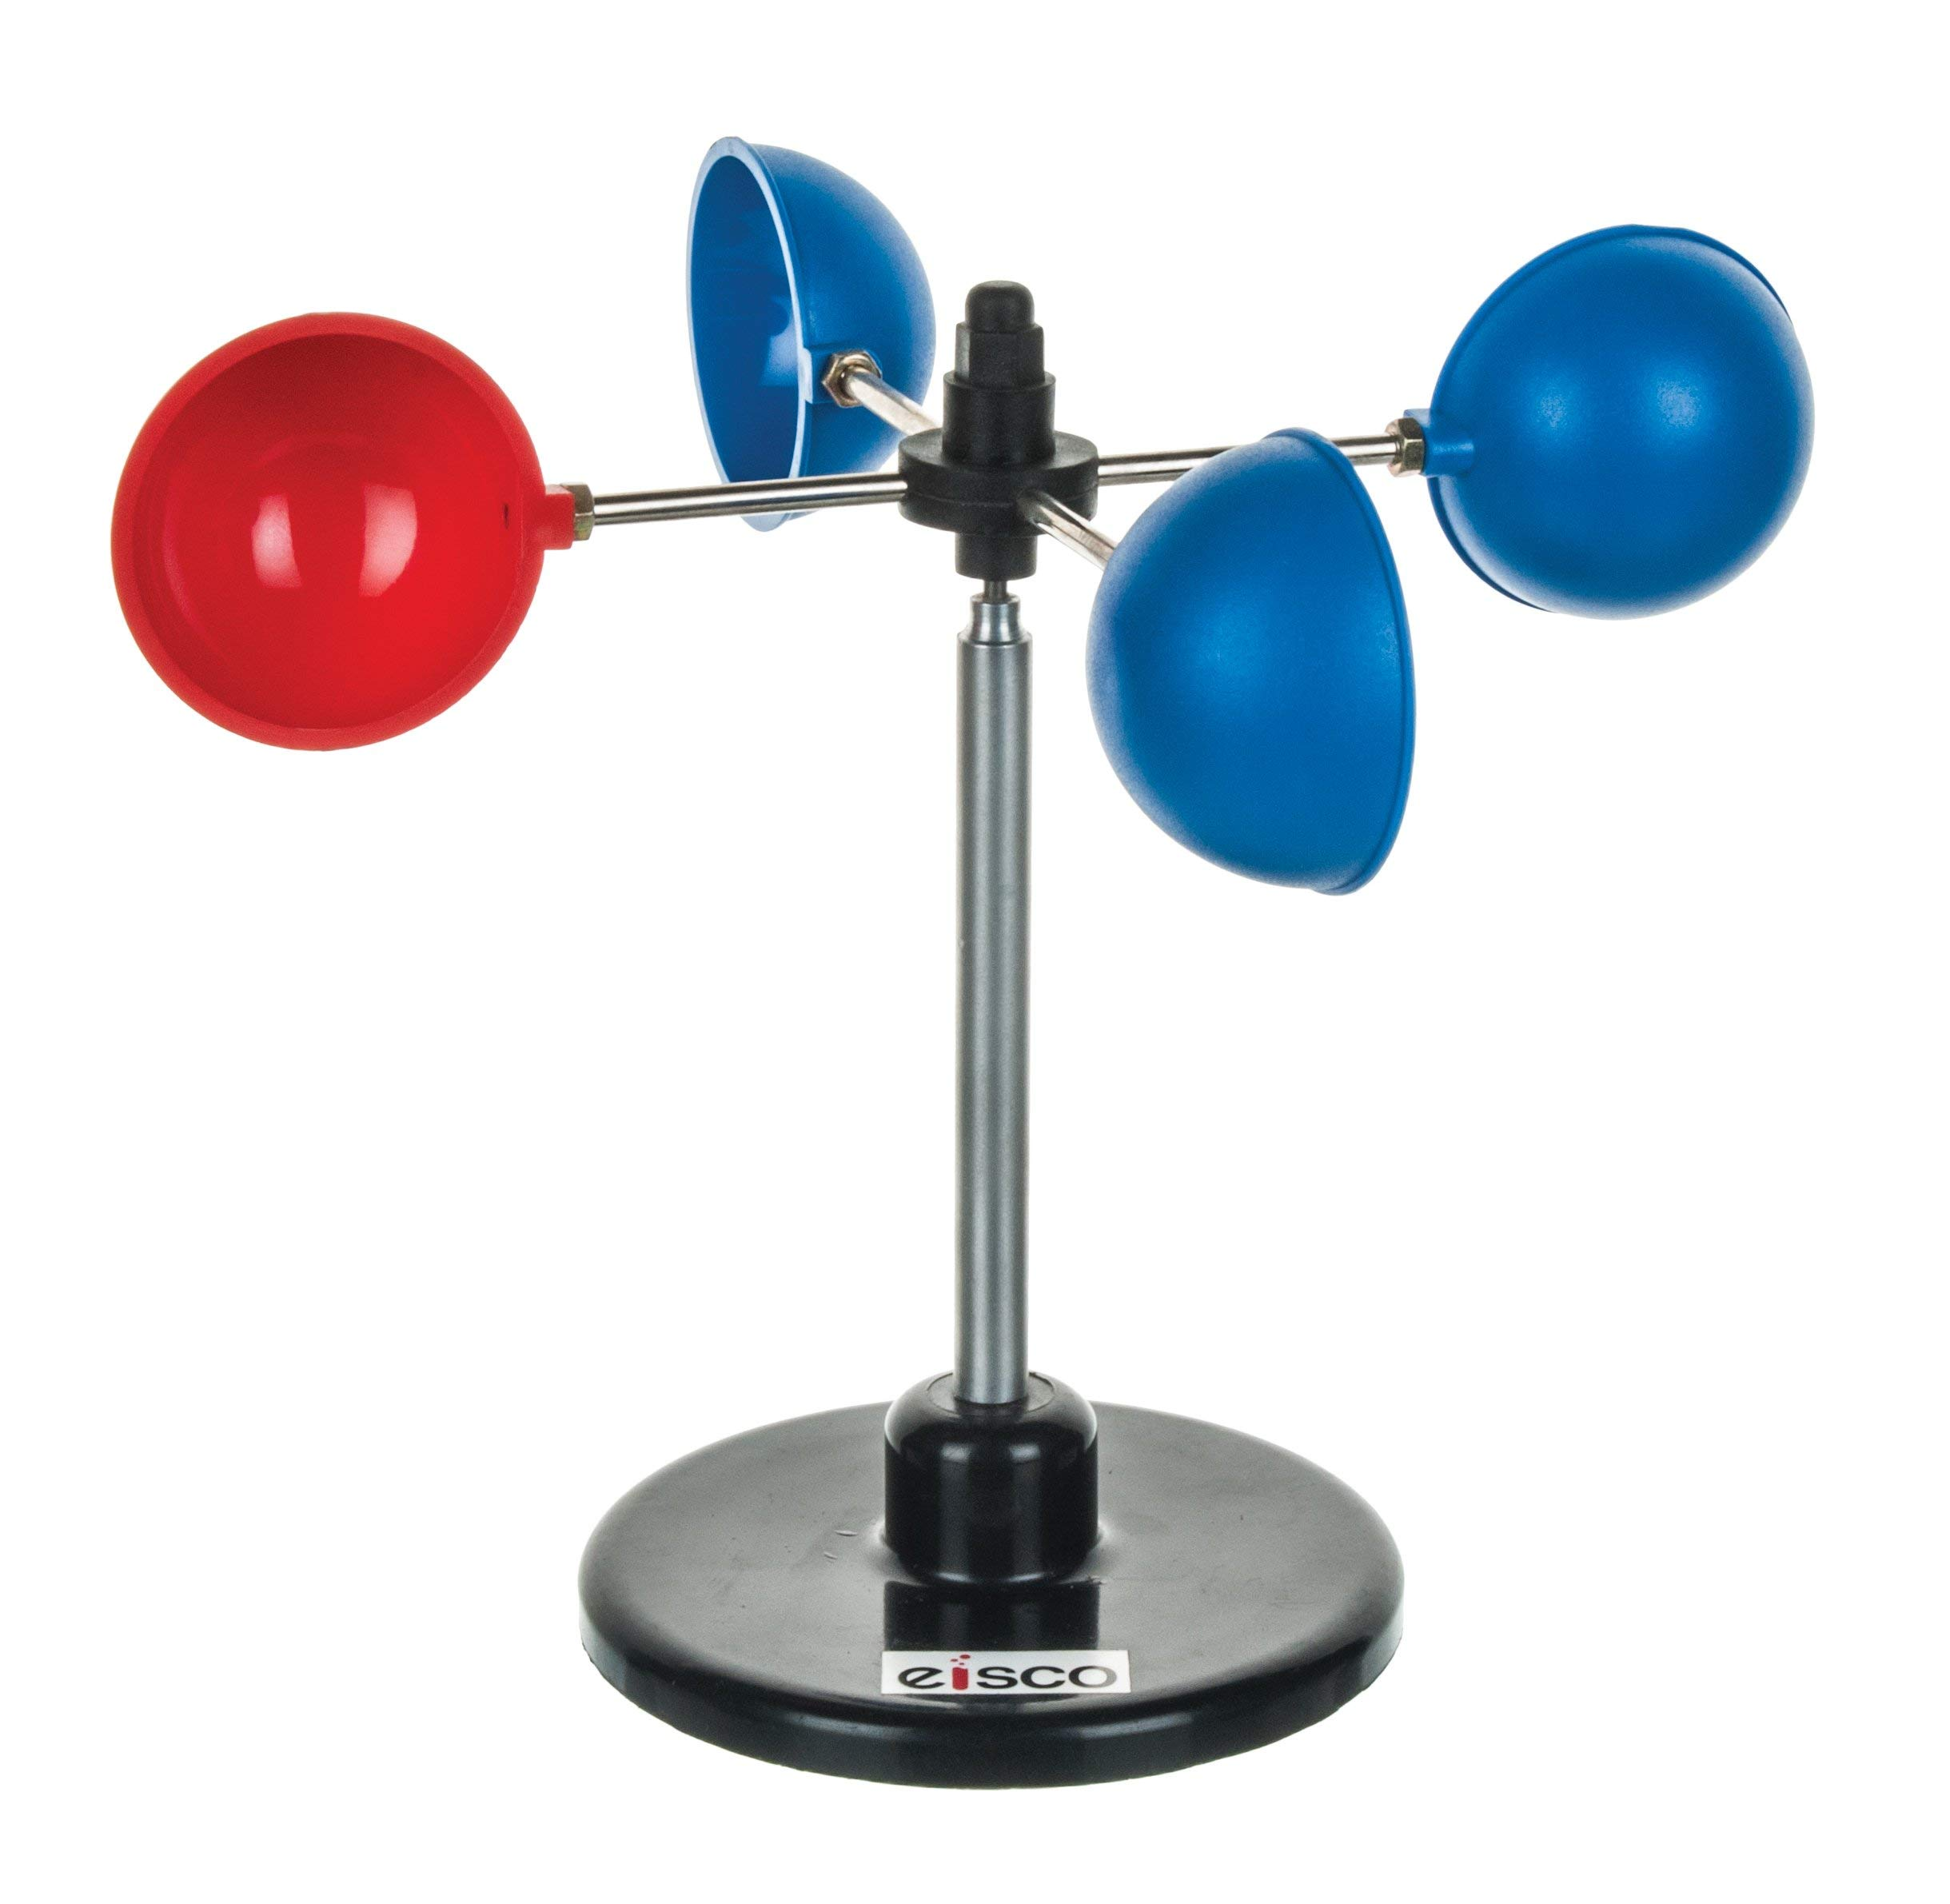

Windsocks | Drought | Satellite Imaging | Rain Gauge
Computer Modelling | Fires | Barometers | Windstorms
Snow Gauges | Historical Data | Thermometers | Wind Vanes
Traditional Indigenous Knowledge | Flooding | Hygrometer | Anemometers
Notes:
Grade two, heritage, civilization. .

Slide 8
Semantic Gradient
Notes:
Random groups of 3 at boards

Slide 9
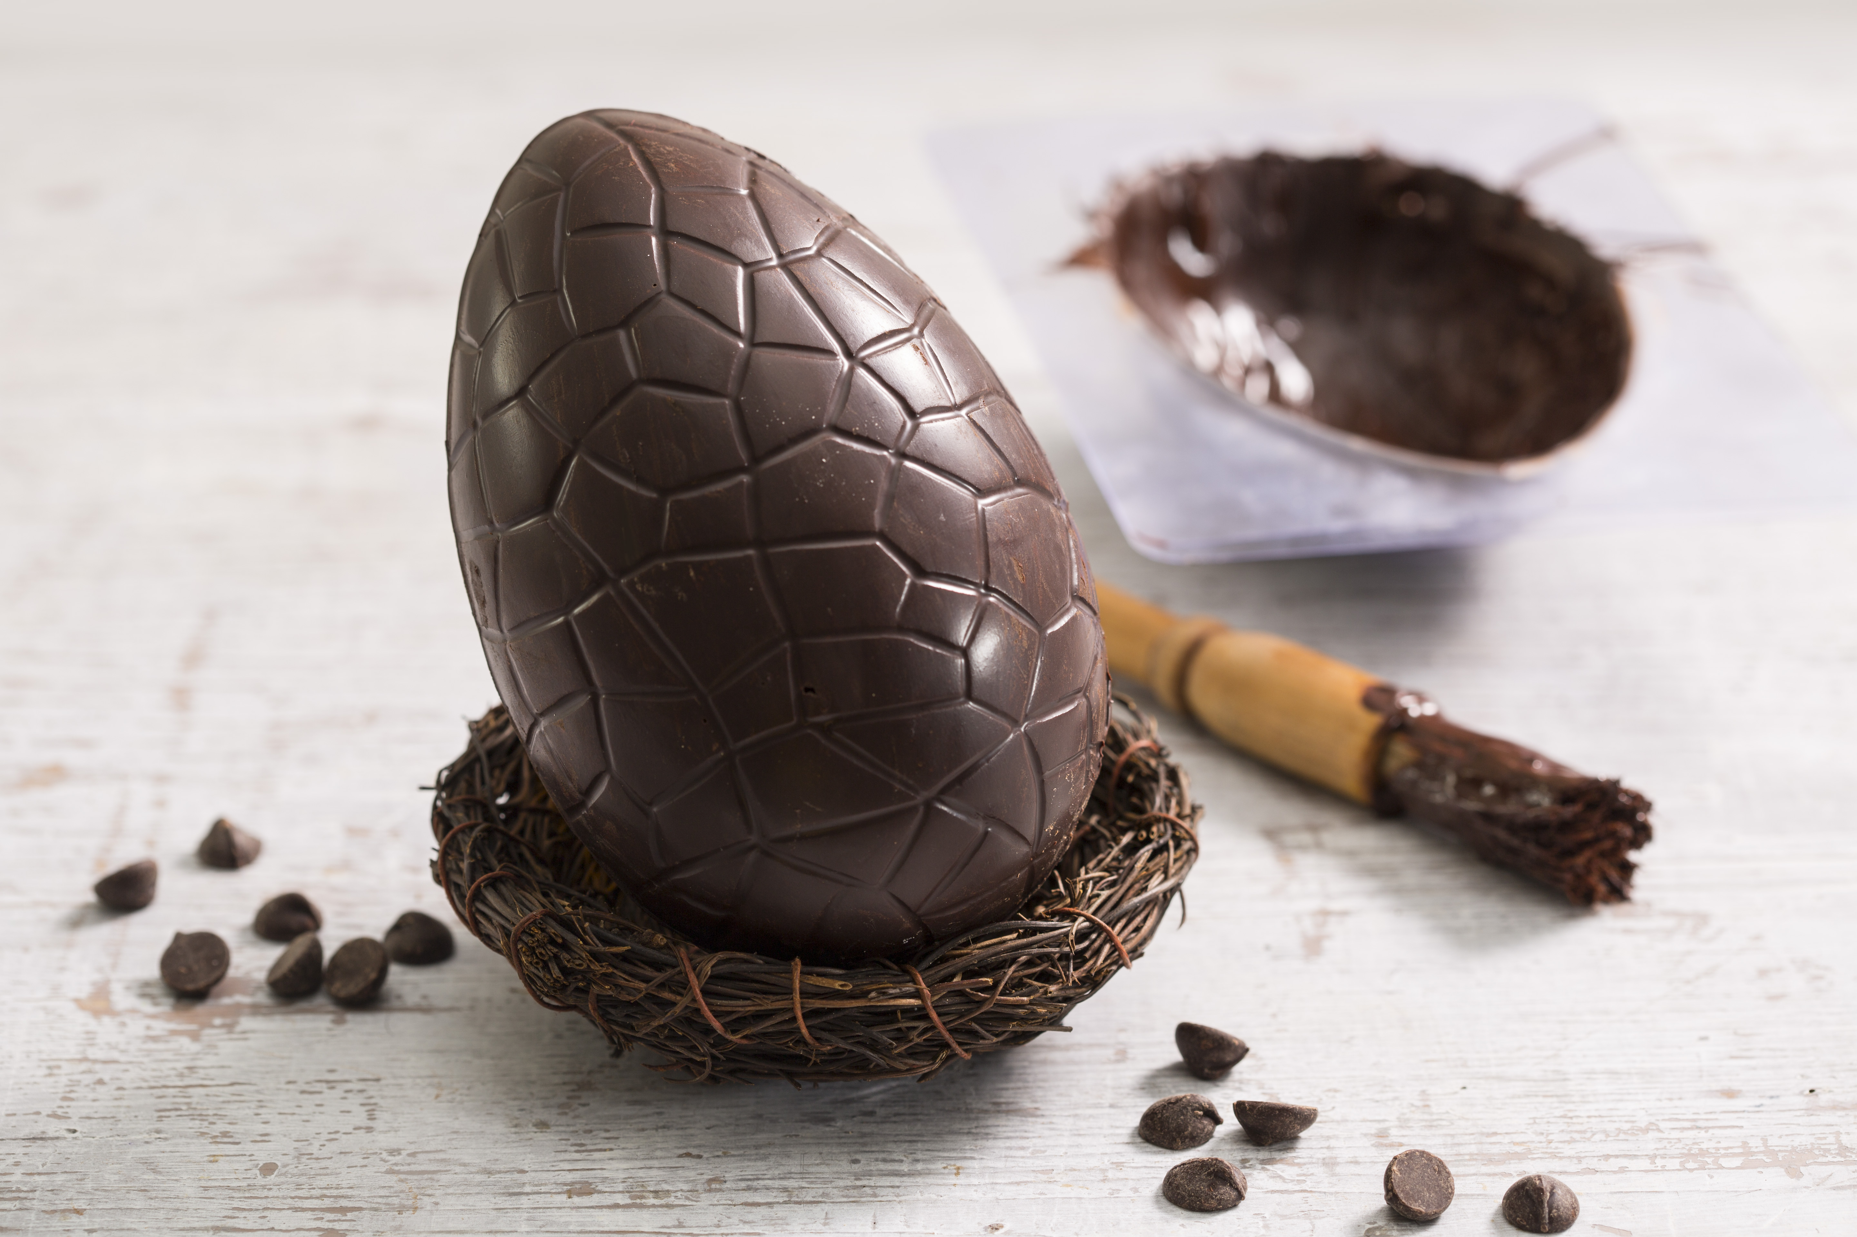
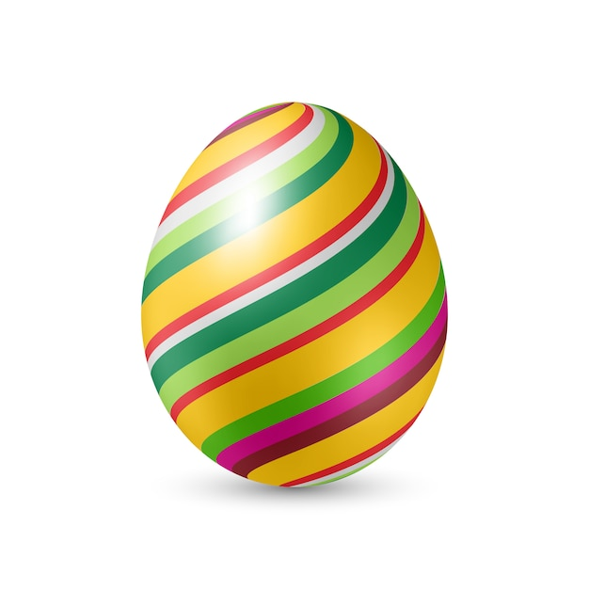

Size
Colorfulness

Slide 10
Give your all
Grind
Hurt
Hustle
Let go
Love
Obsession
Rolling
Savor
Sweat
Challenge
How much effort it takes to do
PHYSICALLY
How much effort it takes to do
EMOTIONALLY

Slide 11
Give your all
Grind
Hurt
Hustle
Let go
Love
Obsession
Rolling
Savor
Sweat
Challenge

Slide 12
Word Study
Words Their Way

Slide 13
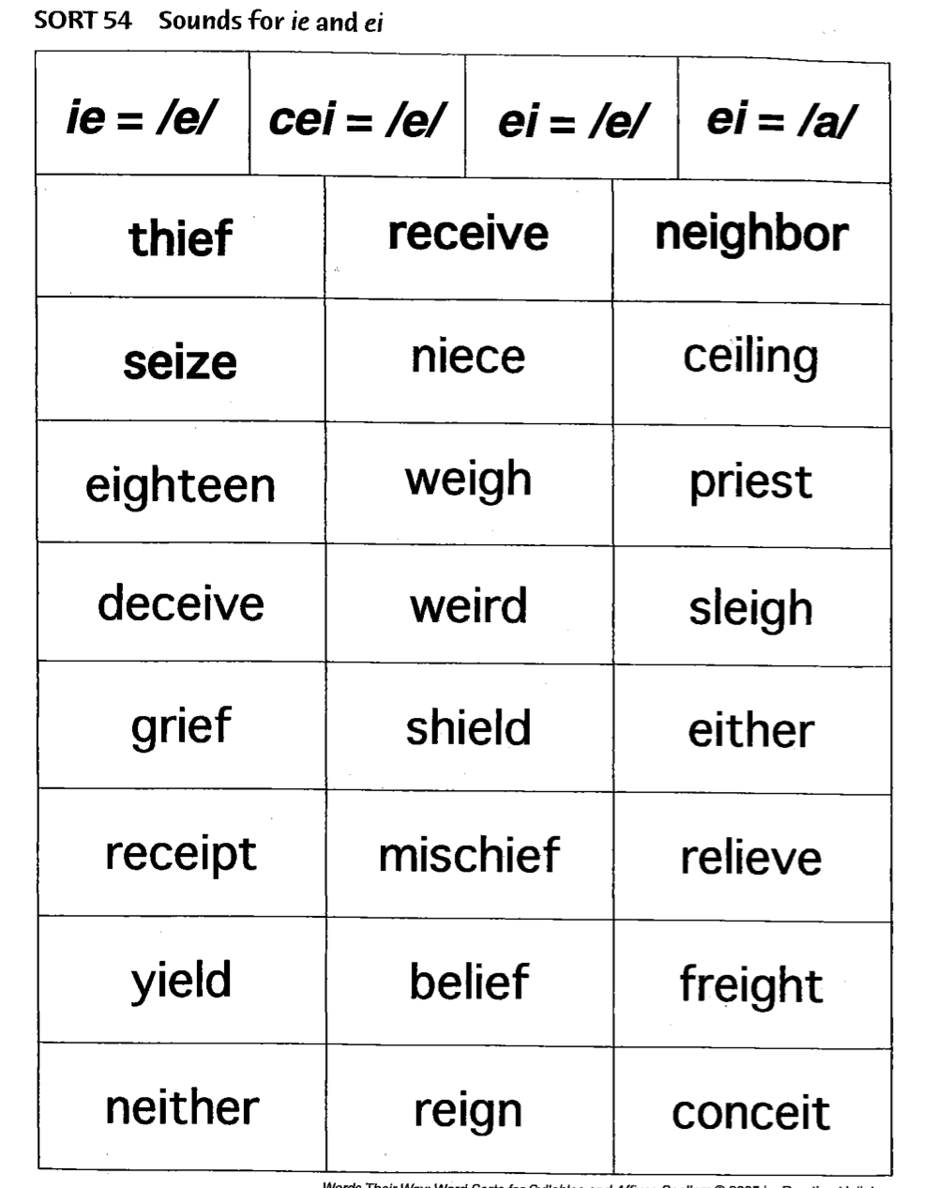
Notes:
Word study. Research = bang for buck! K-8…
Words their way. Success!
Sort the words, kinda boring.
2 GAMES!

Slide 14
Guess who?!
Notes:
A sound? No – weigh, sleigh, reign.

Slide 15
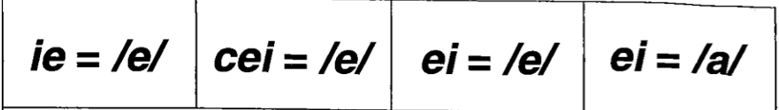
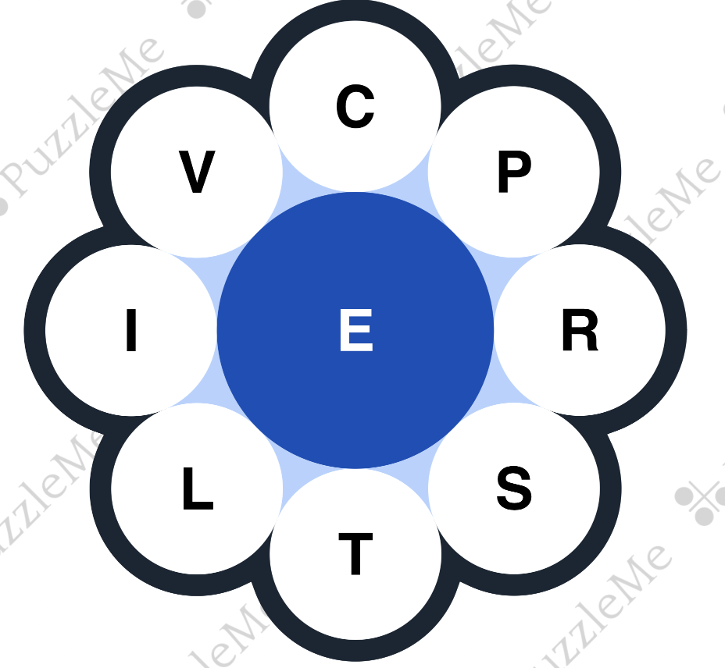
Notes:
Spelling BEE - another NYT game.

Slide 16
Annotating

Slide 17
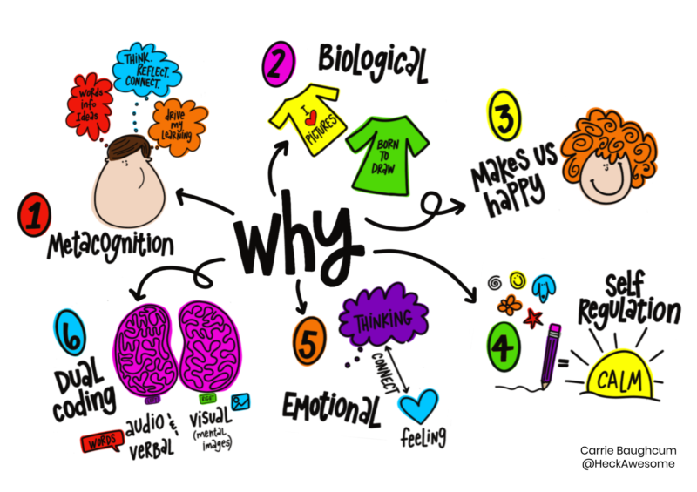

Slide 18

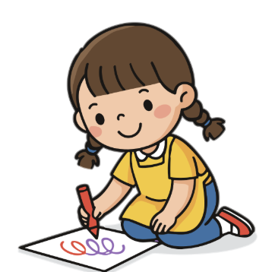


Slide 19
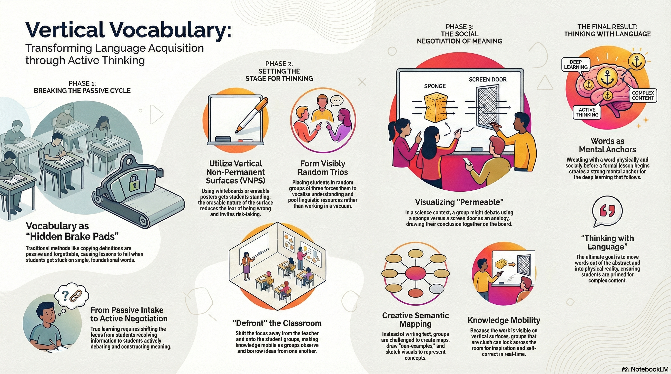

Slide 20
Thank you
Joshua@readesign.pro
Notes:
(torn, 2 activities deep, explain the nuance or 6 quick, Hope overall see BTC as easy and powerful, and with 7 find at least 1 for you.
If you want to go deeper into any of these: email. Love to work with your staff, …

